Slide 1
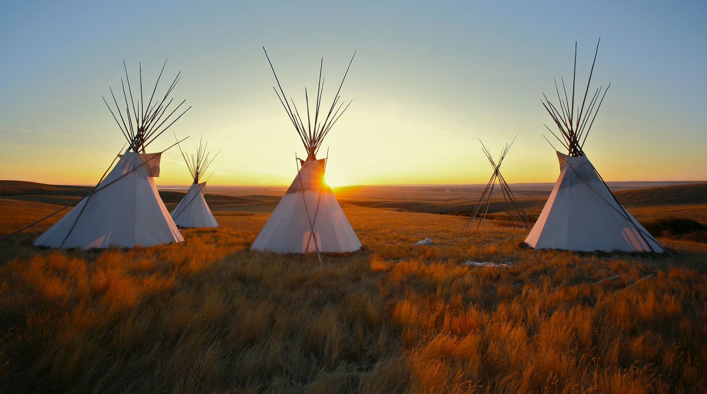
Native American Cultures
1491-1607

Slide 2
OBJECTIVES
There were several different Indian populations in the present-day U.S.
Each tribal group lived a lifestyle in accordance with its environment.

Slide 3
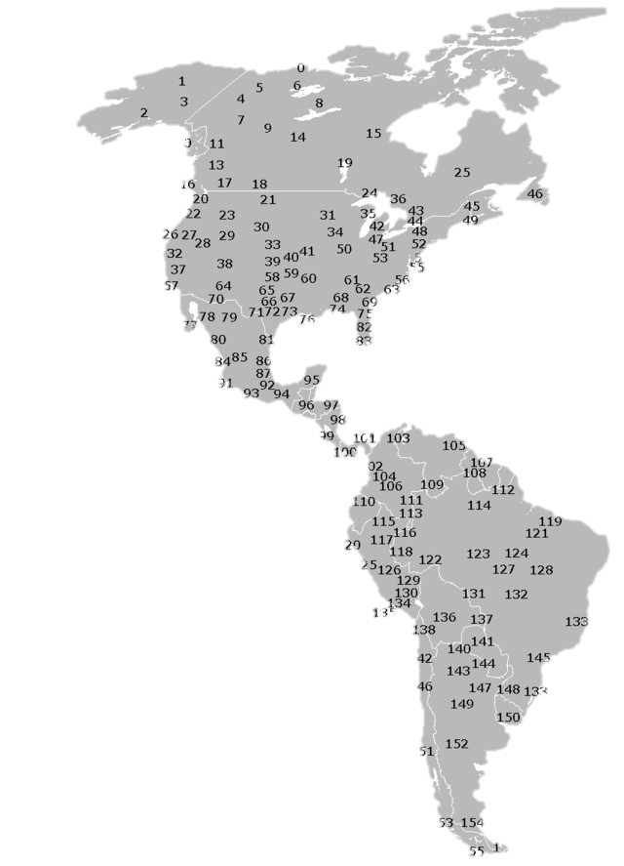
DIVERSITY
156 Distinct Ethnic Groups
Map Credit: KVDP

Slide 4
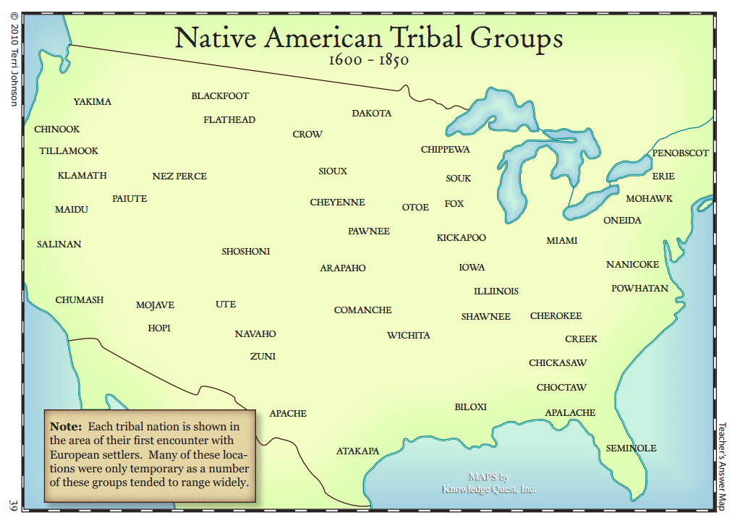
© Terri Johnson
Used with Permission
knowledgequestmaps.com

Slide 5
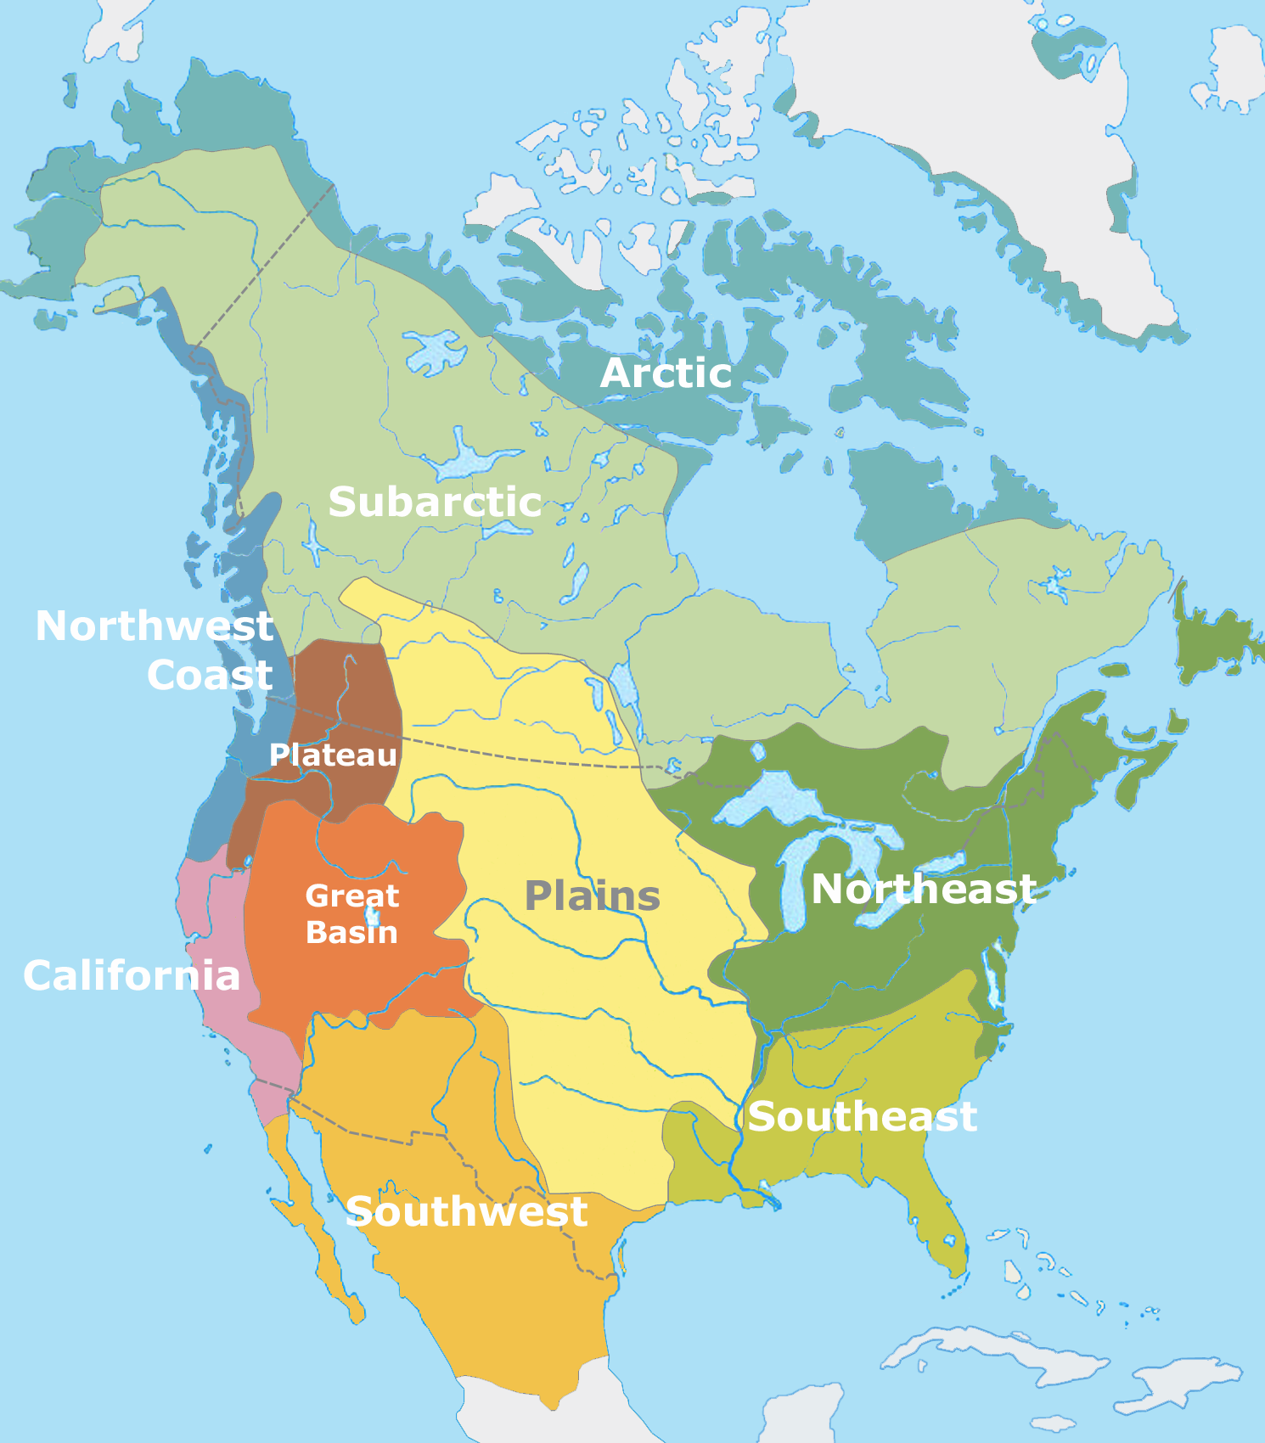
CULTURE GROUPS
Cultural areas of North America at time of European contact
Public Domain Map by Nikater

Slide 6
FISHING
HUNTING

Slide 7
HUNTING
&
FARMING
FISHING
HUNTING
FARMING
&
HUNTING
FARMING
Public Domain Map by Nikater

Slide 8
AMERICAN INDIAN Culture Groups
Arctic (Eskimos, Inuits)
Plains Indians (Sioux, Comanche, Witchita)
Northeast / Great Lakes (Iroquois, Algonquins)
Southwest (Hopi, Pueblo)
Southeast (Cherokee, Creek)

Slide 9
AMERICAN INDIAN Culture Groups
Arctic (Eskimos, Inuits) | Hunting, Gathering, and Fishing
Plains Indians (Sioux, Comanche, Witchita)
Northeast / Great Lakes (Iroquois, Algonquins)
Southwest (Hopi, Pueblo)
Southeast (Cherokee, Creek)

Slide 10
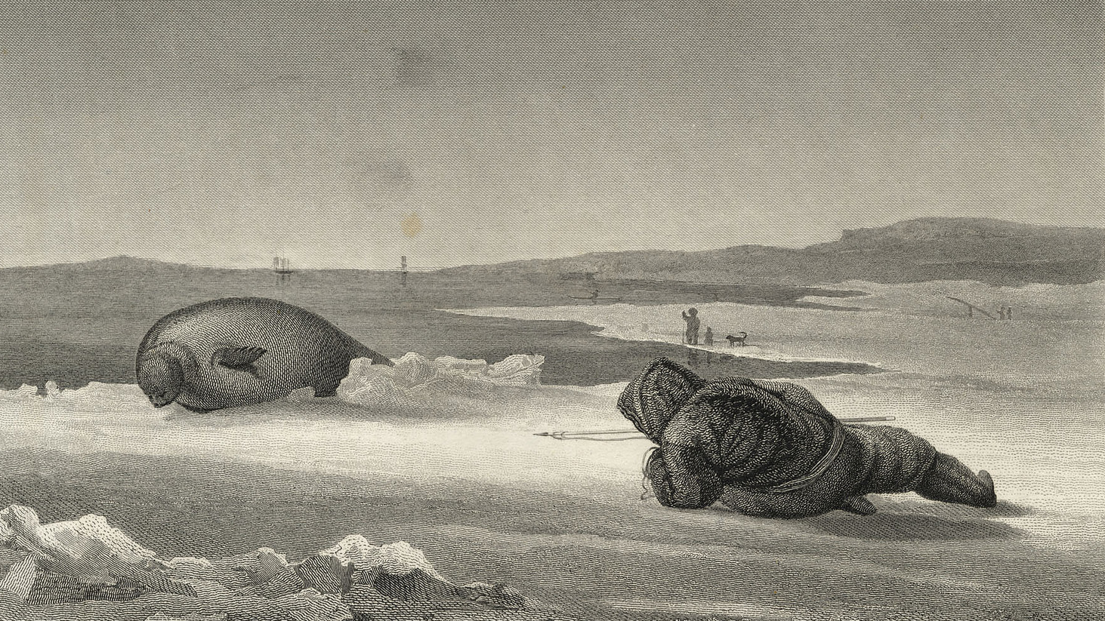
Eskimo Seal Hunter
Special Collections, Toronto Public Library

Slide 11
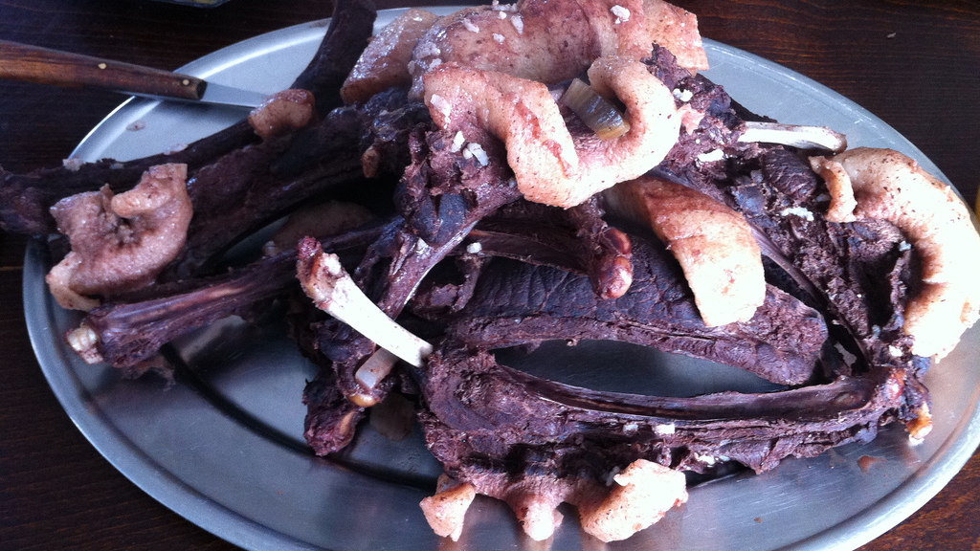
Seal Meat
Photo by Thomas Woodtli

Slide 12
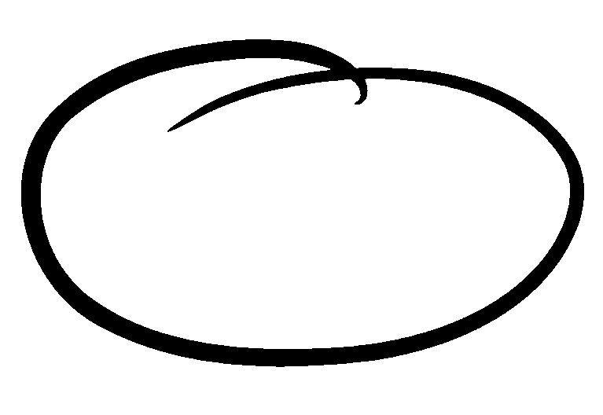

Slide 13
AMERICAN INDIAN Culture Groups
Arctic (Eskimos, Inuits) | Hunting, Gathering, and Fishing
Plains Indians (Sioux, Comanche, Witchita) | Bison Hunters - Migratory (Teepees) Horses (introduced from Europe)
Northeast / Great Lakes (Iroquois, Algonquins)
Southwest (Hopi, Pueblo)
Southeast (Cherokee, Creek)

Slide 14
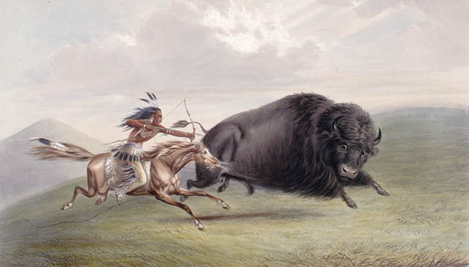
Plains Indian Bison Hunt
Source: Library and Archives Canada
Artist: George Catlin (d. 1872)

Slide 15
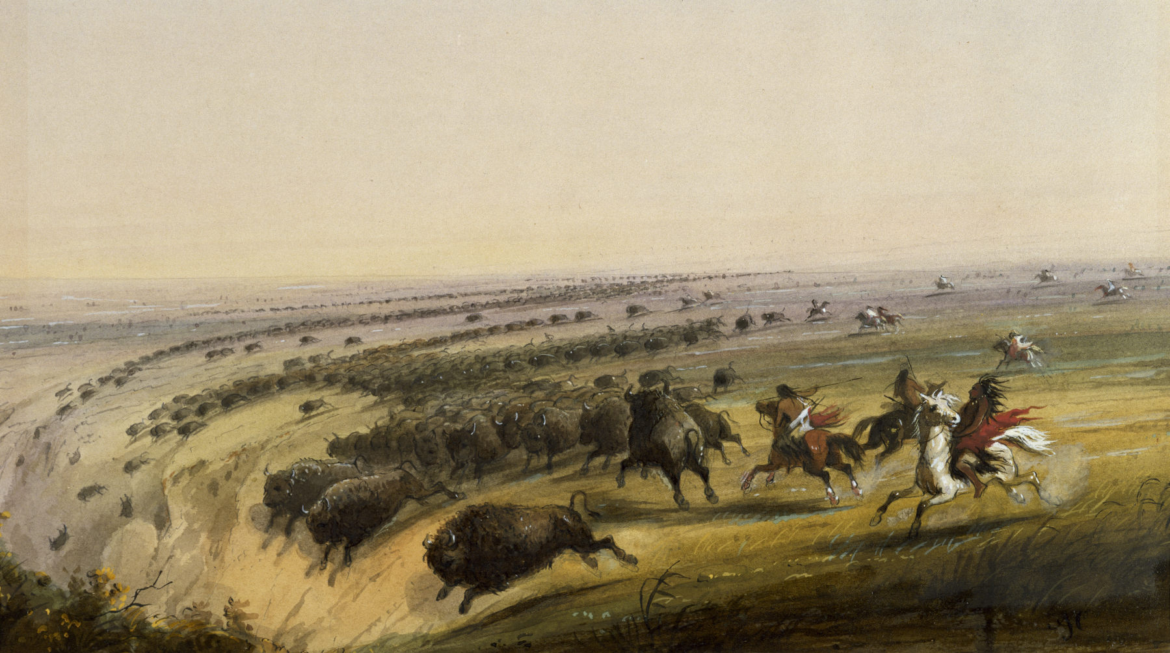
GERONIMO!!!

Slide 16
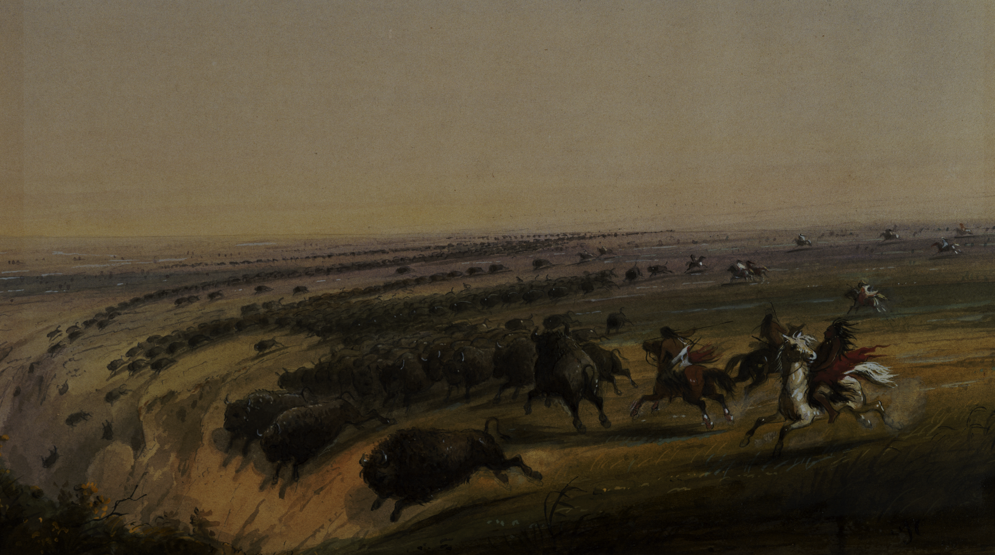
Yes, I know Geronimo wasn’t a Plains Indian.

Slide 17
Nomadic Lifestyle

Slide 18
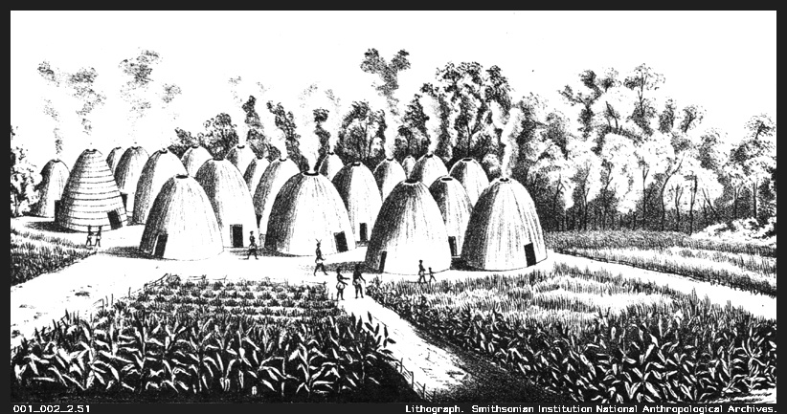
Witchita Tribe (Agriculture & Trade)

Slide 19
© Terri Johnson
Used with Permission
knowledgequestmaps.com

Slide 21
AMERICAN INDIAN Culture Groups
Arctic (Eskimos, Inuits) | Hunting, Gathering, and Fishing
Plains Indians (Sioux, Comanche, Witchita) | Bison Hunters - Migratory (Teepees) Horses (introduced from Europe)
Northeast / Great Lakes (Iroquois, Algonquins) | Hunting and Gathering Slash and Burn Agriculture “Three Sisters” (Corn, Squash, Beans) Longhouses (Iroquois)
Southwest (Hopi, Pueblo)
Southeast (Cherokee, Creek)

Slide 22
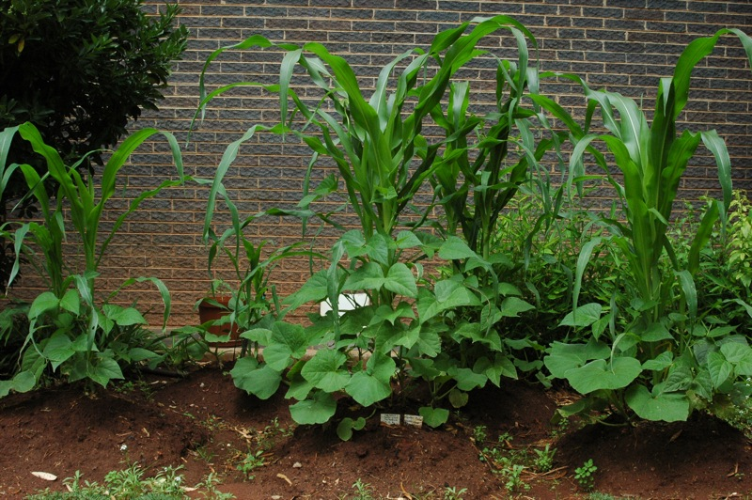
“Three Sisters”
Squash
Corn
Beans
Photo by Abri le Roux

Slide 23
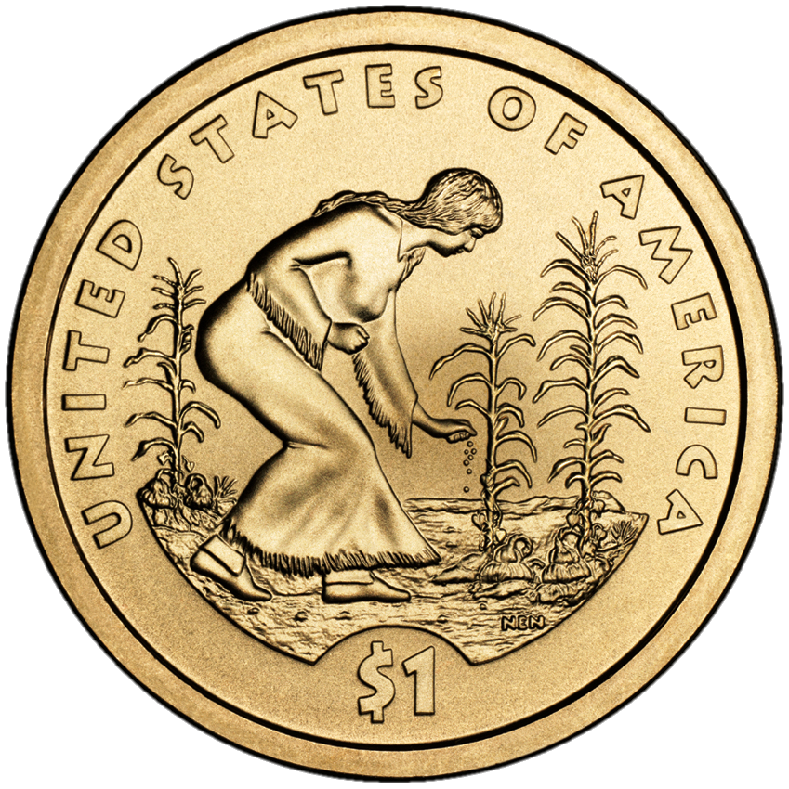

Slide 24
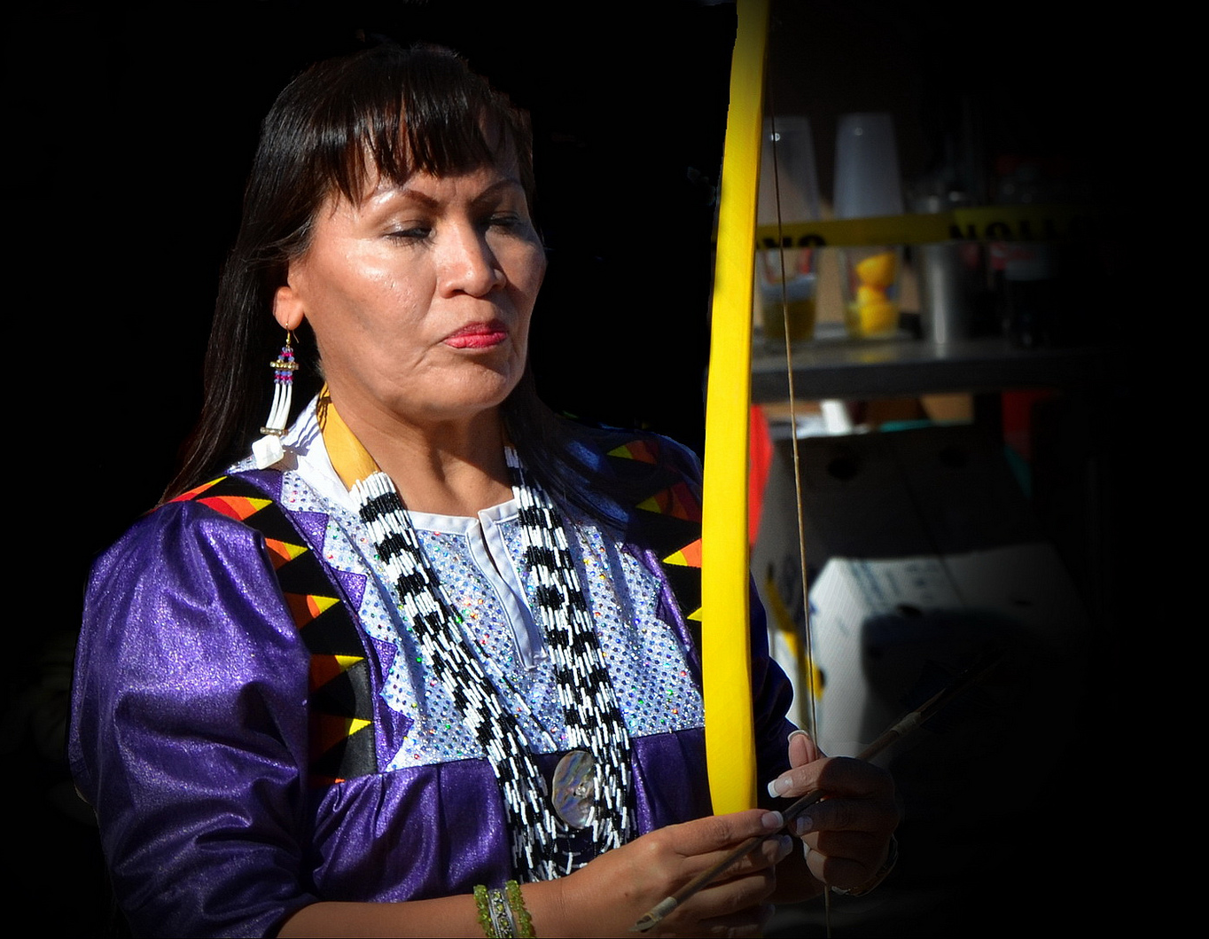
Gender Roles
Women generally shared in labor, except for hunting.
Photo by marksonto

Slide 25
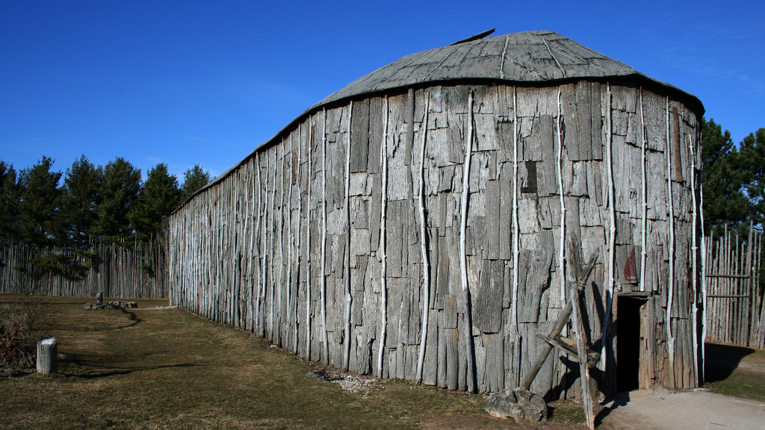
Longhouse
Photo by Perry Quan

Slide 26
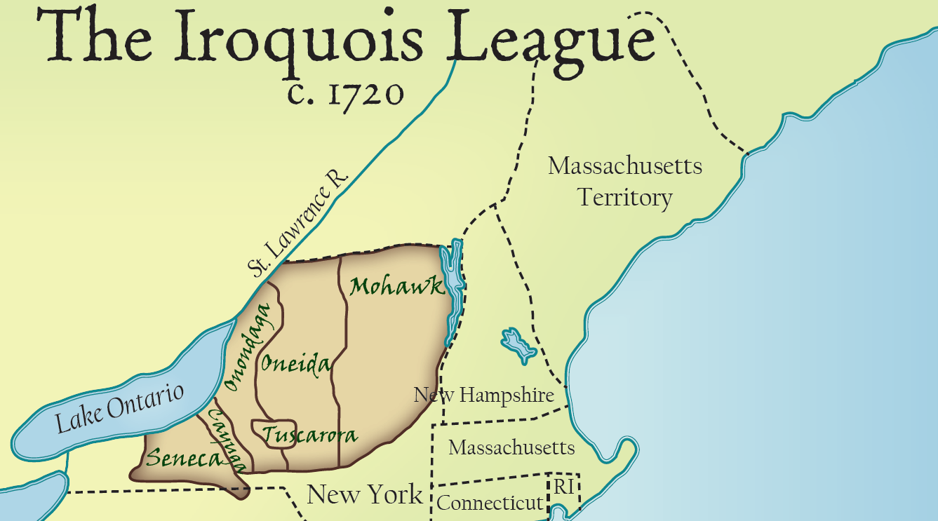
knowledgequestmaps.com
© Terri Johnson
Used with Permission

Slide 27
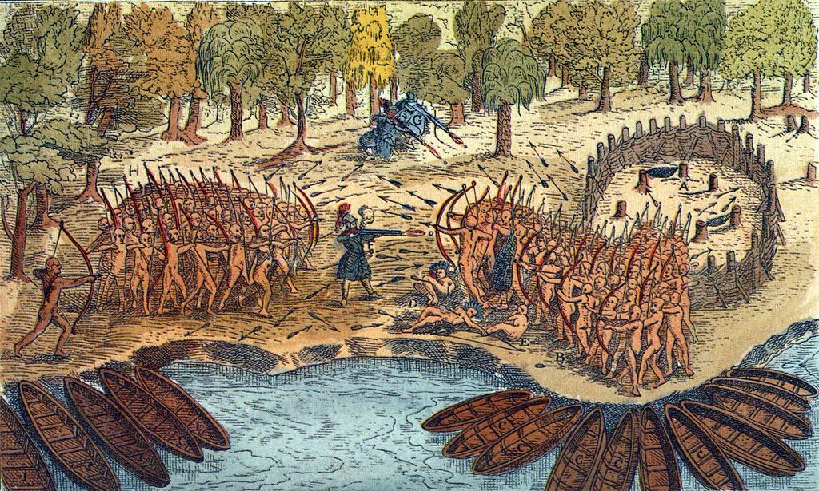
Inter-Tribal Warfare

Slide 29
AMERICAN INDIAN Culture Groups
Arctic (Eskimos, Inuits) | Hunting, Gathering, and Fishing
Plains Indians (Sioux, Comanche, Witchita) | Bison Hunters - Migratory (Teepees) Horses (introduced from Europe)
Northeast / Great Lakes (Iroquois, Algonquins) | Hunting and Gathering Slash and Burn Agriculture “Three Sisters” (Corn, Squash, Beans) Longhouses (Iroquois)
Southwest (Hopi, Pueblo) | Clay Houses / Cliff Dwellings Maize (Corn) Agriculture
Southeast (Cherokee, Creek)

Slide 30
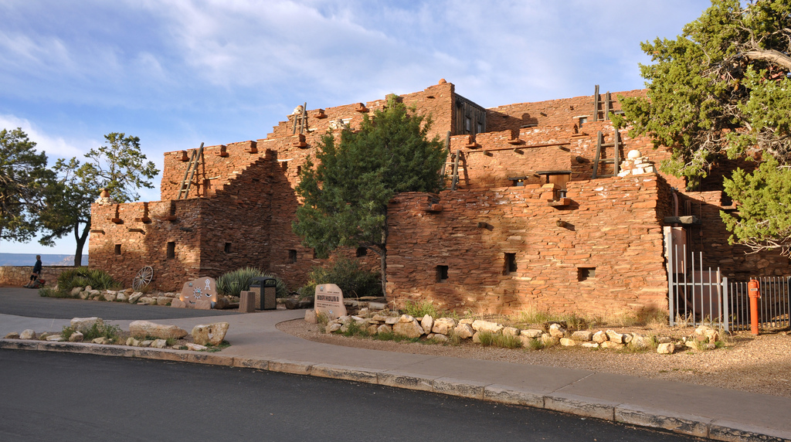
Hopi Apartment Complex
Photo by Grand Canyon National Park

Slide 31
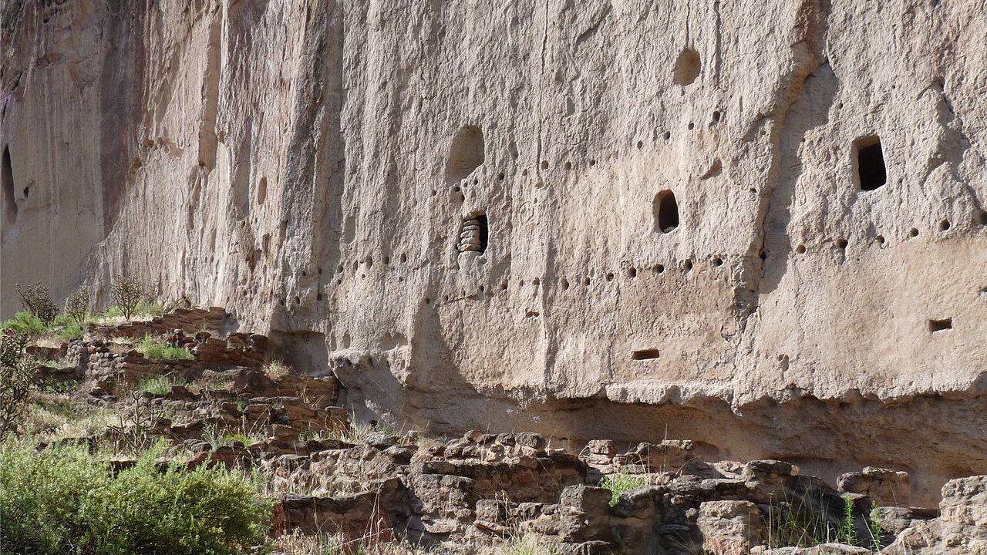
CLIFF DWELLINGS

Slide 32
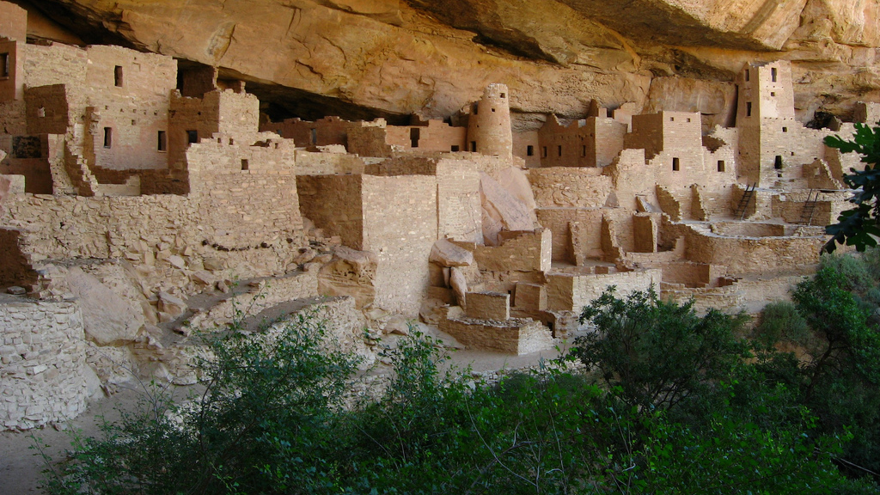
Cliff Palace Mesa Verde National Park
Photo by Ken Lund

Slide 34
AMERICAN INDIAN Culture Groups
Arctic (Eskimos, Inuits) | Hunting, Gathering, and Fishing
Plains Indians (Sioux, Comanche, Witchita) | Bison Hunters - Migratory (Teepees) Horses (introduced from Europe)
Great Lakes (Iroquois, Algonquins) | Hunting and Gathering Slash and Burn Agriculture “Three Sisters” (Corn, Squash, Beans) Longhouses (Iroquois)
Southwest (Hopi, Pueblo) | Clay Houses / Cliff Dwellings Maize (Corn) Agriculture
Southeast (Cherokee, Creek) | Agriculture / Settled Communities Mississippian Culture (Cahokia, Mounds)

Slide 35
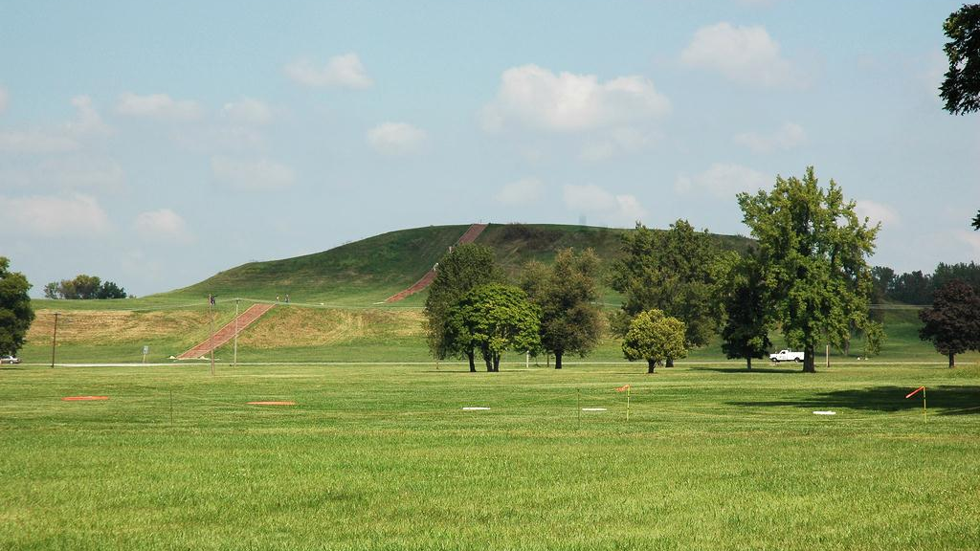
Cahokia Mounds
Outside St. Louis
Photo by Michael Dolan

Slide 36
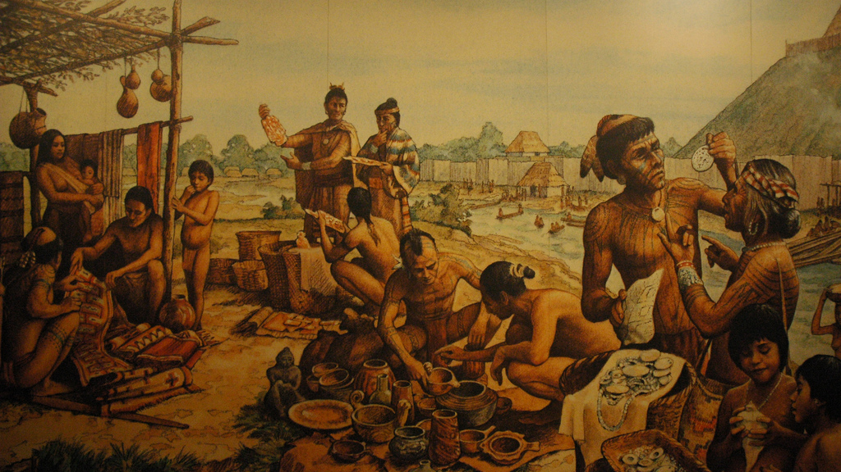
SETTLED communities
Photo by Michael Dolan

Slide 37
AMERICAN INDIAN Culture Groups
Arctic (Eskimos, Inuits) | Hunting, Gathering, and Fishing
Plains Indians (Sioux, Comanche, Witchita) | Bison Hunters - Migratory (Teepees) Horses (introduced from Europe)
Great Lakes (Iroquois, Algonquins) | Hunting and Gathering Slash and Burn Agriculture “Three Sisters” (Corn, Squash, Beans) Longhouses (Iroquois)
Southwest (Hopi, Pueblo) | Clay Houses / Cliff Dwellings Maize (Corn) Agriculture
Southeast (Cherokee, Creek) | Agriculture / Settled Communities Mississippian Culture (Cahokia, Mounds)

Slide 38
LEARNING. DELIVERED.

