Slide 1
The Civil Constitution of the Clergy

Slide 2
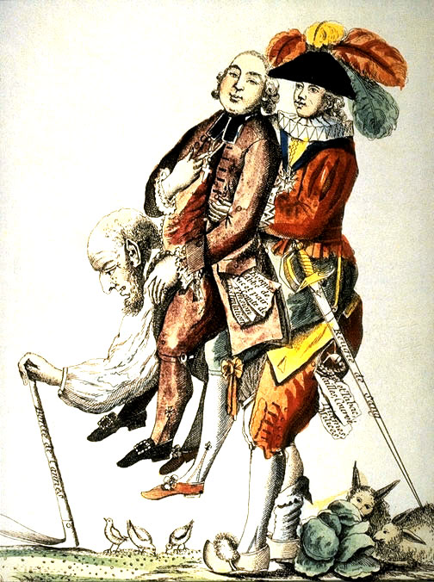
The Old Regime
1
2
3
Church
Nobility
“Third”

Slide 3
The Goal
The privileged estates must be brought into the new French NATION.
Some rights reserved by quinn.anya

Slide 4
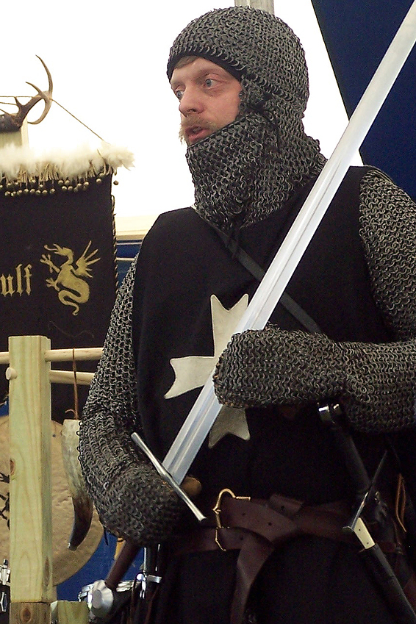
Decrees of August 4th
Abolished the “feudal system”
[NOBLE PRIVILEGES]
tax exemptions
hunting rights
feudal dues
ABOLISHED
Link to Document
Photo Credit: One lucky guy

Slide 5
You’re next
1

Slide 6
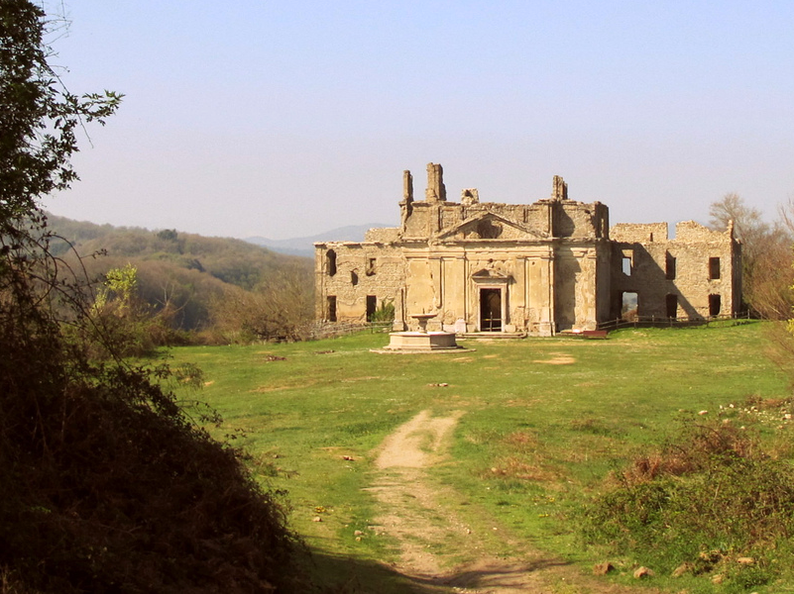
NATIONALIZATION
The National Assembly confiscated Church property in 1789 and abolished religious orders in 1790.
Some rights reserved by JJKDC

Slide 7
And abolished mandatory tithes...

Slide 8
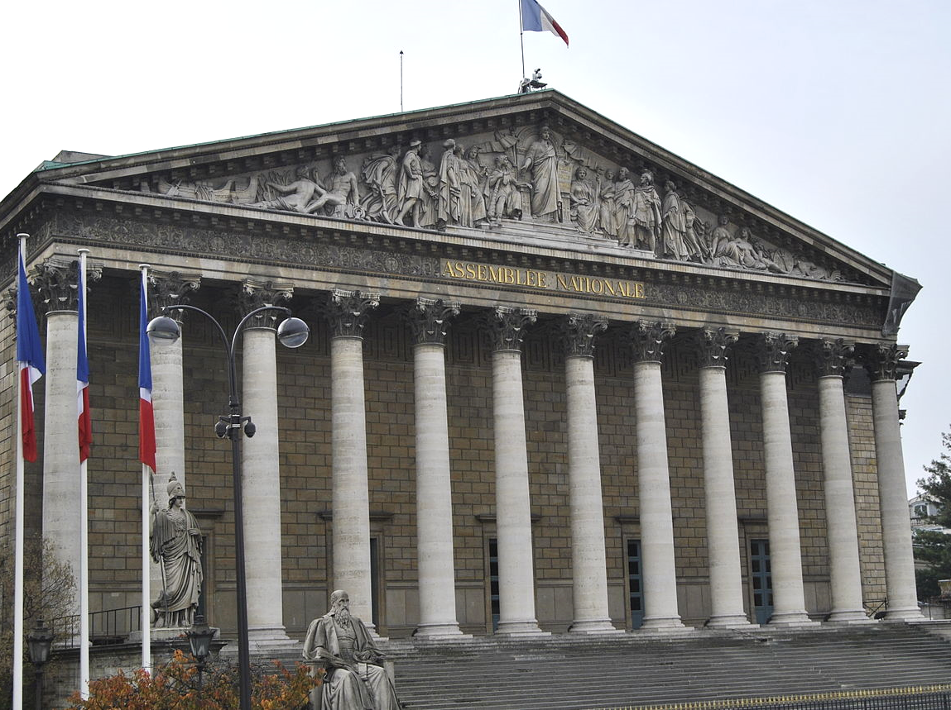
The Church was at the mercy of the State.
Photo by Freepenguin

Slide 9
Civil Constitution of the Clergy
The National Assembly transformed the French Catholic Church into a civil religion.
View Document

Slide 10
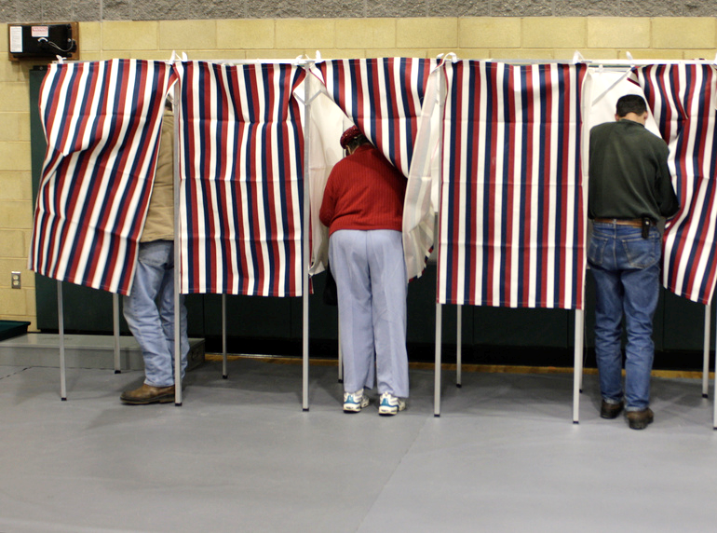
Election of Bishops and Priests
Some rights reserved by redjar

Slide 11
OATHS OF ALLEGIANCE
French priests were required to swear oaths of allegiance to the French nation.
Photo by Jim Pruitt

Slide 12
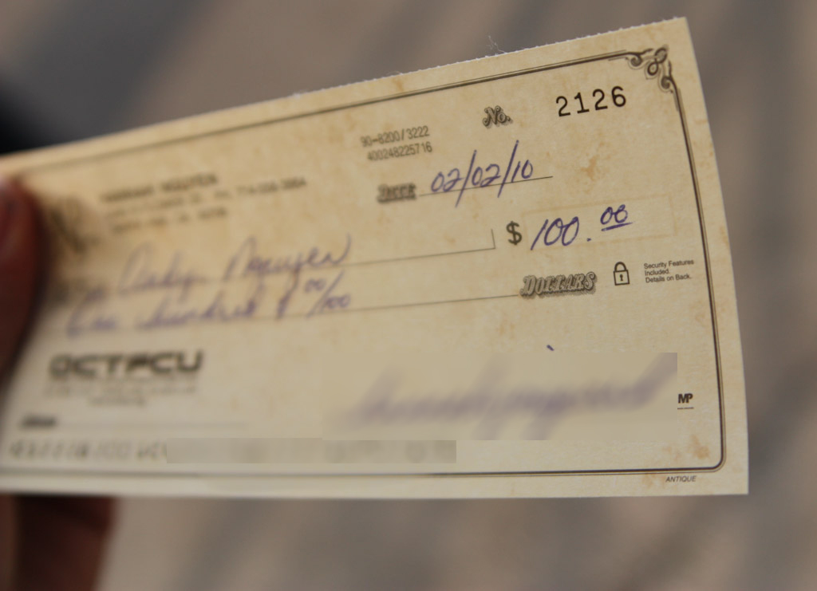
Standard Pay Scales
Some rights reserved by bigburpsx3

Slide 13
Attendance Policy
Some rights reserved by BostonCatholic

Slide 14
Everyone here?
Some rights reserved by BostonCatholic

Slide 15
Everyone here?
Bishops and priests had to get permission from government officials in order to travel outside of their diocese.
Some rights reserved by BostonCatholic

Slide 16
REFORM
What abuses did the Civil Constitution of the Clergy seek to curb?
Review Regulations

Slide 17
LIBERAL?
Did the Civil Constitution of the Clergy contribute to the creation of a more free, less regulated state?

Slide 18
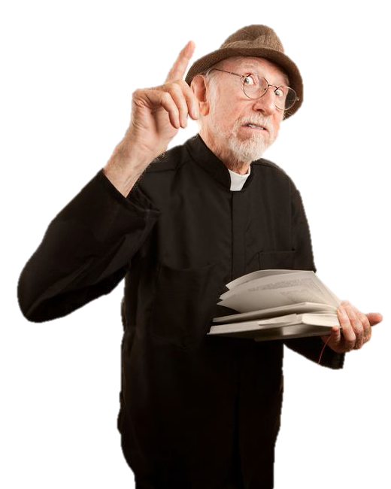
TWO GROUPS
Swearing Priests
Refractory Priests

Slide 19
#@$%
YEAH!
Swearing priests were totally cool with this $#&% stuff.
Swearing Priests

Slide 20
Not so much...
re·frac·to·ry riˈfraktərē adj.
stubborn or unmanageable.
“his refractory pony"
Refractory Priests

Slide 21
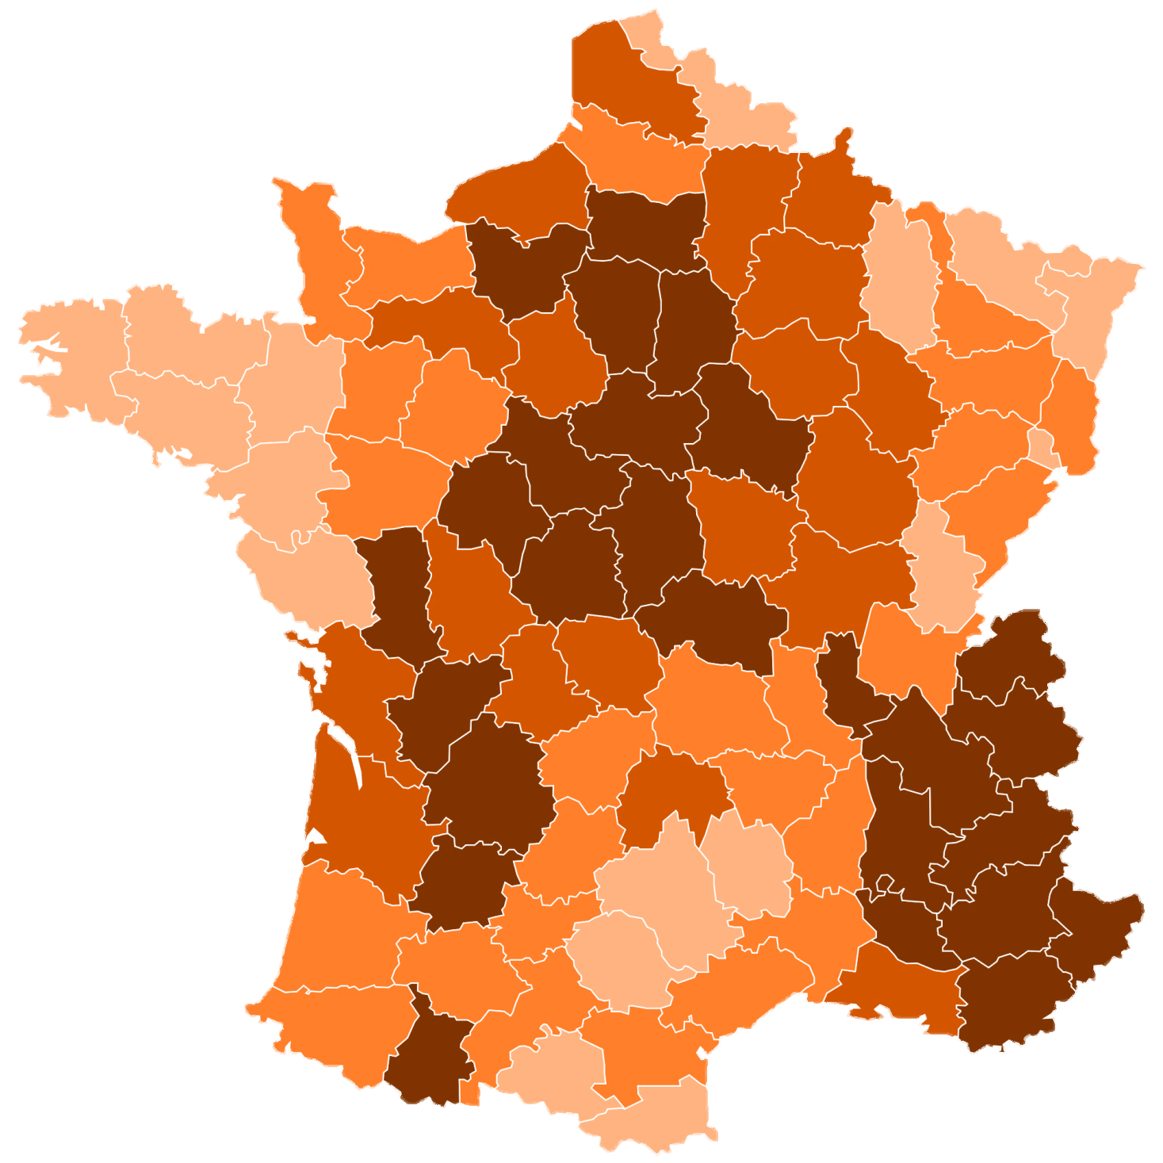
% of Swearing Priests:
According to this map, where was support for the French Revolution strongest?
Where was it weakest?
Map Credit: Marmelad

Slide 22
“ Procession of Refractory Clergy"
Of particular interest in this caricature of refractory clergy here are the long noses, traditionally used to caricature Jews, that suggest the refractory clergy were not of the people. This image shows resistant clergy marching in their last procession. The satyr at the rear with a coffin seems to threaten their very lives. Source: mfr 84.128 http://chnm.gmu.edu/revolution/d/6/

Slide 23
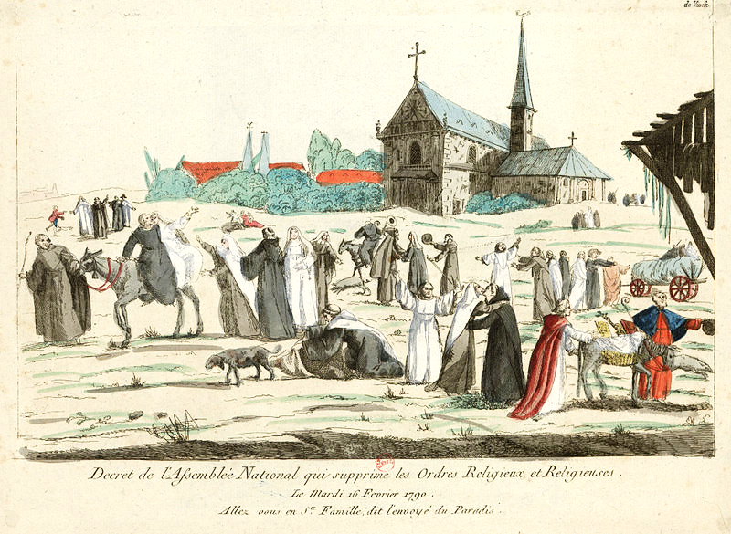
FREEDOM

Slide 24
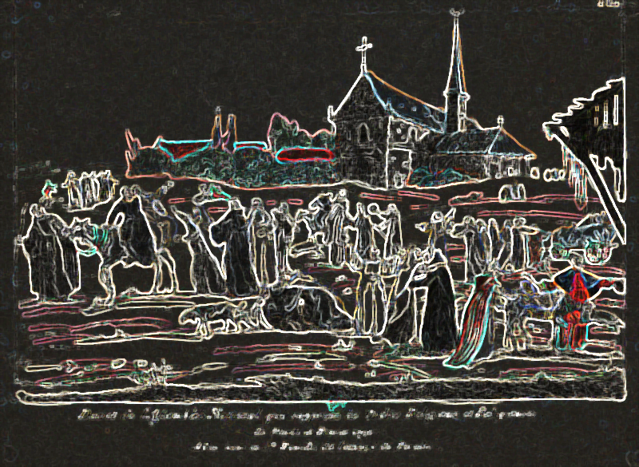
OR CHAOS?

Slide 25
radicalization
The Civil Constitution of the Clergy was a transitional step between the liberal revolution of 1789 and the radical revolution of 1793.

Slide 26
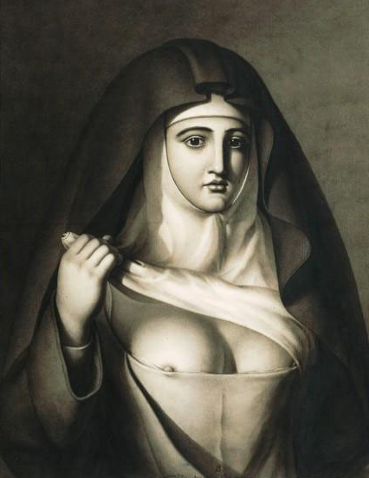
The Next Step
During the Reign of Terror, the state would move from regulating Catholicism to attacking it.
And we too shall be mothers because...
Jean-Jacques Lequeu, 1794

Slide 27
LEARNING.
DELIVERED.

