Slide 1
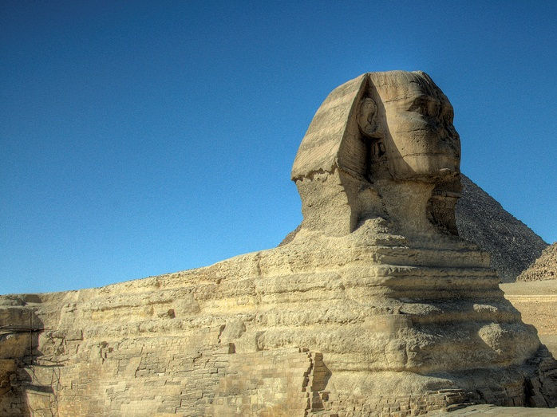
Ancient Egypt
POLITICS & SOCIETY
Photo by Keith Yahl

Slide 2
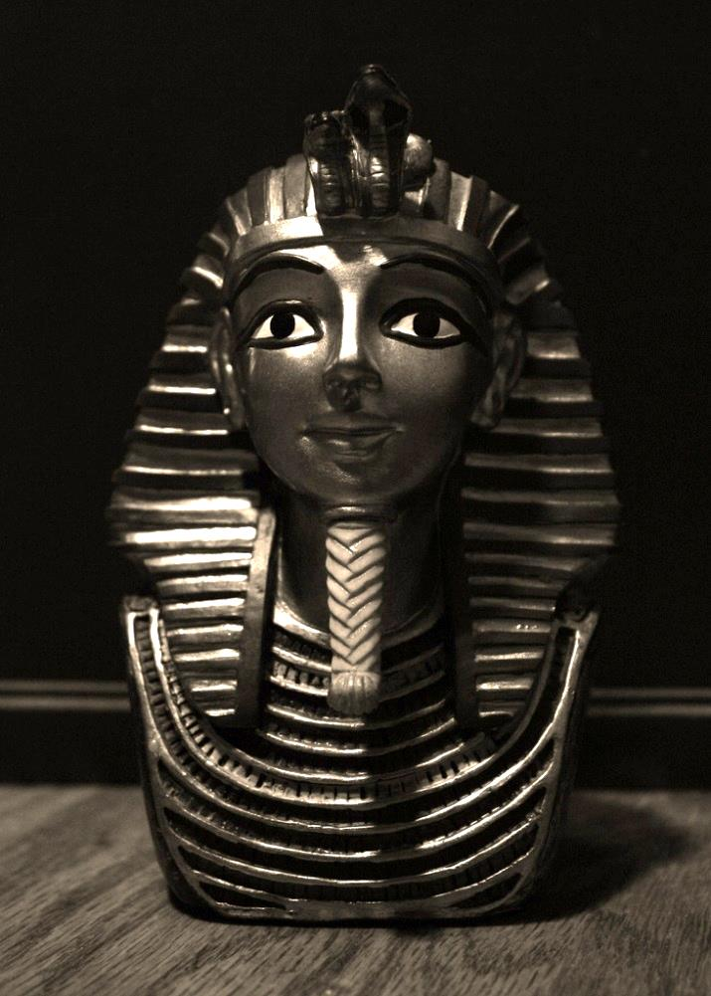
Timeline of Ancient Egypt
OLD KINGDOM (c. 2660 – c. 2180 B.C.)
First Intermediate Period
MIDDLE KINGDOM (c. 2080 – c. 1640)
Second Intermediate Period (Hyksos Invasion)
NEW KINGDOM (Empire) (c. 1550 – c. 1075)
Photo by Nick Ares
NOTE: Stability only broken TWICE in about 1500 years.

Slide 3
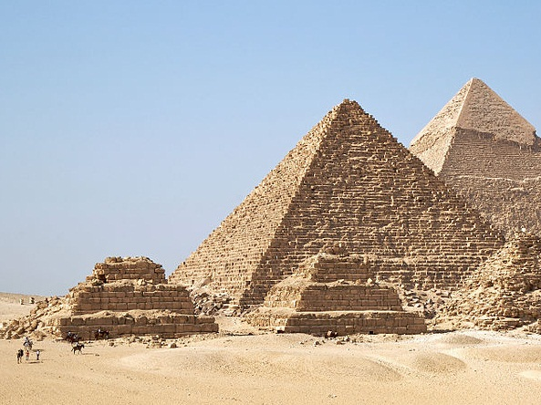
The Old Kingdom
Photo Credit: Ricardo Liberato

Slide 4
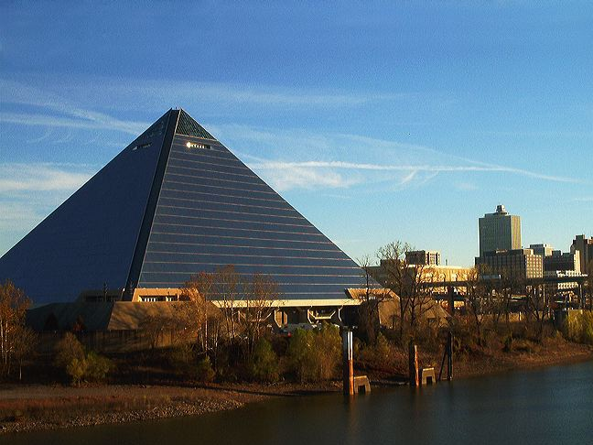
Memphis
Capital of the Old Kingdom (Lower Egypt)
Pyramid Arena Memphis, TN
Photo Credit: Jeremy Atherton

Slide 5
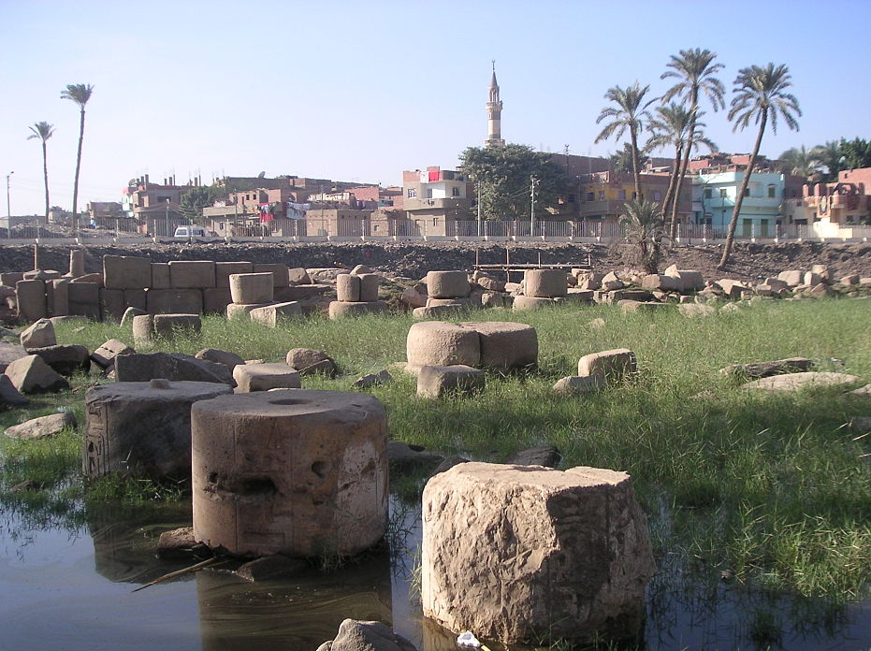
Ruins of Memphis

Slide 6
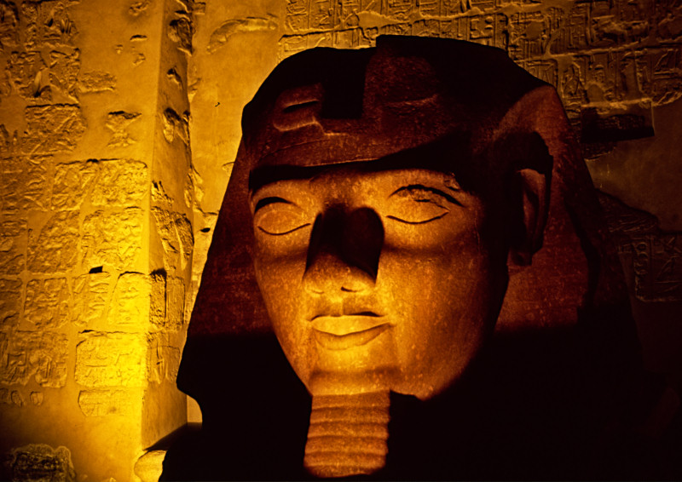
Pharaoh
“Great House”
In this life and the next, the Pharaoh lived in the great house.
Some rights reserved by laurenz

Slide 7
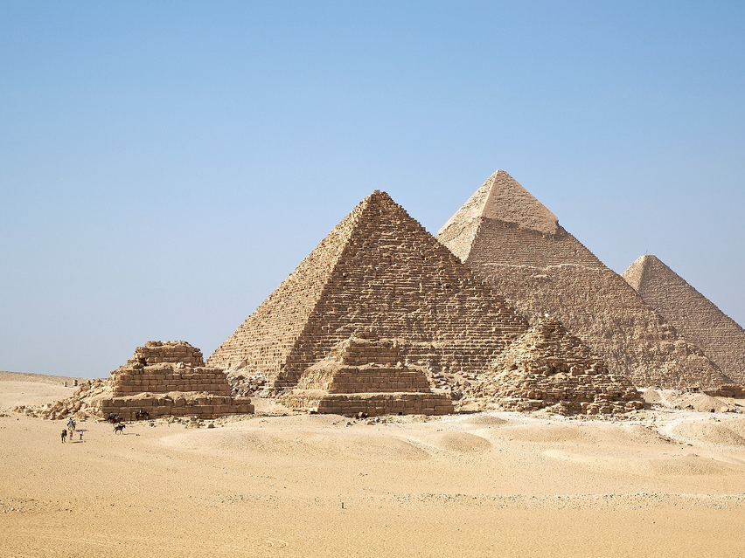
Pyramids at Giza
Photo by Jim Trodel

Slide 8
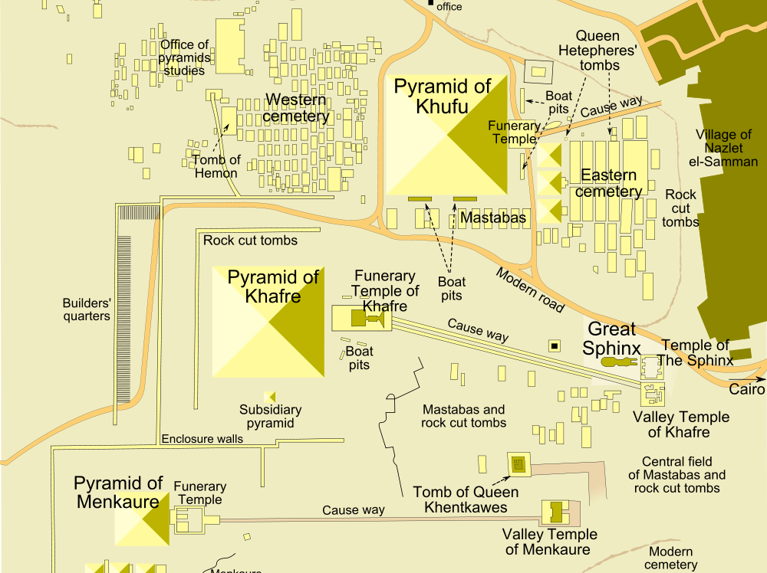
Map Credit: MesserWoland

Slide 9
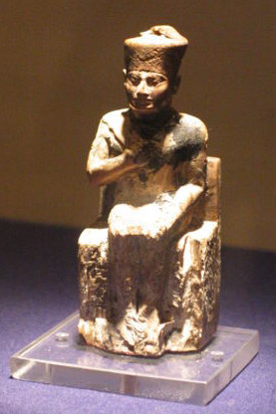
The “Great Pyramid”
7
Khufu was here
The Great Pyramid is the only one of the Seven Wonders of the Ancient World that still survives, today.
Photo Credit: Nina

Slide 10
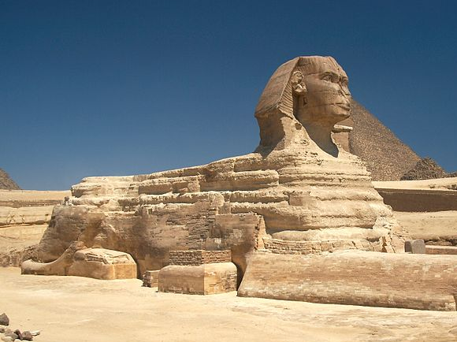
The Great Sphinx
Photo Credit: Barcex

Slide 11
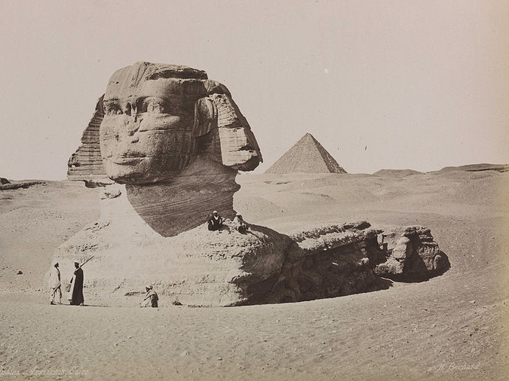
Circa 1870

Slide 12
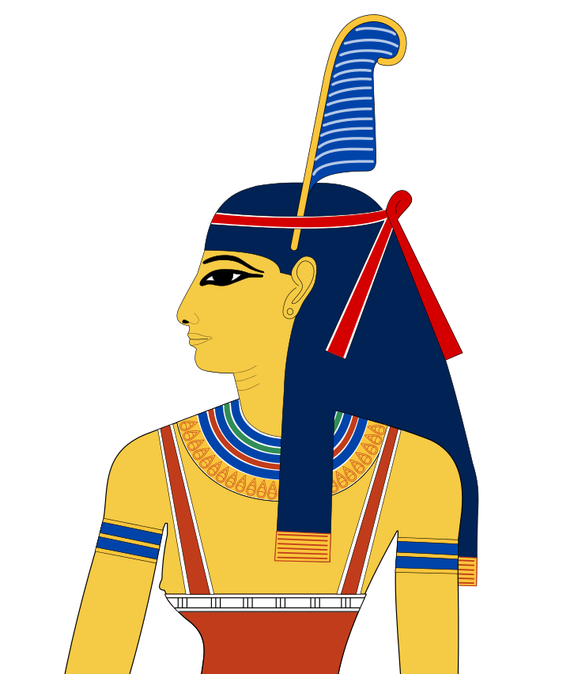
Ma’at
Truth
Balance
Order
Justice
Picture Credit: Jeff Dahl

Slide 13
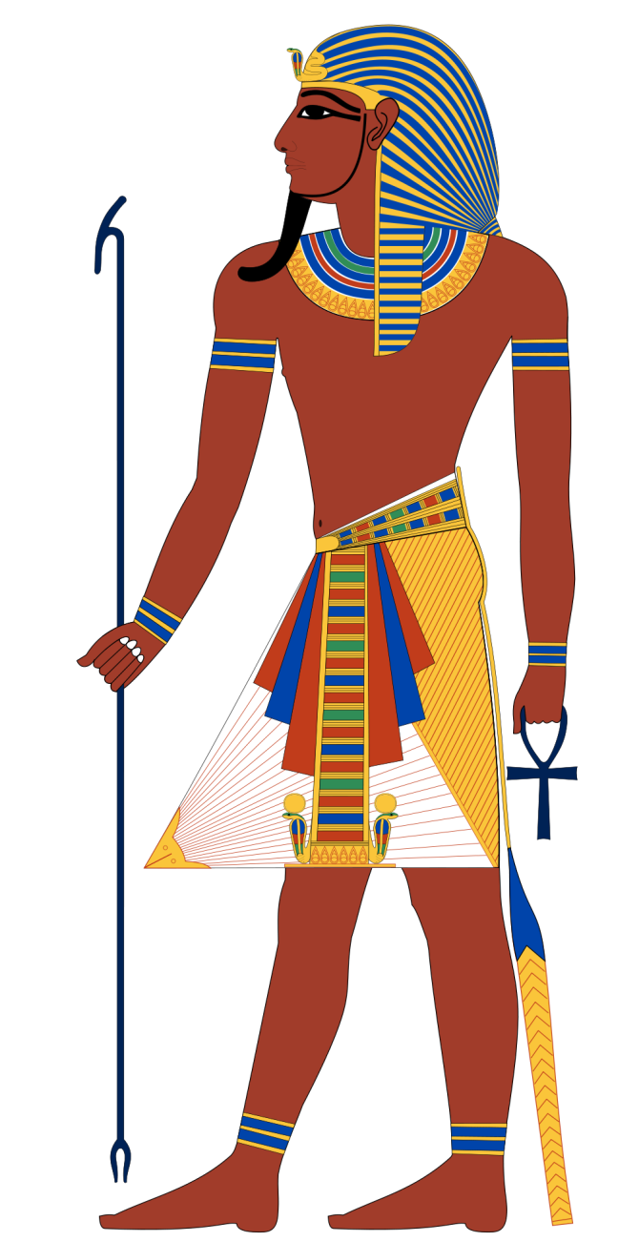
Ma’at
The pharaoh’s job was to keep the land in ma’at.
Picture Credit: Jeff Dahl

Slide 14
A Keeper of ORDER
Picture Credit: Jeff Dahl

Slide 15
UNIFIER
of Egypt
Picture Credit: Jeff Dahl

Slide 16
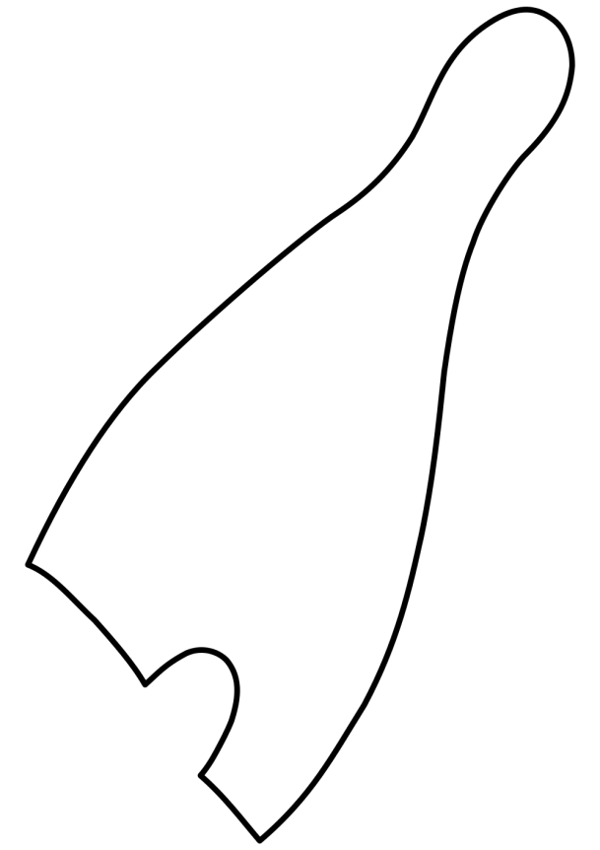
The Pharaoh’s [Double] Crown
Red Crown
(Lower Egypt)
White Crown
(Upper Egypt)
Picture Credits: Jeff Dahl & Kompak

Slide 17
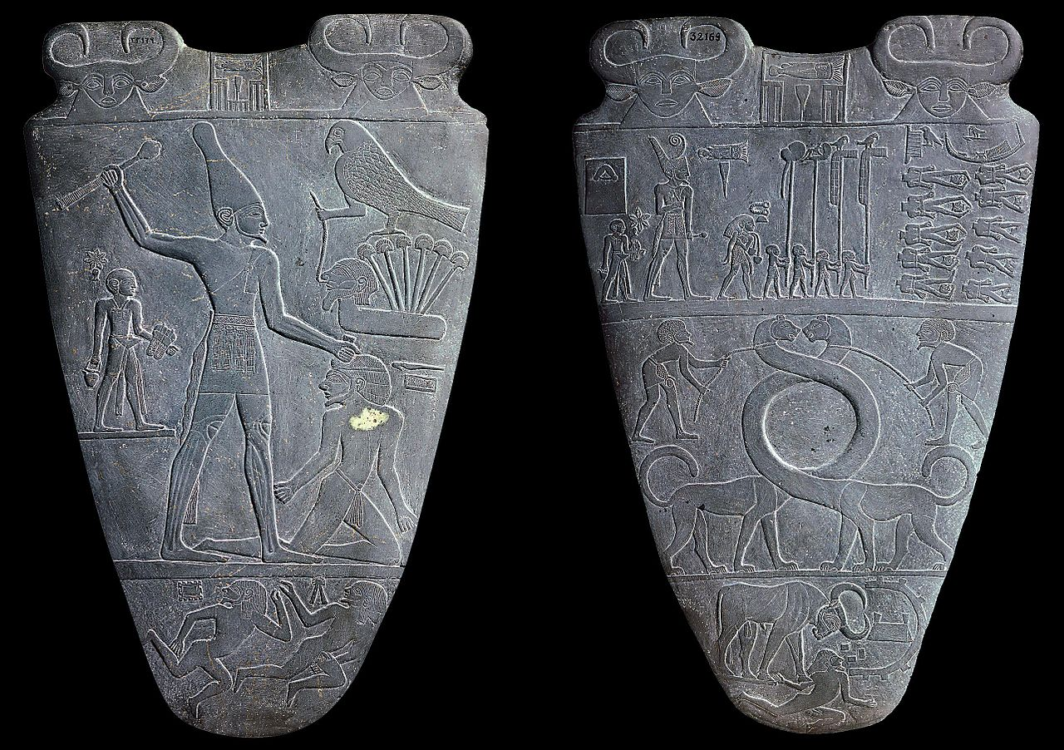
The Narmer Palette

Slide 18
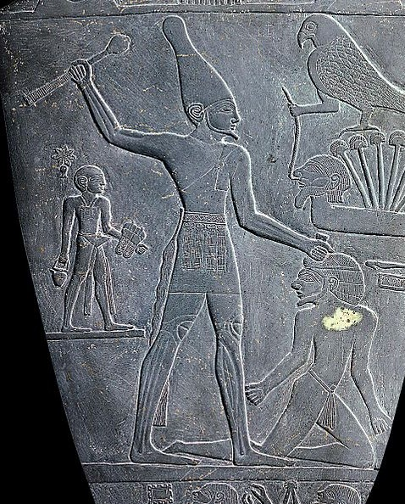
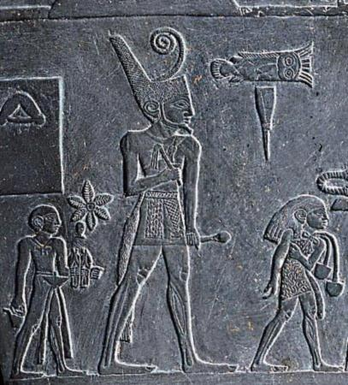
Pharaoh as Unifier

Slide 19
Deification
Pharaoh as “God-King”
Picture Credit: Jeff Dahl

Slide 20
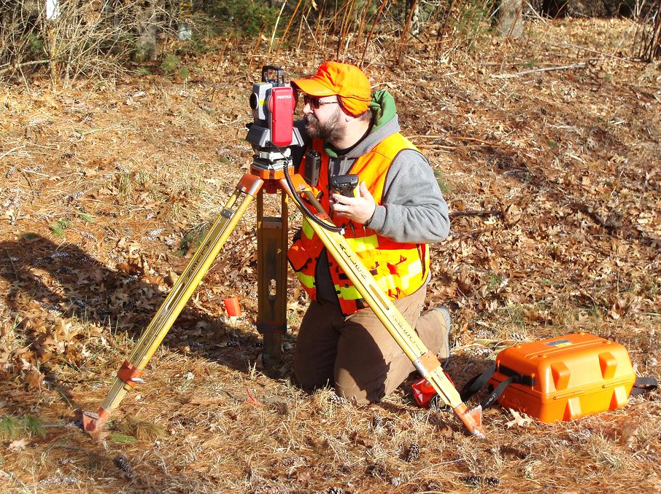
Surveyors
Some rights reserved by Bosshard Surveying

Slide 21
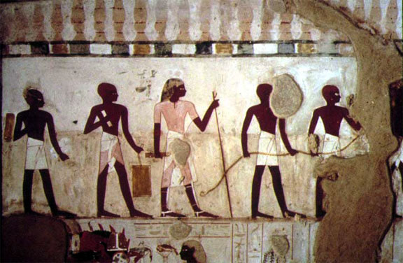
Surveyors
educated class of skilled laborers (like scribes)
re-marked boundaries after annual Nile flooding
Measured pyramids

Slide 22
Surveyors Stretching Rope

Slide 23
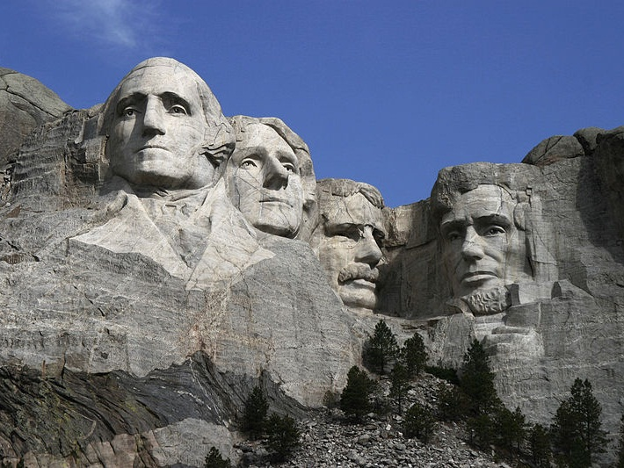
“Three surveyors and another guy…”
George Washington, Thomas Jefferson, and Abraham Lincoln were all trained as land surveyors.

Slide 24
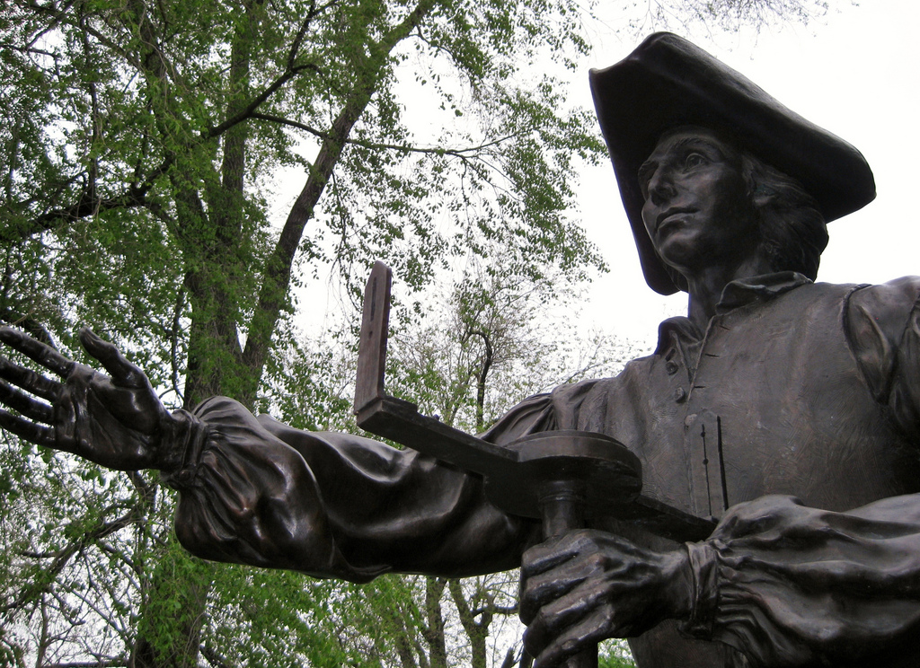
Young George Washington about to get his survey on!
Some rights reserved by TheSeafarer

Slide 25
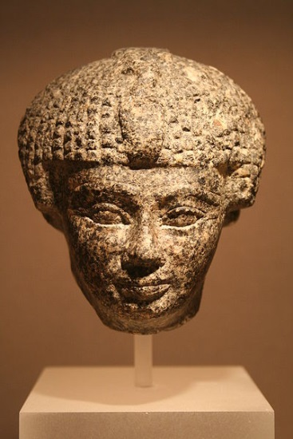
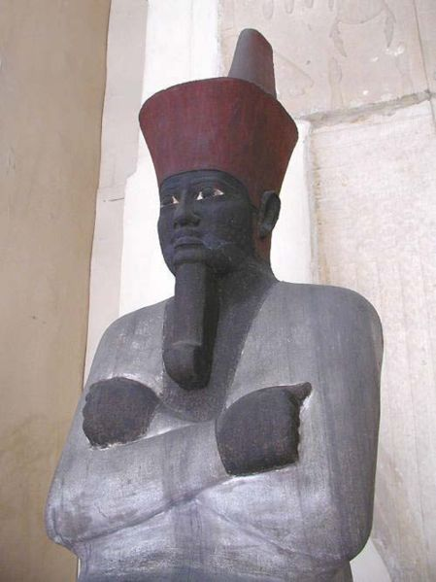
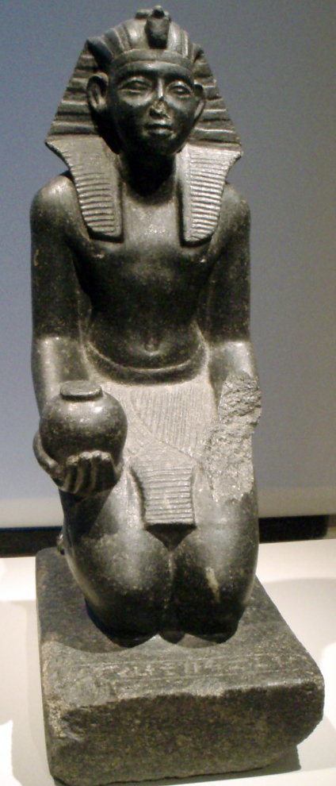
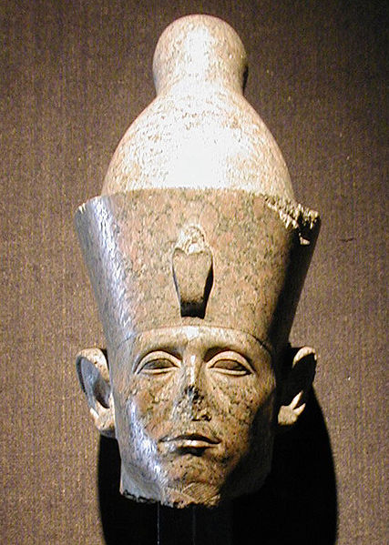
The Middle Kingdom
Lots of cool stuff probably happened…
…but it’s outside the scope of this course…

Slide 26
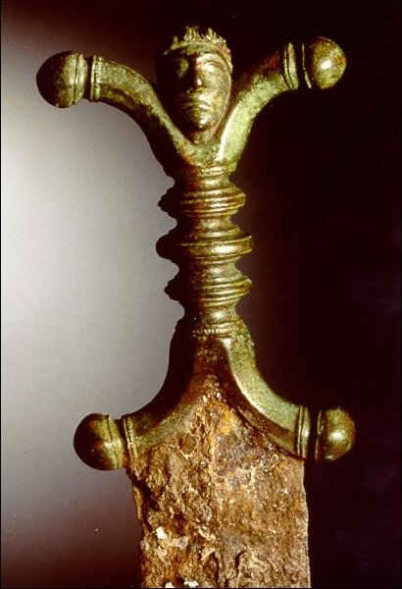
Hyksos
Nomads?
Set up a capital in the delta.
Shared Bronze Age technology (moving beyond Stone Age)
Some rights reserved by Hull City Council

Slide 27
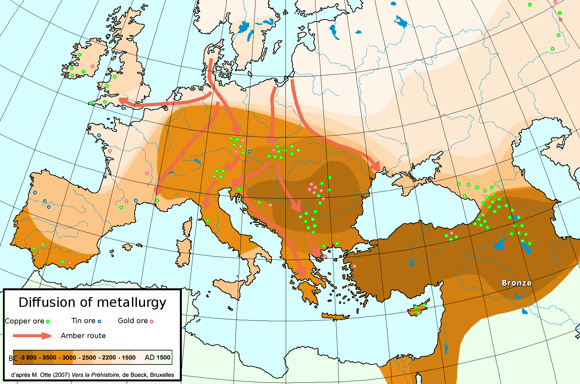
Diffusion of Bronze Age Technology
Hittite Empire

Slide 28
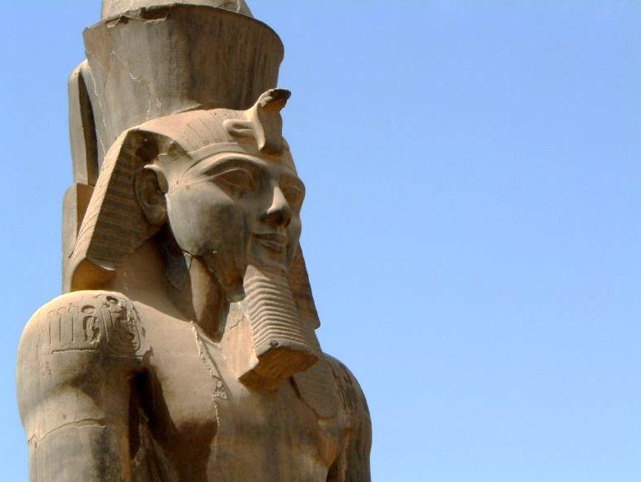
The New Kingdom
Some rights reserved by sukesu

Slide 29
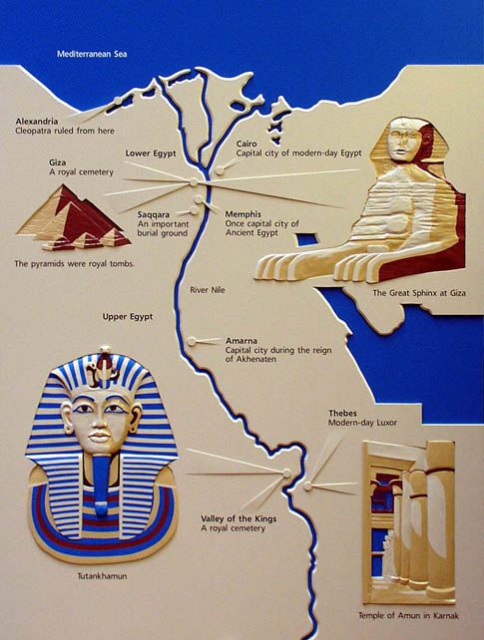
The New Kingdom
Capital: Thebes
(Upper Egypt)
Important Pharaohs:
Hatshepsut
Thutmose III
Akhenaten
Tutankhamun
Ramses II [the Great]

Slide 30
Old Kingdom vs. New Kingdom
 | OLD KINGDOM | NEW KINGDOM
Capital City | Memphis (Lower Egypt) | Thebes (Upper Egypt)
Burial Place | Pyramids | Valley of the Kings

Slide 31
The Valley of the Kings

Slide 32
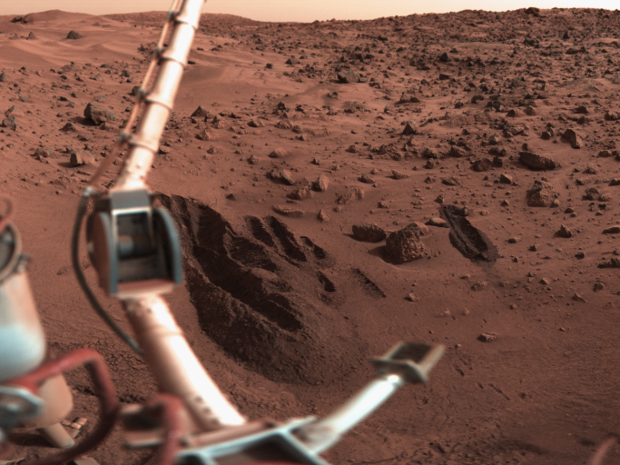

Slide 33
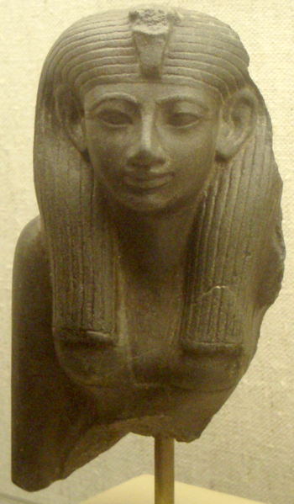
Hatshepsut
Female Pharaoh
One of the first known female rulers
“King” of Egypt

Slide 34
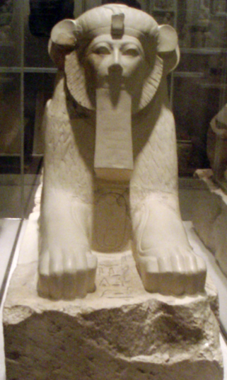
Hatshepsut as “King” of Egypt

Slide 35
Hatshepsut’s Temple
Valley of the Kings

Slide 36
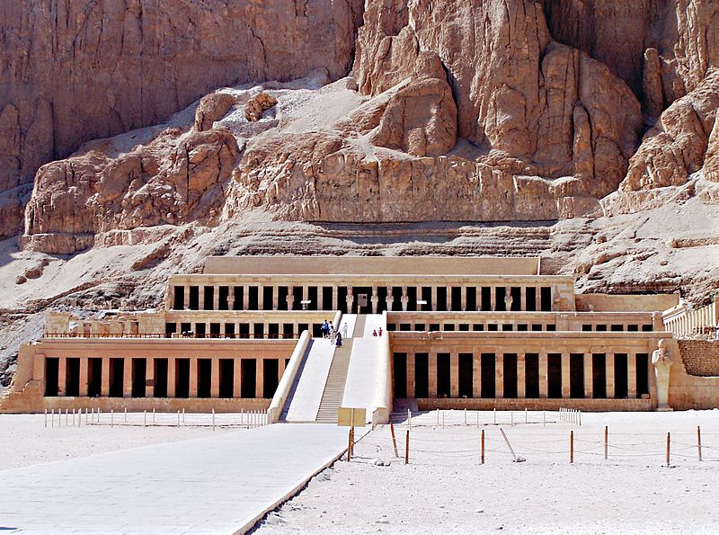

Slide 37
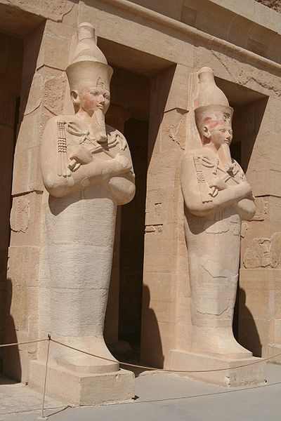
Statues of Hatshepsut at Her Tomb
In what god’s image is she represented here?

Slide 38
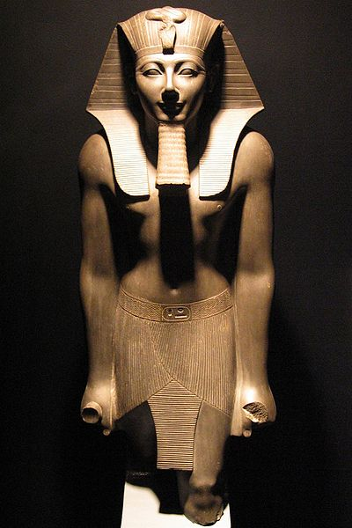
Thutmose III
Hatshepsut’s Stepson
Co-regent until her death
Sole ruler afterwards
Commanded her armies

Slide 39
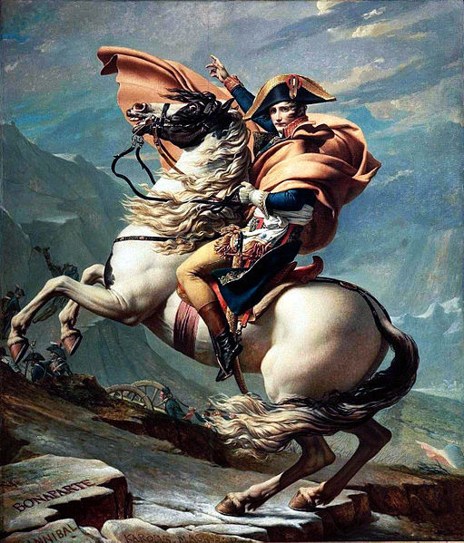
Napoleon of Egypt
Great military leader and conqueror

Slide 40
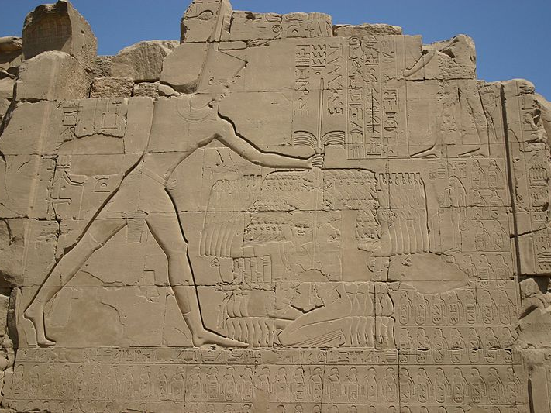
Thutmose III smites his enemies…

Slide 41
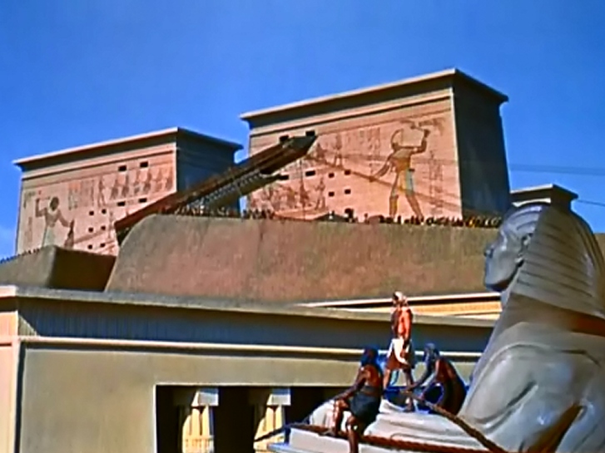
Obelisks
CLICK the logo to watch a clip from The Ten Commandments on YouTube!

Slide 42
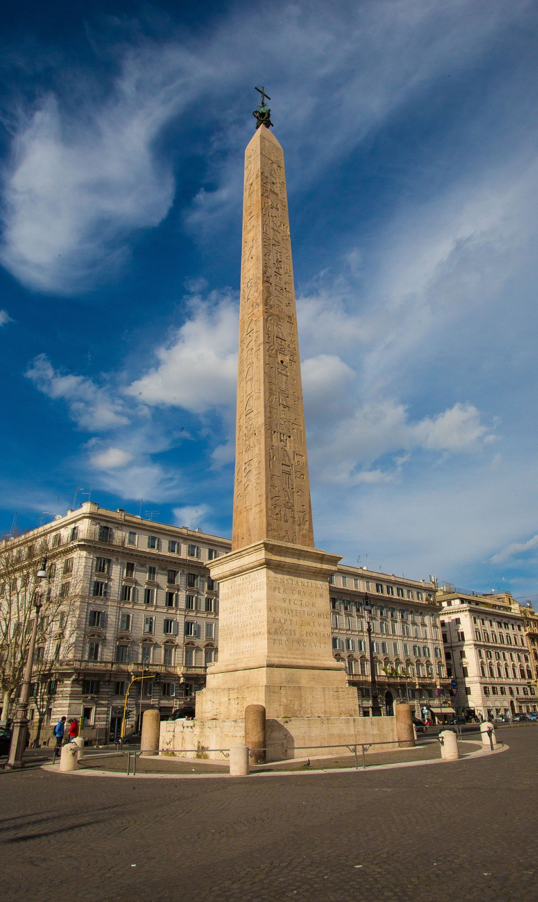
Lateran Obelisk
Vatican City (Rome)
Erected by Thutmose III to commemorate his victories
Tallest obelisk in Rome
Shipped from Egypt
32 m. tall
230 tons
Photo Credit:
Roman Catholic Archdiocese of Boston

Slide 43
Lateran Obelisk
Vatican City (Rome)
Erected by Thutmose III to commemorate his victories
Tallest obelisk in Rome
Shipped from Egypt
32 m. tall
230 tons
Photo Credit:
Roman Catholic Archdiocese of Boston

Slide 44
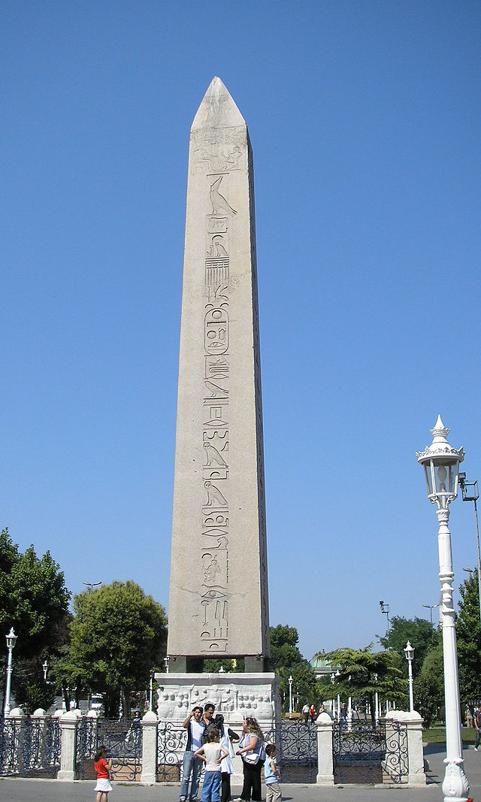
Obelisk of Theodosius
Another of Thutmose III’s obelisks was transported to Constantinople by Theodosius I.

Slide 45
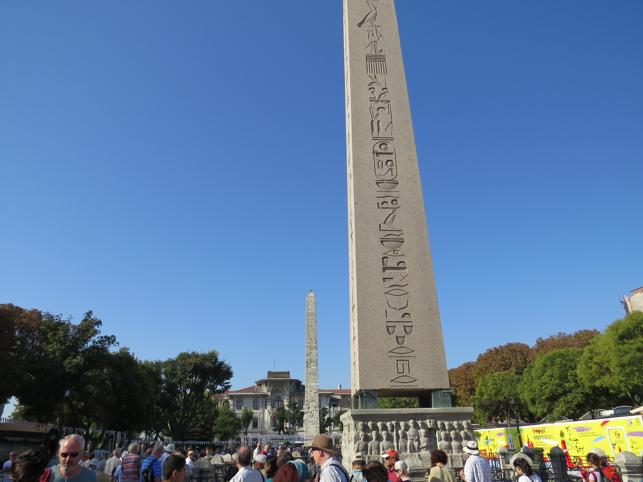
Photo by David Berkowitz

Slide 46
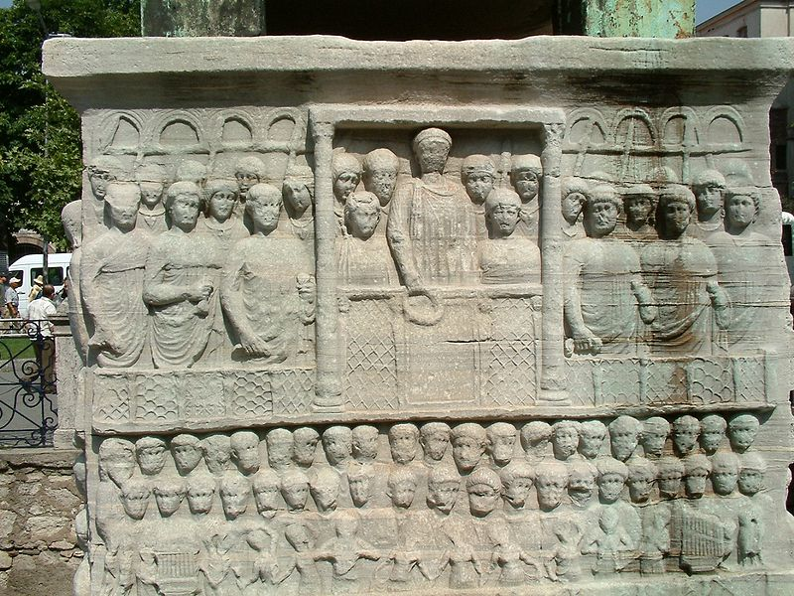
Photo Credit: Radomil

Slide 47
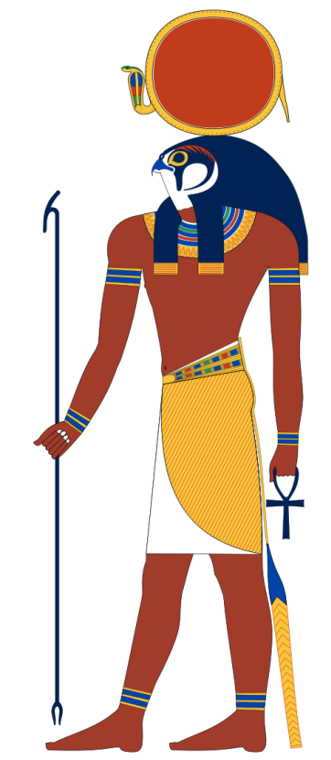
Akhenaten (and Nefertiti)
MONOTHEISM
Akhenaten claimed that the sun (Aten) was the only god.
Picture Credit: Jeff Dahl

Slide 48
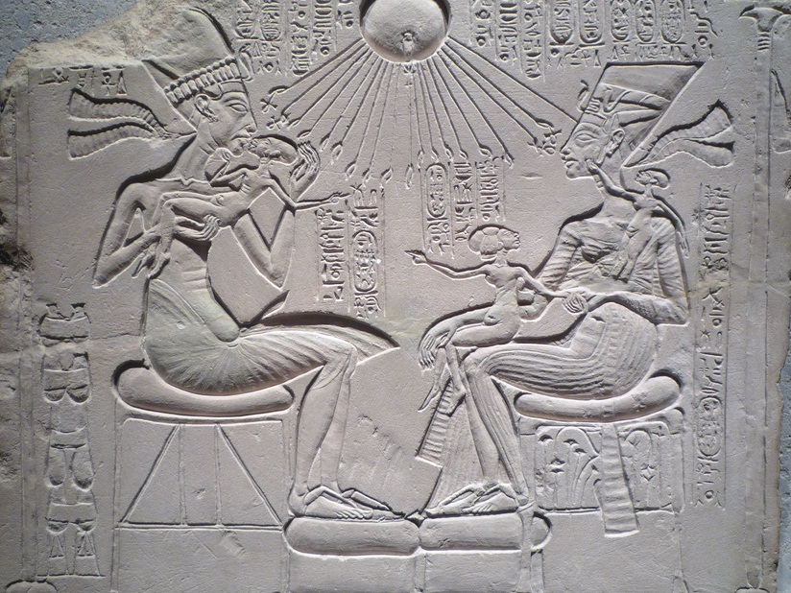
Photo by profzucker

Slide 49
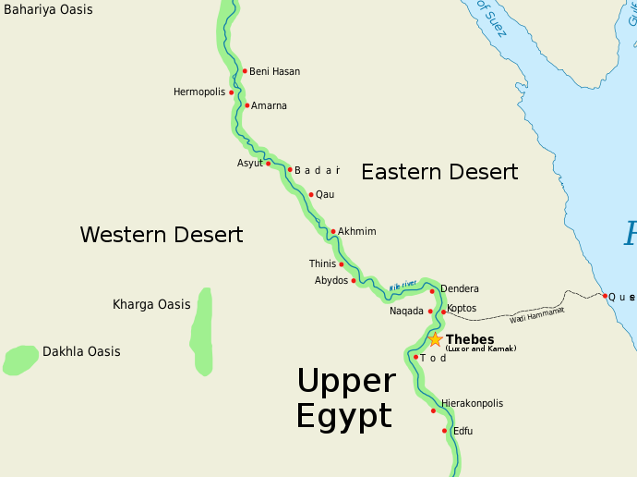
Amarna A New Capital

Slide 50
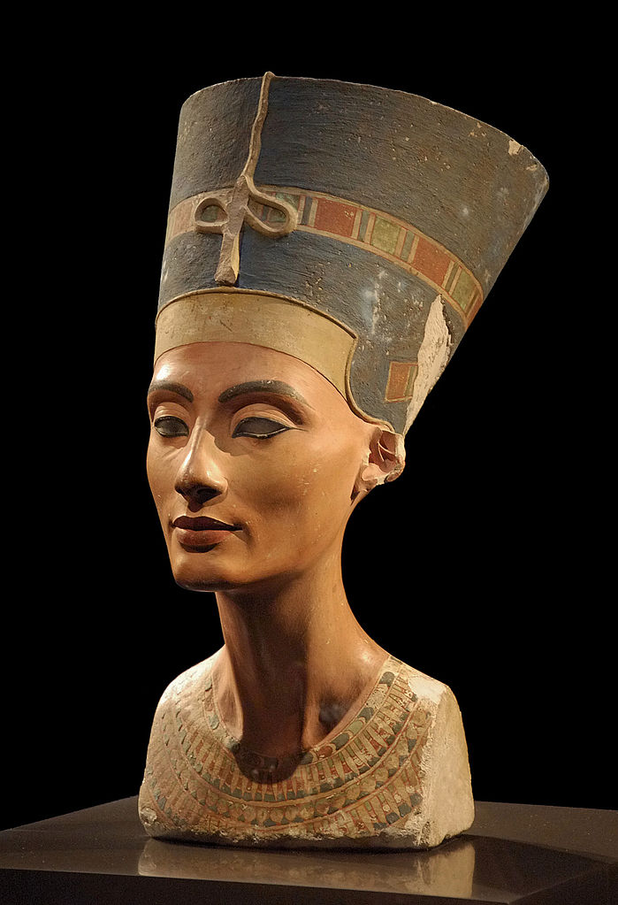
Nefertiti
Akhenaten’s “Great Wife”
Bust of Nefertiti discovered in the ruins of Amarna
Photo by Philip Pikart

Slide 51
FAIL
Monotheism in Egypt died with Akhenaten…
…but the idea survived to fight another day.
Photo by profzucker

Slide 52
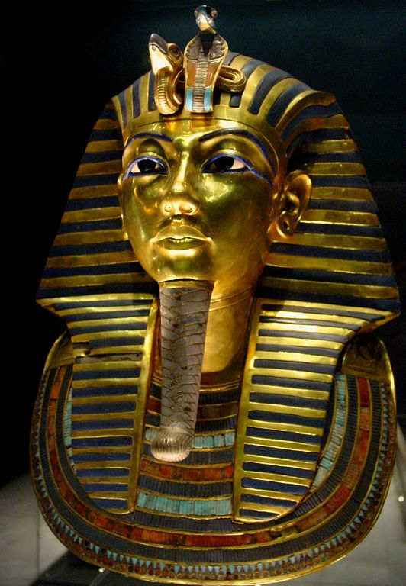
“King Tut”
Tutankhamun
Son of Akhenaten
Polytheism Re-established
Capital → Thebes
1922 – Nearly intact tomb discovered

Slide 53
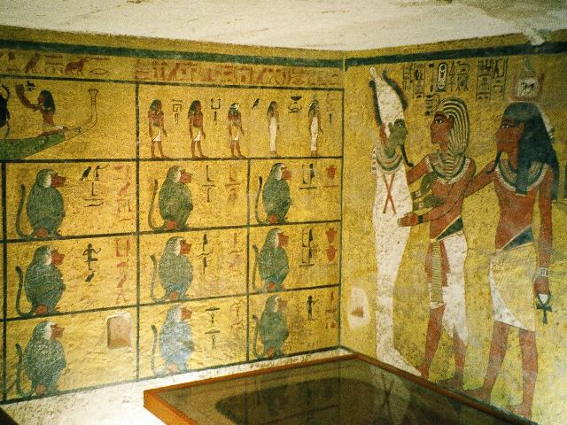
King Tut’s Tomb
Discovery of nearly intact tomb in 1922 sparked interest in ancient Egypt

Slide 54
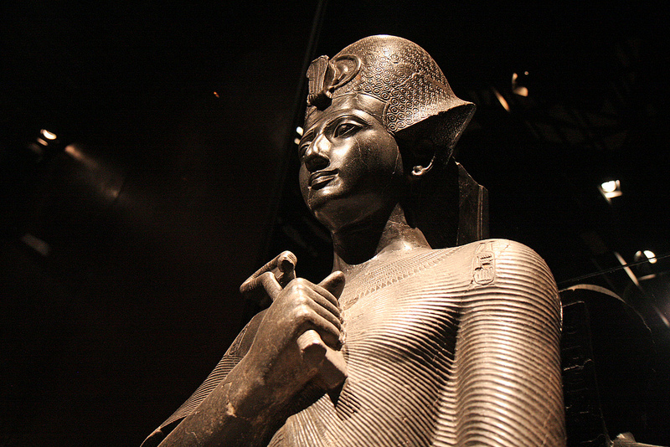
Ramses II “The Great”
Photo by Soloegipto

Slide 55
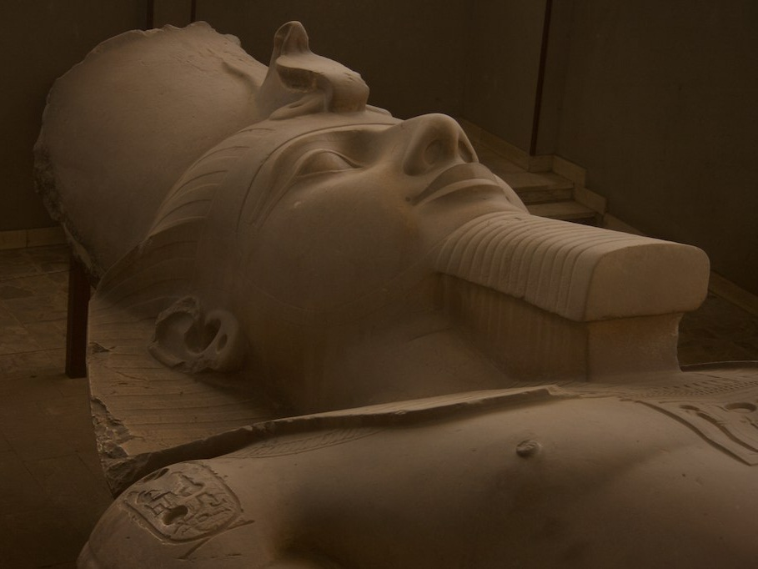
Statue of Ramses II
Reigned 1279-1213 B.C.
Lived 96 Years
Monuments and temples galore!
Photo by lamimesis

Slide 56
The Ramesseum
CLICK for more photos

Slide 57
Battle of Kadesh
Hittite Empire
Asia Minor
Modern Turkey
Ramses II vs. Hittites
Large chariot battle

Slide 58
Ramesses atop chariot, at the battle of Kadesh. (Relief inside his Abu Simbel temple.)

Slide 59
Peace Treaty
The treaty that followed the Battle of Kadesh is the oldest international agreement known to historians.

Slide 60
Papyrus
an ancient form of paper
Makes writing easier, but not as durable as stone or clay
Papyrus Reeds

Slide 61
Rosetta Stone
Discovered 18th c.
by Napoleon’s soldiers
allowed scholars to translate hieroglyphics
The Egyptians engraved important documents in stone.
Hieroglyphics
“Demotic”
Greek

Slide 62
Egyptology
Egypt has continued to fascinate us thousands of years later.
Egyptologists study Egypt for a living.

