Slide 1
PHILOSOPHES
The
Photo by Eric Huybrechts

Slide 2
PHILOSOPHE

Slide 3
PHILOSOPHE
This is NOT a misspelling.

Slide 4
PHILOSOPHE
It’s FRENCH for philosopher.

Slide 5
PHILOSOPHE
=
ENLIGHTENMENT PHILOSOPHER

Slide 6
WHO’S WHO
of the Enlightenment

Slide 7
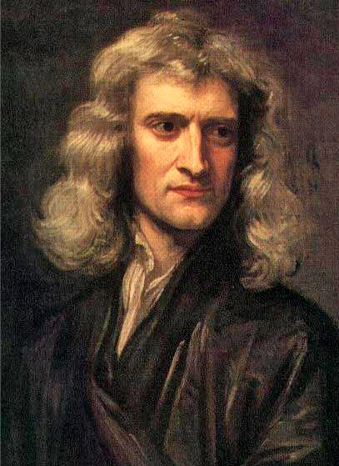
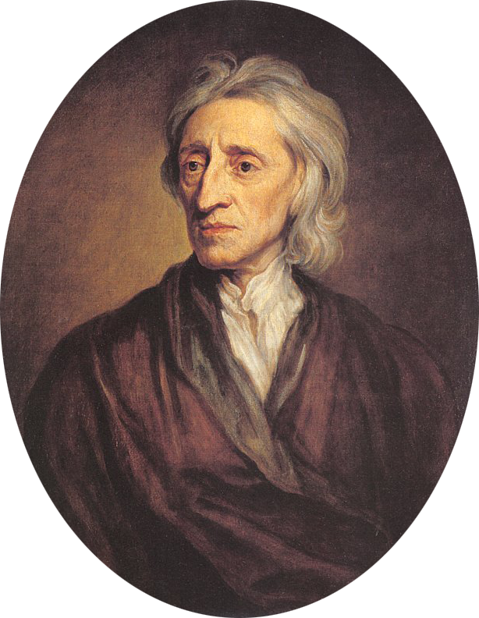
PRECURSORS
Newton and Locke

Slide 8
NEWTON
Laws of Physics

Slide 9
NEWTON
Rational View of the Universe

Slide 10
NATURAL LAW

Slide 11
LOCKE
Religious Toleration

Slide 12
LOCKE
Rational View of Government

Slide 13
NATURAL RIGHTS

Slide 14
Life
Liberty
Property

Slide 15
THE PHILOSOPHES
FRANCE | PRUSSIA | USA
Voltaire Diderot Montesquieu Rousseau | Kant | Jefferson Franklin Paine
 | SCOTLAND
 | Smith

Slide 16
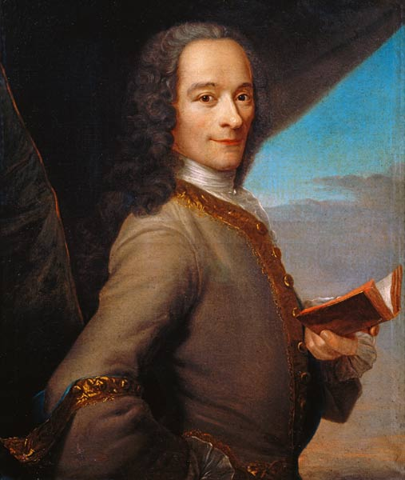
VOLTAIRE
French Philosophe, Author, & Playwright

Slide 17
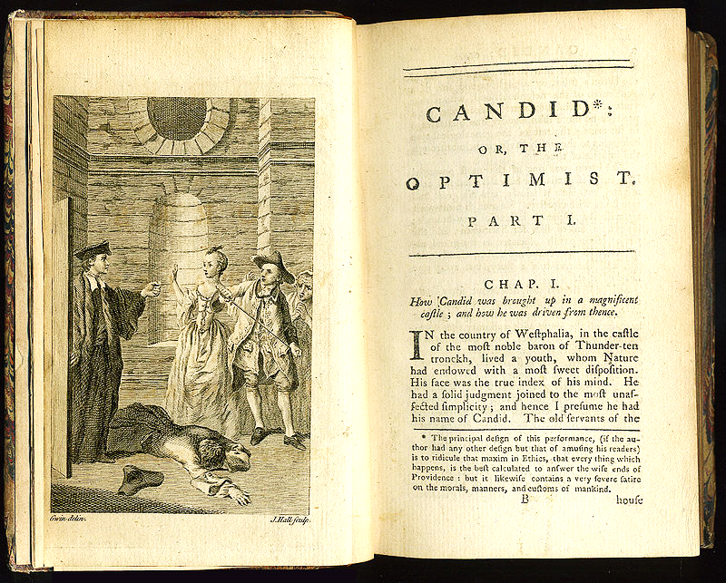

Slide 18
NOTABLE WORKS
Letters on England
Philosophical Dictionary
Elements of Newton’s Philosophy

Slide 19
POPULARIZER

Slide 20
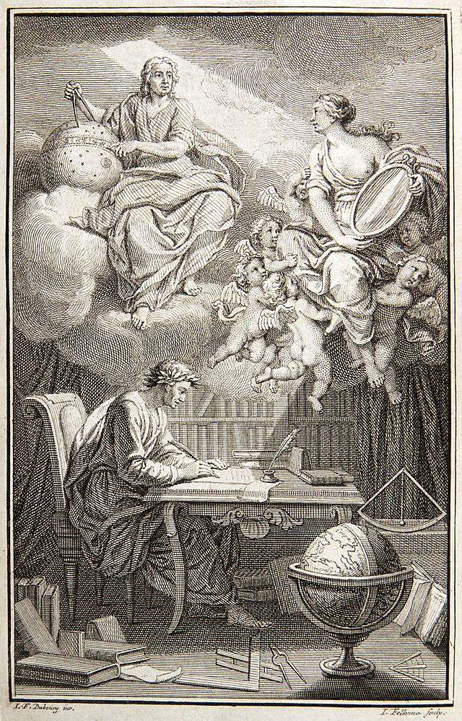
Voltaire writing his book on Newton’s philosophy

Slide 21
Who is the woman?

Slide 22
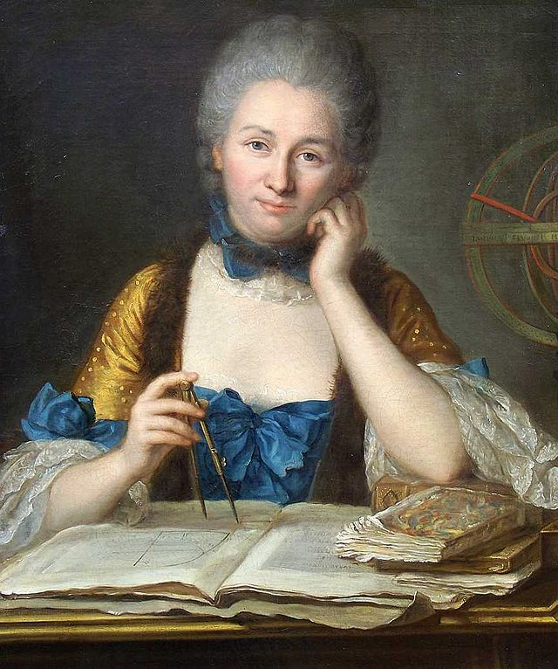
CHÂTELET
Émilie du
French Mathematician, Physicist, and Author

Slide 23
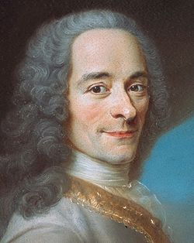

Slide 24
“a great man whose only fault was being a woman.”
-- Voltaire

Slide 25
MUSE

Slide 26
ADVOCATE
of Religious Toleration

Slide 27
CRITIC
of Christianity
(“Revealed” Religion)

Slide 28
DEISM
Natural Religion
Photo by Giuseppe Milo

Slide 29
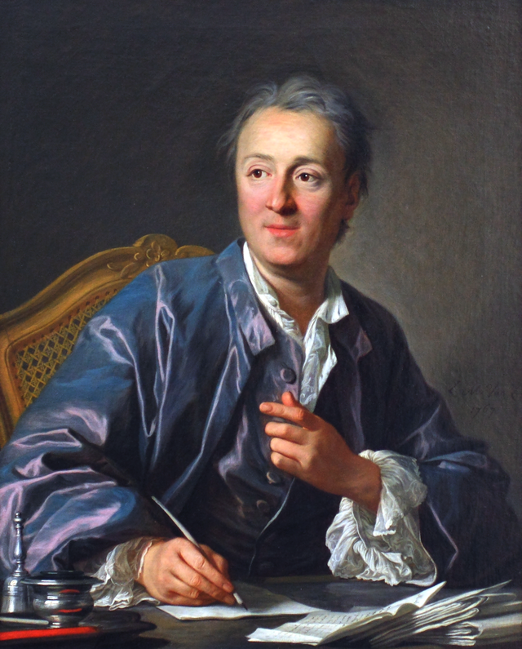
DIDEROT
Denis
French Author
and Editor

Slide 31
The Encyclopédie was a collaborative effort to compile and distribute a wide variety of knowledge from an “enlightened” perspective.
4,250 COPIES PRINTED
The Encyclopedia Online:
http://quod.lib.umich.edu/d/did/

Slide 32
POET
“Poetry must have something in it that is barbaric, vast and wild.”
-- Diderot

Slide 33
his hands would plait the priest’s entrails
for want of a rope
to strangle kings
-- Les Eleutheromanes
Photo by Jay Bergesen

Slide 34
CONTEXT
Carnival
Photo by Caitee Smith

Slide 35
AUTHOR
&
PRANKSTER

Slide 36
The Nun
Photo by Robert Frank Gabriel

Slide 37
HAHA SO FUNNY
Photo by carrotmadman6

Slide 38
EXPECTO PATRONUM!

Slide 39
PATRONUS

Slide 40
PATRONUS
Patroness

Slide 41
When Catherine the Great heard that Diderot was broke, she bought his library… then paid him “to be her librarian.”

Slide 42
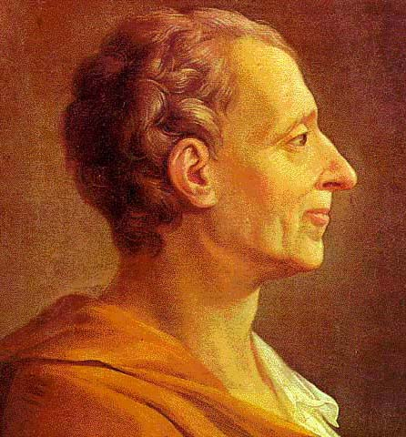
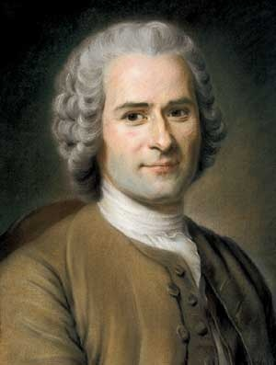
POLITICAL THEORY
Montesquieu & Rousseau

Slide 43
MONTESQUIEU
The Spirit
of the Laws

Slide 44
GOVERNMENT
Organized on Enlightenment Principles

Slide 45
SEPARATION
of Powers
LEGISLATIVE
EXECUTIVE
JUDICIAL
Martha Ormiston (Noun Project)

Slide 46
SEPARATION
of Powers
LEGISLATIVE | EXECUTIVE | JUDICIAL
Makes Laws
Enforces Laws
Judges Disputes

Slide 47
JEALOUSY
Photo by Nicoleta Ifrim-Ionescu

Slide 48
CHECKS
& Balances
Each branch has oversight over the other branches.
Erin Gillaspy (The Noun Project)

Slide 49
VETO
Executive Checks the Legislative

Slide 50
EMPIRICISM

Slide 51
Universal experience, in all ages and countries, however, teaches that
POWER can only be restrained by POWER and not by reason and justice.
-- The South Carolina Exposition (1828)

Slide 52
JEALOUSY
Photo by Nicoleta Ifrim-Ionescu

Slide 53
Montesquieu’s work was based on empirical methods, studying history to find out what forms of government had worked best.

Slide 54
ROUSSEAU
Jean Jacques
The Social Contract

Slide 55
MAN IS BORN FREE
But everywhere he is in chains.
Photo by Randen Pederson

Slide 56
LEGITIMATE?
What makes a government

Slide 57
FREEDOM?
What is

Slide 58
GENERAL WILL
Submission to the

Slide 59
EMILE
On Education

Slide 60
GENDER ROLES
Acceptance of
“Sophie should be a woman as Emile is a man.”
http://history.hanover.edu/courses/excerpts/165rouss-em.html
Generic Man by Alex Berkowitz (The Noun Project)

Slide 61
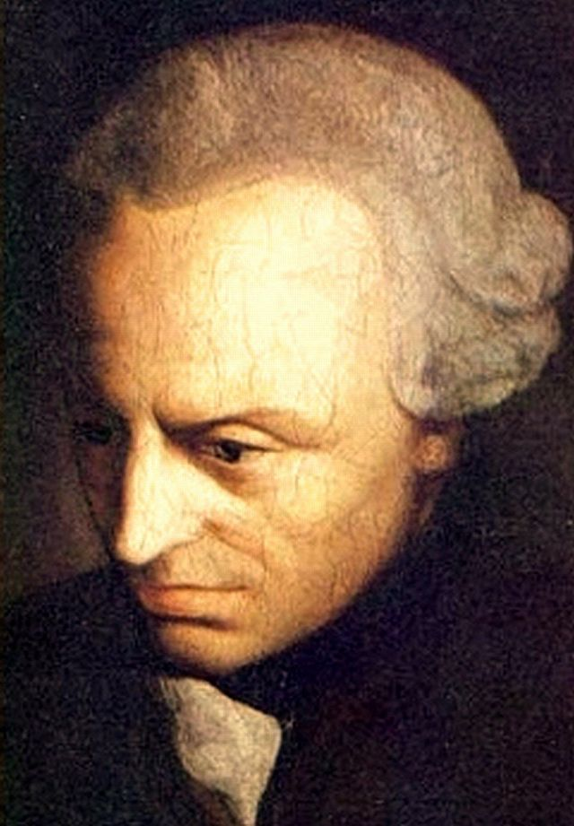
KANT
Immanuel
Prussian Philosophe

Slide 62
ENLIGHTENMENT?
What is
Kant’s 1784 essay is a great starting point for understanding the core principles of the Enlightenment.

Slide 63
PURE REASON
Critique of

Slide 64
My Most Famous Book

Slide 65
REASON
Relationship Between
&
EXPERIENCE

Slide 66
ETHICS

Slide 67
CATEGORICAL IMPERATIVE
Universal [Moral] Law

Slide 68
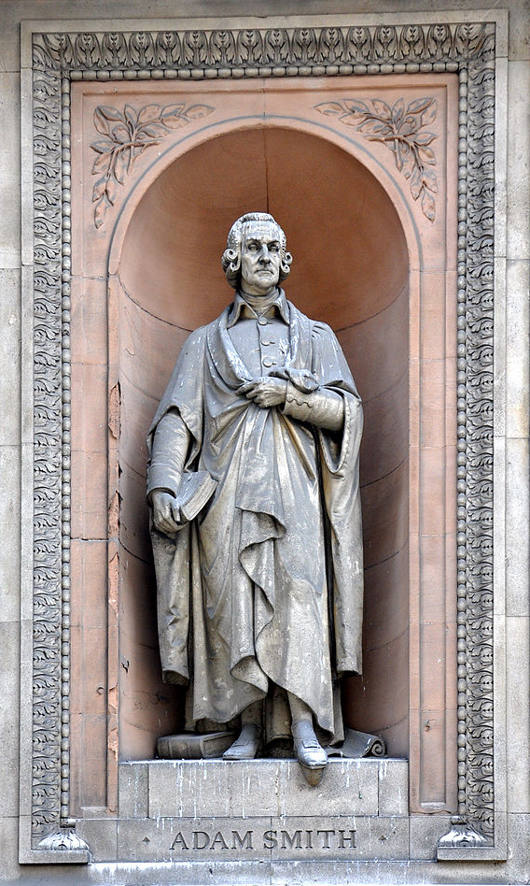
SMITH
Adam
The Father of Modern Economics
Photo by Andreas Praefcke

Slide 69
WEALTH
An Inquiry into the Nature and Causes of the
of
NATIONS
Photo by Andreas Praefcke

Slide 70
SELF- INTEREST
Rational
Photo by Andreas Praefcke

Slide 71
SELFISHNESS
Enlightened

Slide 72
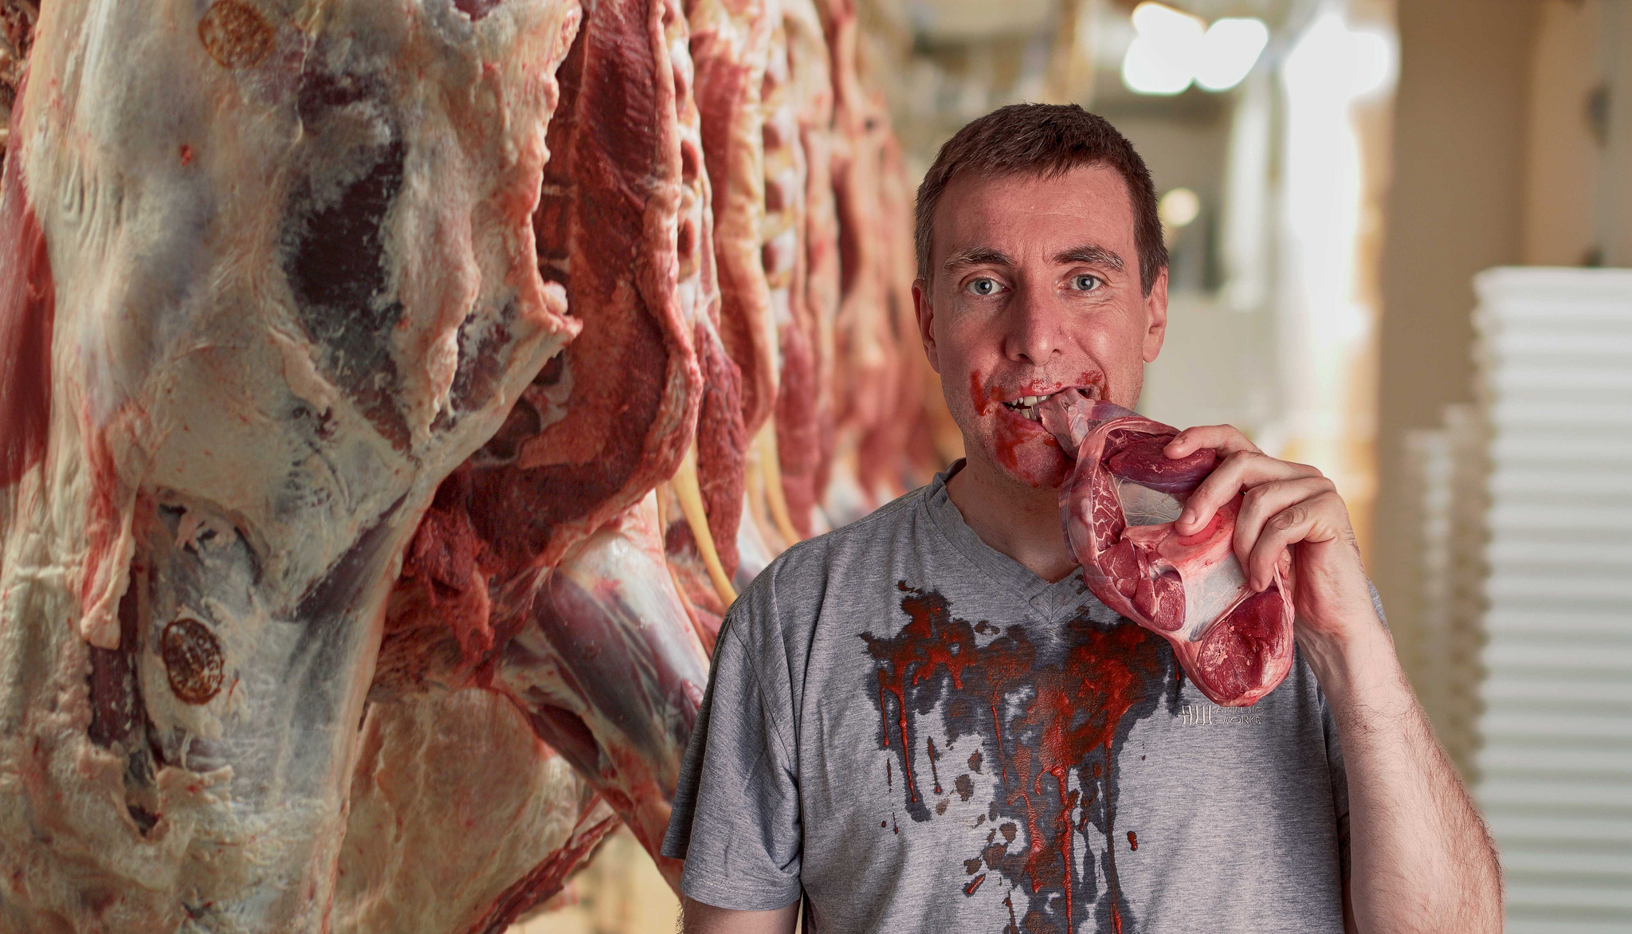
THE BUTCHER
Photo by David Blackwell.

Slide 73
“It is not from the benevolence of the butcher, the brewer, or the baker, that we expect our dinner, but from their regard to their own interest.”
Photo by David Blackwell.

Slide 74
MUTUALLY BENEFICIAL EXCHANGE
Photo by Andreas Praefcke

Slide 75
Self-love is the instrument of our preservation… it is necessary, it is dear to us, it gives us pleasure, and we must conceal it.
-- Voltaire

Slide 76
EMPIRICISM

Slide 77
NATURAL LAW
The Sufficiency of

Slide 78
THE AMERICAN ENLIGHTENMENT
Photo by Ed Uthman

Slide 79
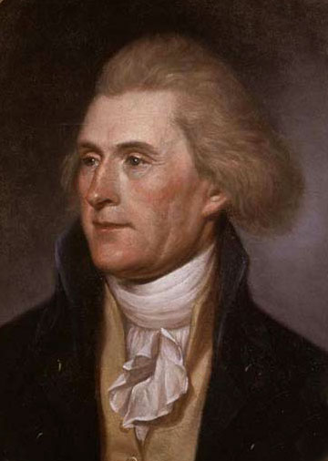
Thomas
JEFFERSON
Politician & Philosopher

Slide 80
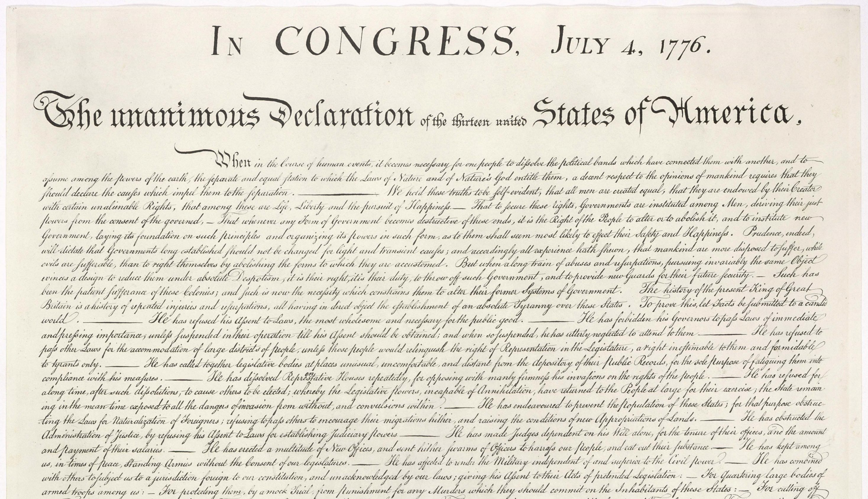

Slide 81
ALL MEN
ARE
CREATED EQUAL

Slide 82
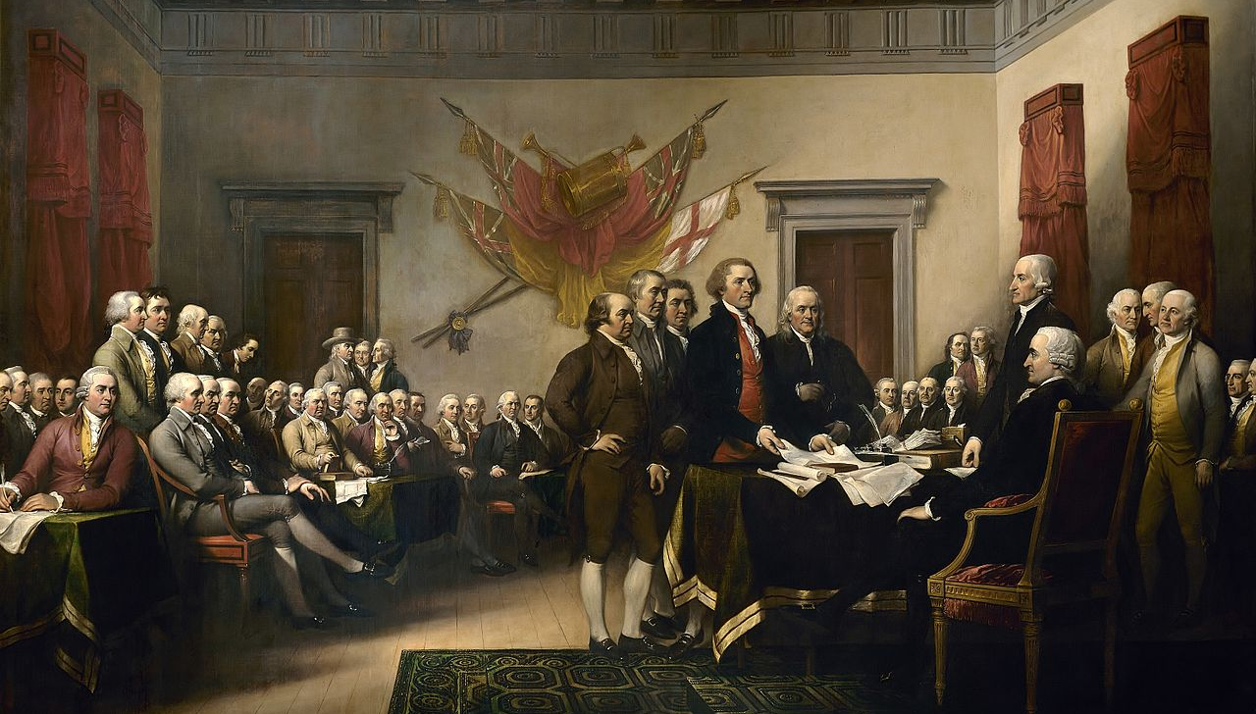
John Trumbull, The Declaration of Independence

Slide 83
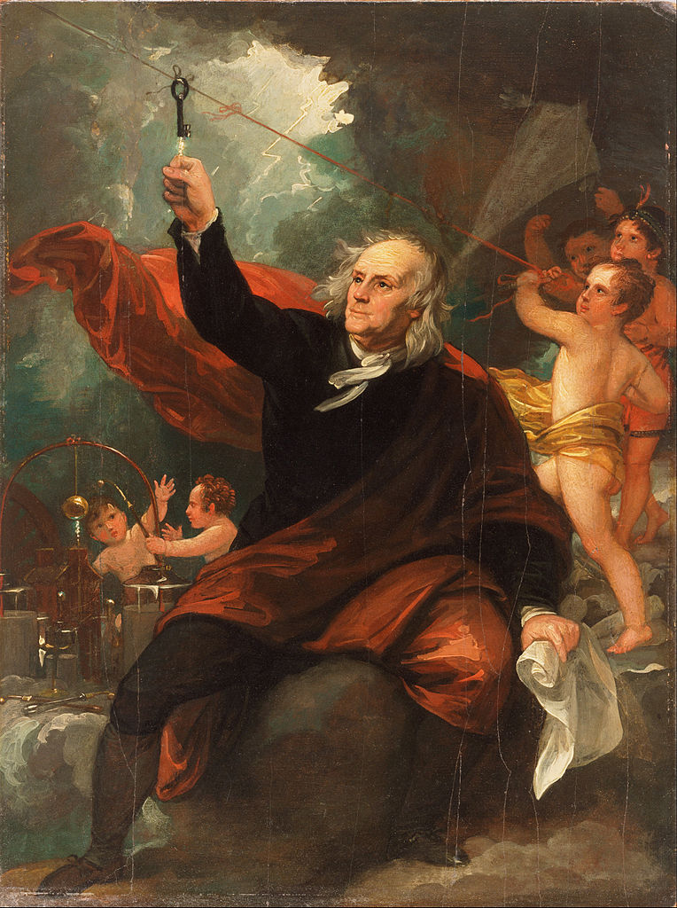
Benjamin
FRANKLIN
Politician & Inventor

Slide 84
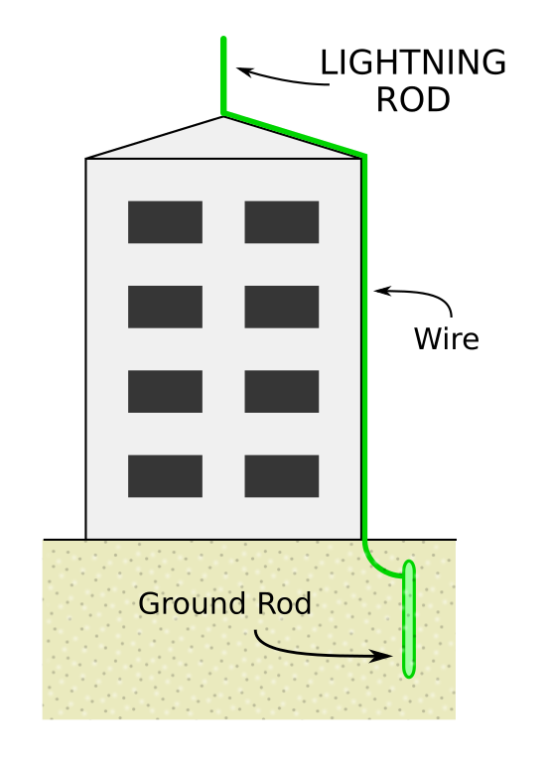
LIGHTNING ROD
Protects buildings from lightning
Art Credit: Wdchk

Slide 85
BIFOCALS
Photo by liz west

Slide 86
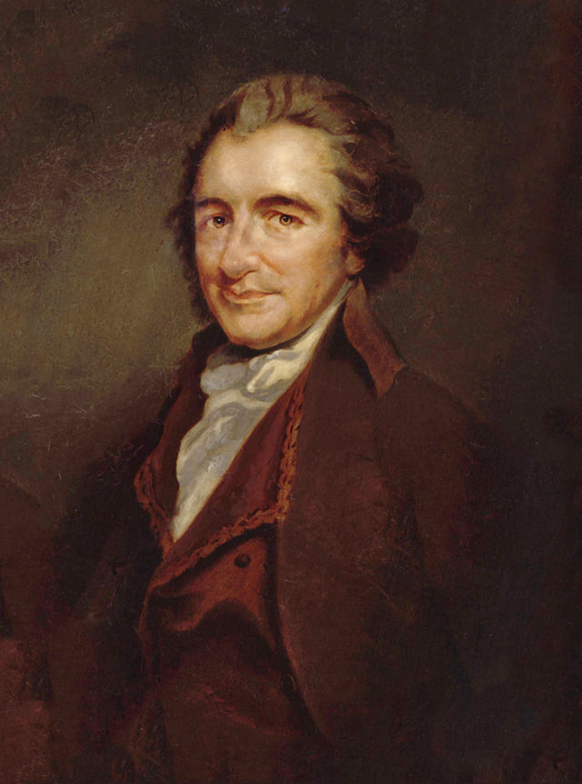
Thomas
PAINE
Professional Revolutionary

Slide 87
COMMON SENSE
THE RIGHTS OF MAN
THE AGE OF REASON

Slide 88
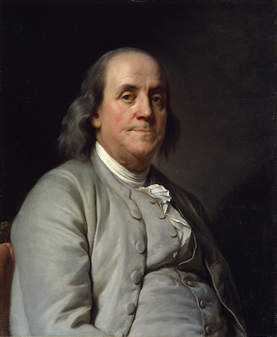
DEISTS

