Slide 1
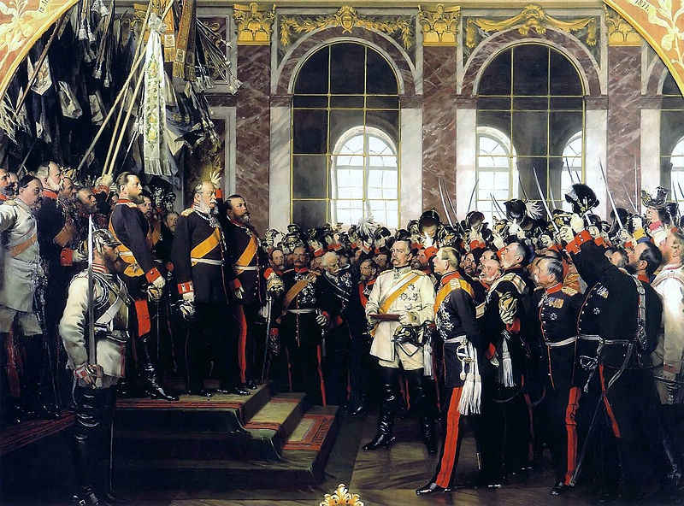

German
Unification
Co-Author: Paul Stewart

Slide 2
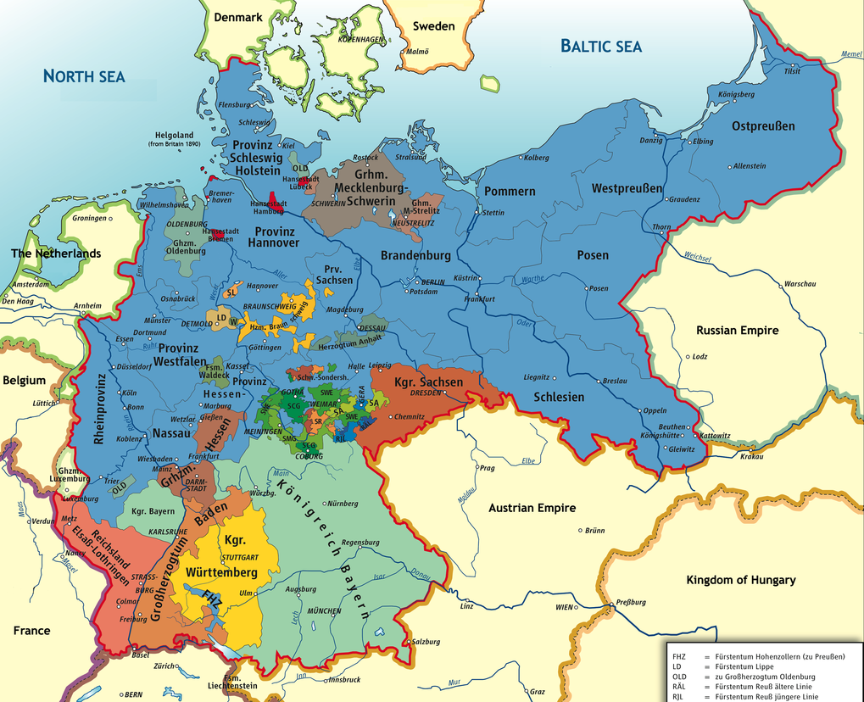
The single most important political development
in Europe between 1848 and 1914
Map Credit: kgberger

Slide 3
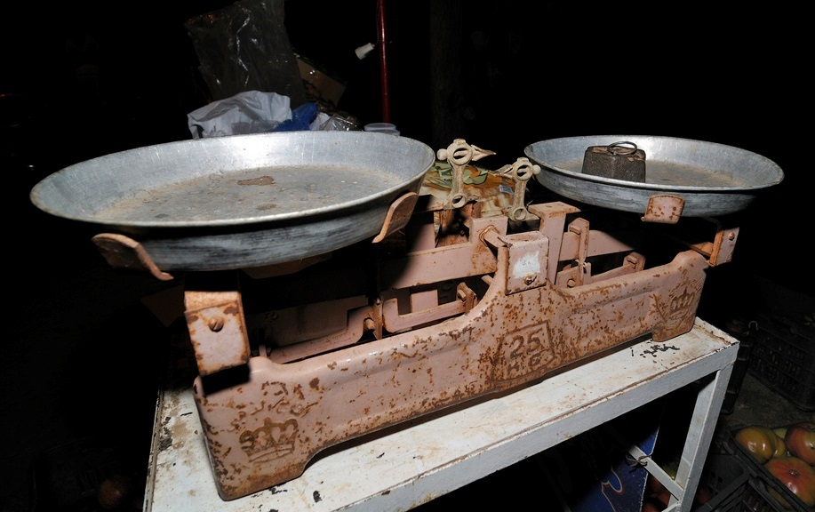
It fundamentally altered the
Balance of Power in Europe.
Some rights reserved by Serge Melki

Slide 4
A HISTORY
OF DIVISON

Slide 5
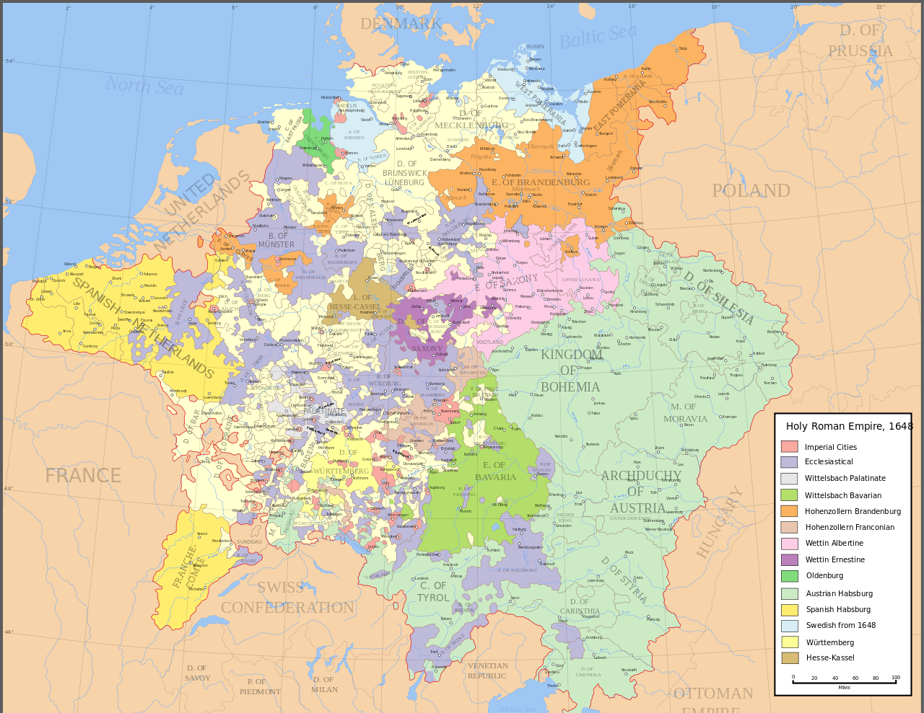
The Holy Roman Empire
962-1806
Several States
Frequent Wars
Map by Astrokey44 (Wikipedia)

Slide 6

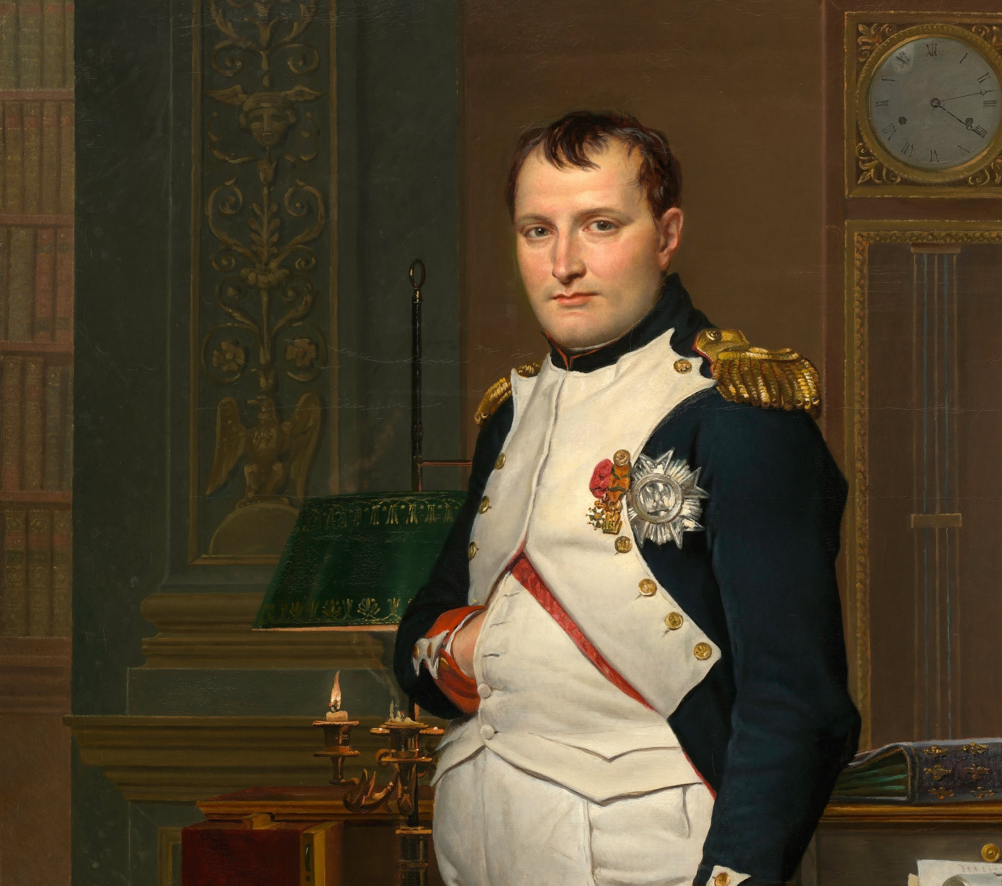
ABOLISHED
1806

Slide 7
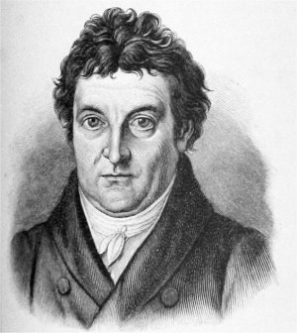
GERMAN NATIONALISM
“The first, original, and truly natural boundaries of states are beyond doubt their internal boundaries. Those who speak the same language are joined to each other by a multitude of invisible bonds by nature herself, long before any human art begins; they understand each other... they belong together and are by nature one and an inseparable whole.”
-- Johann Gottlieb Fichte

Slide 8
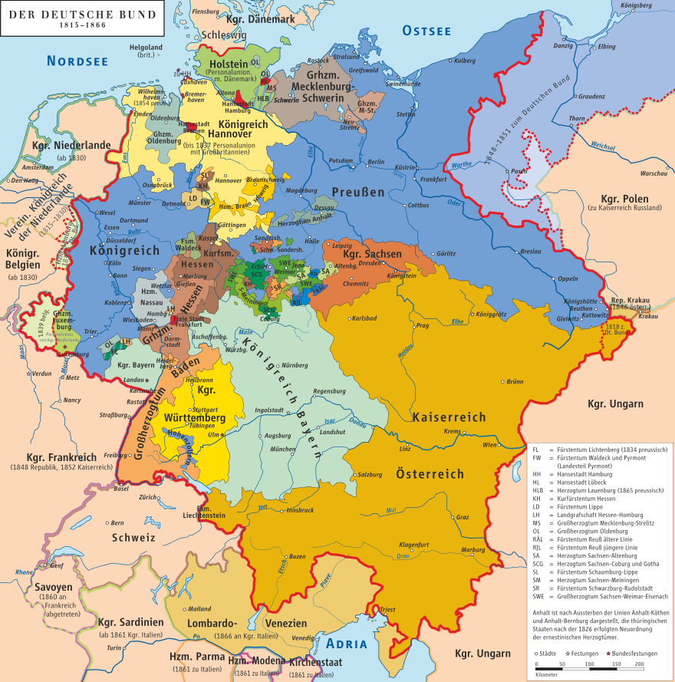
The German Confederation
Association of
39
German States
Map by kgberger

Slide 9
PRUSSIA
Austria
WHO WILL DOMINATE?
Map by kgberger

Slide 10
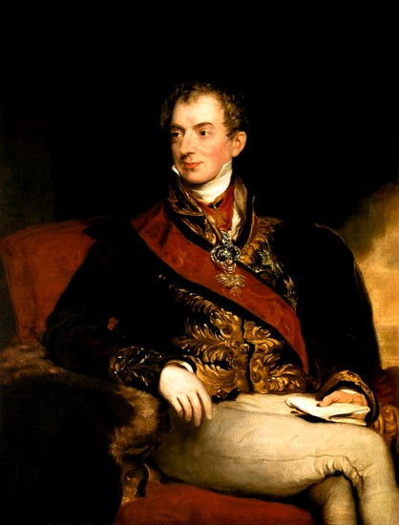
Austrian
Dominance
The Congress of Vienna established Austria
as the dominant German state.

Slide 11

PRUSSIAN
ASCENDANCE
Modern Industrialized Military
State
Some Rights Reserved by David Liuzzo

Slide 12
PRUSSIA
Austria
How to unify?
Map by kgberger

Slide 13
TWO MODELS
FOR UNIFICATION
BIG GERMANY (GROSSDEUTSCHLAND)
INCLUDES Austria

Slide 14
TWO MODELS
FOR UNIFICATION
BIG GERMANY (GROSSDEUTSCHLAND) | Small Germany (Kleindeutschland)
INCLUDES Austria | EXCLUDES Austria

Slide 15
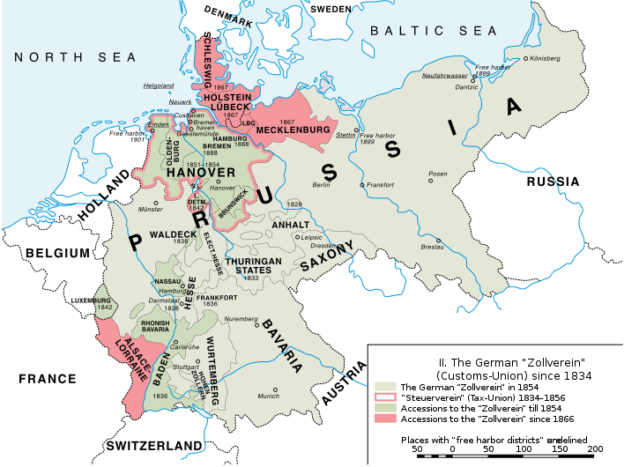
Zollverein
German
Free Trade
Agreement

Slide 17
Economic Union
Political Union
The Zollverein was the first agreement of its kind in Europe.

Slide 18
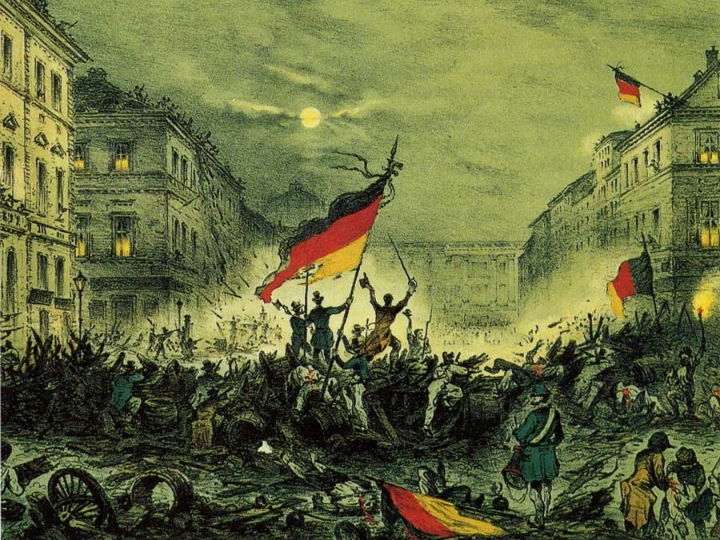
Revolutions of 1848
Nationalists & Liberals

Slide 19
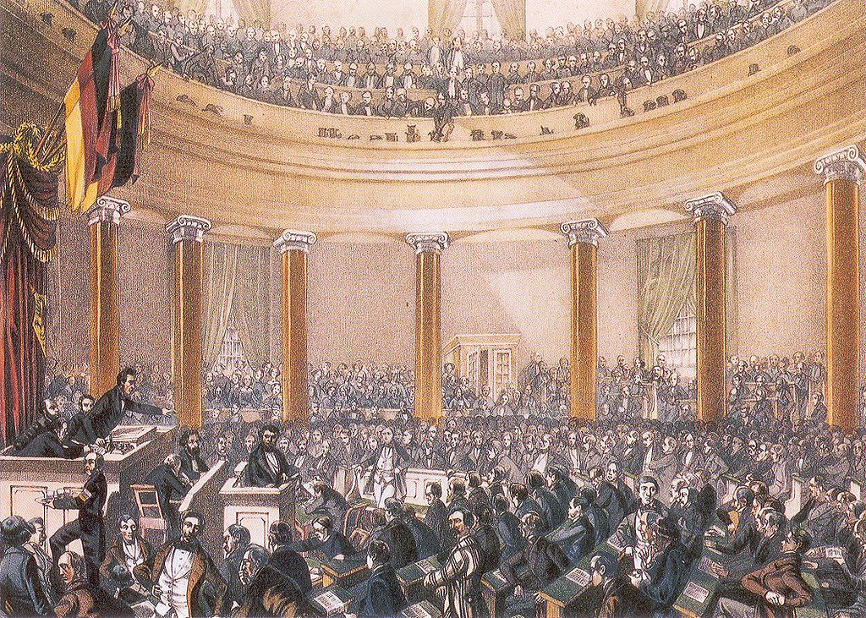
Frankfurt
Parliament
(1848)

Slide 20
PAN-GERMAN PARLIAMENT

Slide 21
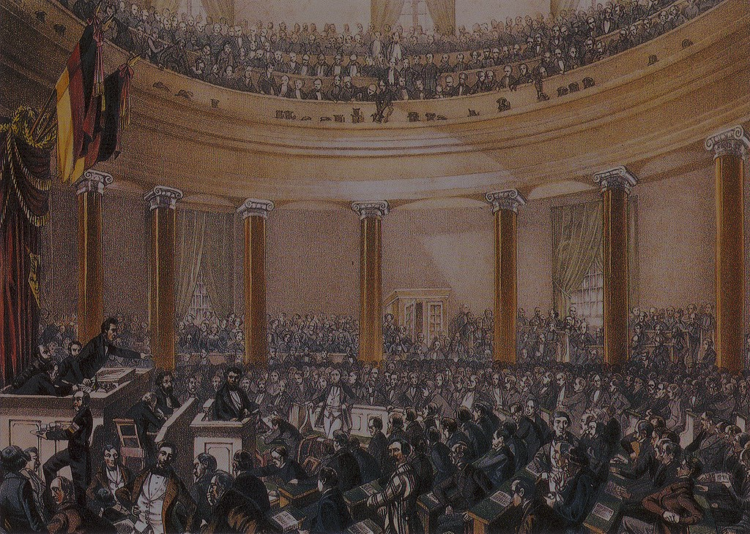
The Frankfurt Parliament drafted a
Constitution
for a unified Germany.

Slide 22
Constitutional
Monarch
Staatenhaus
Volkshaus

Slide 23
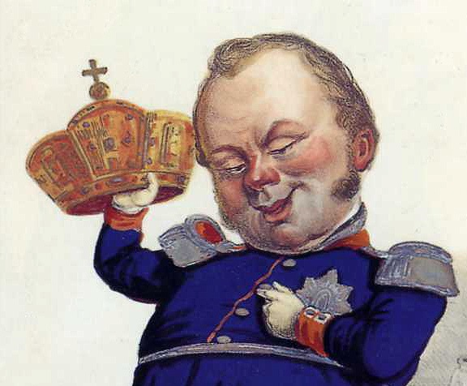
Should I?
Frederick William IV
of Prussia

Slide 24
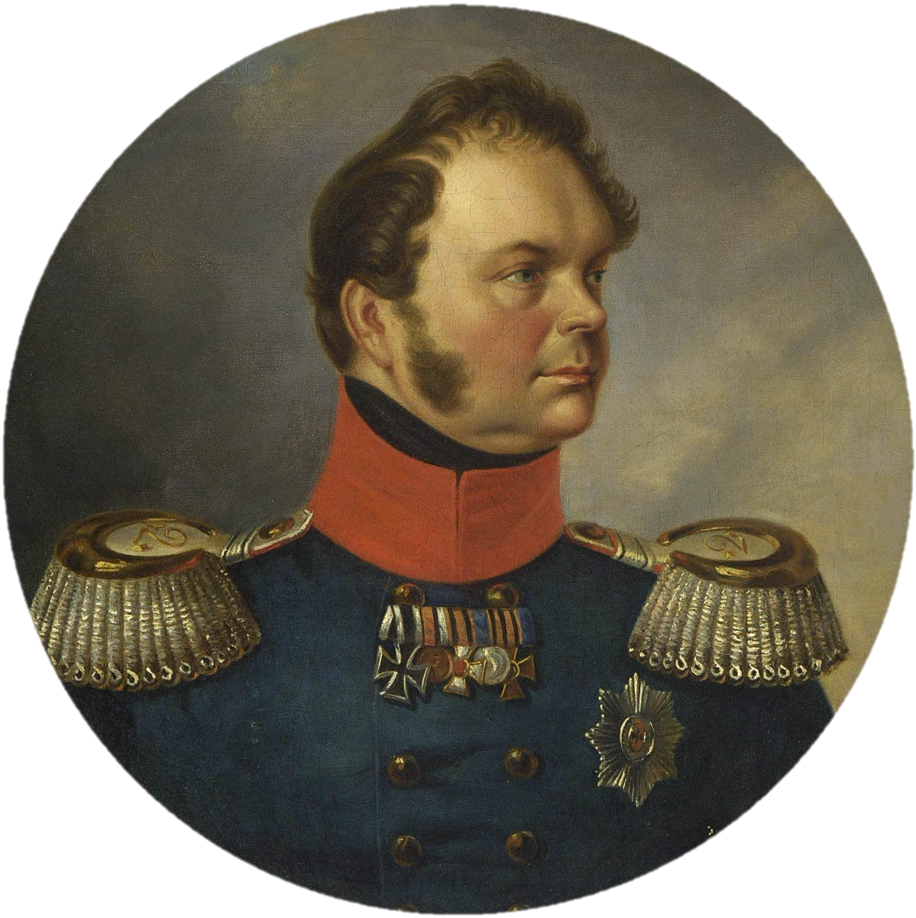
NO THANKS

Slide 25

PIG’S
CROWN
Photo by Tiffany Terry Some Rights Reserved (2.0)

Slide 26
FAIL

Slide 27
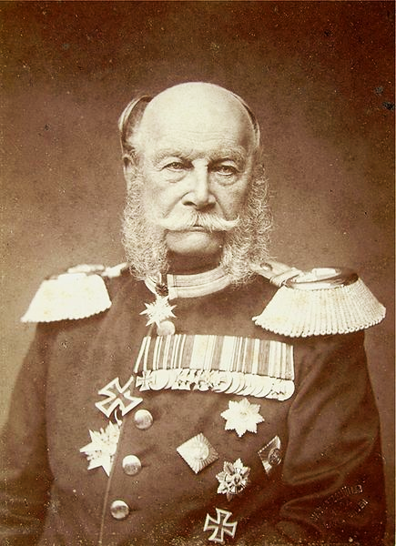
Kaiser
William I
Appointed Otto von Bismarck as Prime Minister

Slide 28
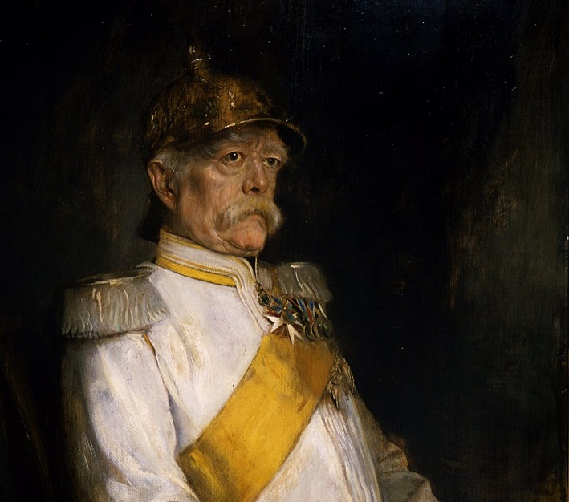

Otto von Bismarck
Ministerpräsident
of Prussia
1862-1873

Slide 29


GOAL:
A strong, unified German State under Prussian dominance

Slide 30

CONSERVATIVE
Photo by le vent le cri (cc 2.0)

Slide 31

Realpolitik
Photo by *Light Painting* (cc 2.0)

Slide 32
POLITICS BASED ON
power
rather than ideals.

Slide 33
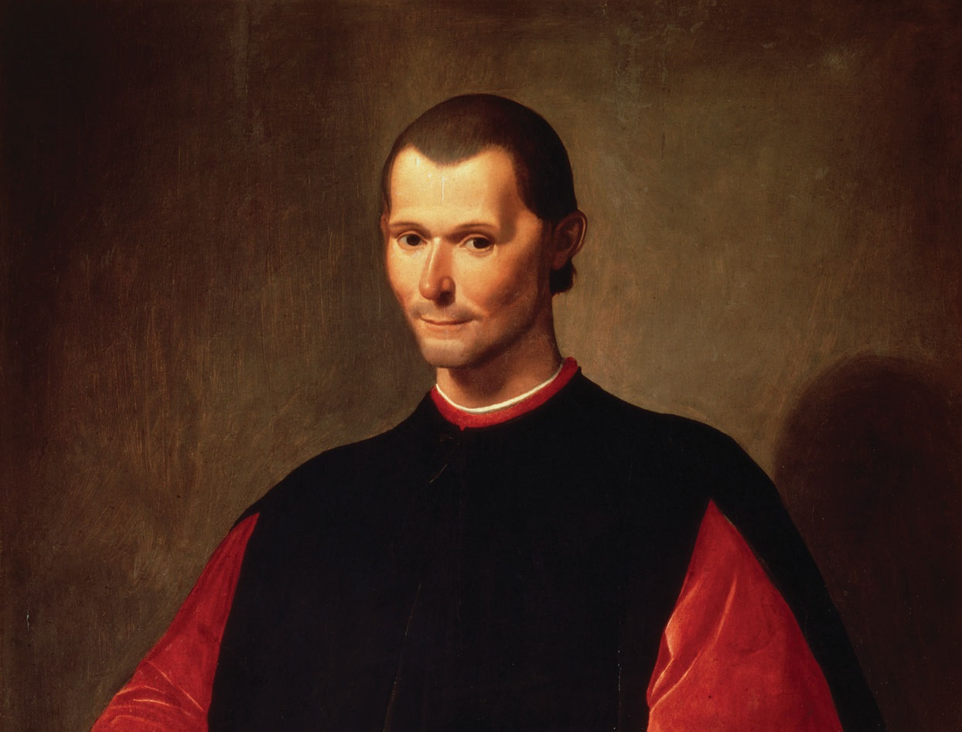
I can Dig It.

Slide 34
ISMS

Slide 35
Idealistic
=
Unrealistic

Slide 36
DOMESTIC policy

Slide 37
Socialism is a Threat

Slide 38
realpolitik
“State Socialism”
BAN Social Democratic Party & Socialist Political Propaganda

Slide 39
realpolitik
“State Socialism”
BAN Social Democratic Party & Socialist Political Propaganda | Sponsor Europe’s First Social Welfare Programs

Slide 40

Old Age Pensions

Slide 41

ACCIDENT INSURANCE

Slide 42

Health Insurance

Slide 43
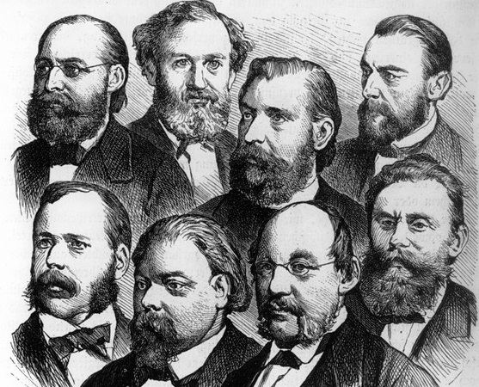
LIBERALS

Slide 44
I got this

Slide 45
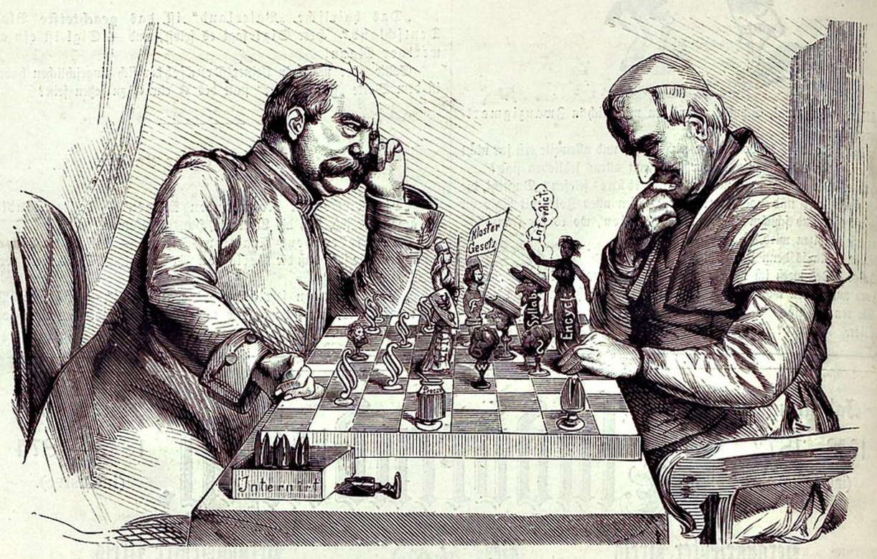
Kulturkampf

Slide 46
Bismarck’s anti-Catholic policies appealed to anticlerical liberals who were otherwise turned off by his authoritarian conservatism.

Slide 47

Industrialization
Liberals were also placated by Bismarck’s support of industrialization.

Slide 48
FOREIGN policy

Slide 49
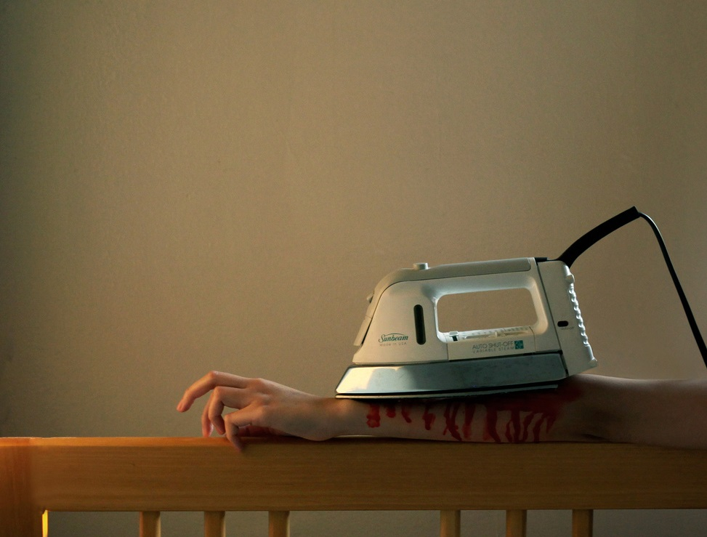
BLOOD & IRON
Photo © Andrea Pun Used with Permission

Slide 50
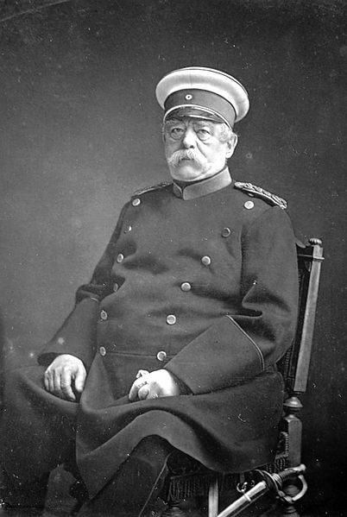
BLOOD & IRON
"The position of Prussia in Germany will not be determined by its liberalism but by its power... Prussia must concentrate its strength and hold it for the favorable moment... Not through speeches and majority decisions will the great questions of the day be decided...

Slide 51
BLOOD & IRON
“but by iron and blood.”
-- Otto von Bismarck (1862)

Slide 52

WARS OF GERMAN UNIFICATION
Schleswig Wars | Established German dominance over German-speaking territories
Austro-Prussian War | Established Prussia as dominant German state
Franco-Prussian War | United Northern and Southern Germany

Slide 53
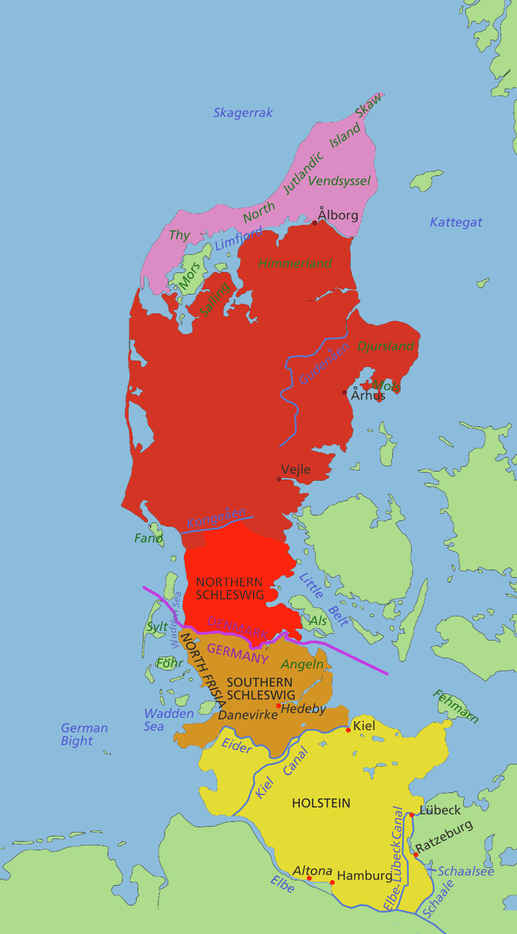
Schleswig Wars
Prussia & Austria vs.
Denmark

Slide 54
Schleswig Wars
Fought on the pretense
of liberating pockets of ethnic Germans under Danish control

Slide 55
Schleswig
Administered by Prussia
HOLSTEIN
Administered by Austria

Slide 56
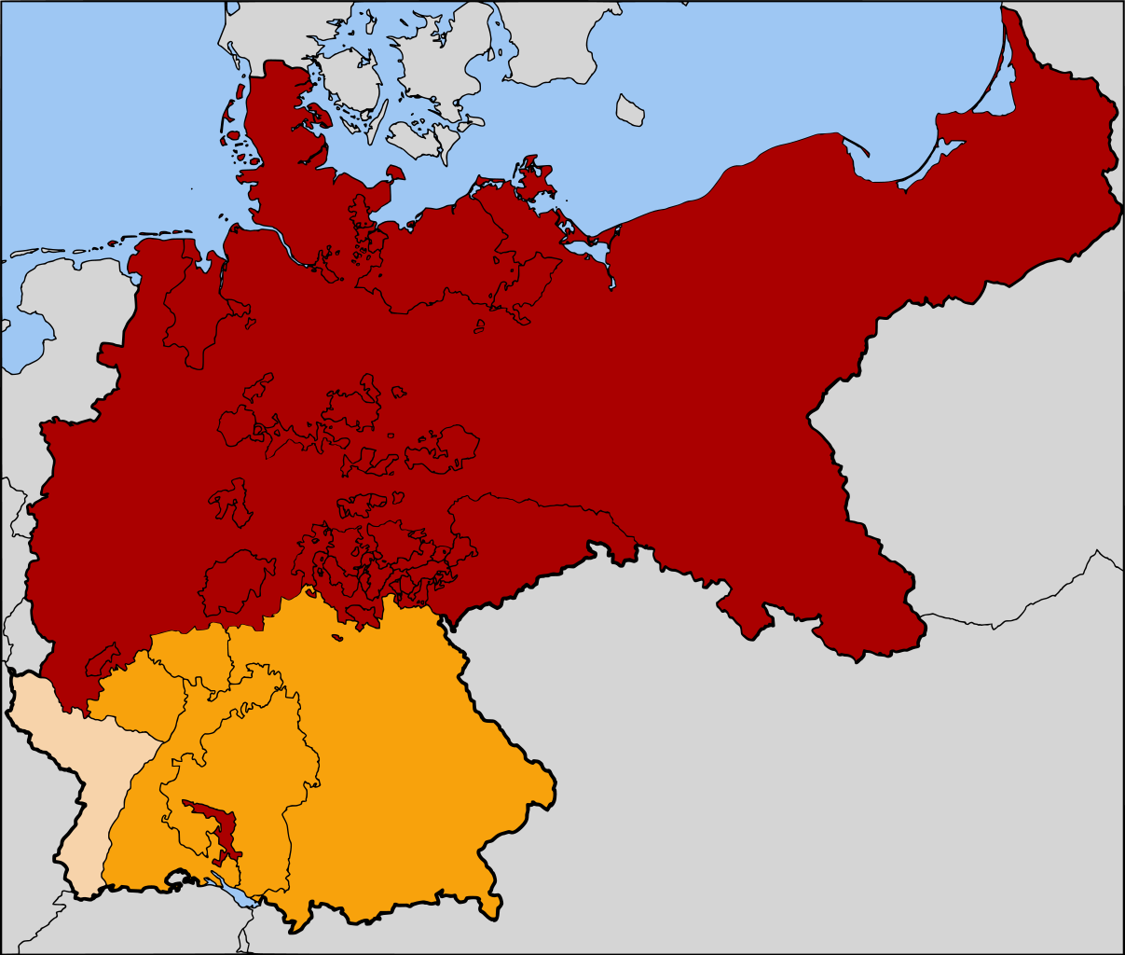
North German Confederation
Map Credit: 52 Pickup (Wikipedia)

Slide 57
Prussia annexed several smaller German states.
South German states resisted Prussian dominance.
Map Credit: 52 Pickup (Wikipedia)

Slide 58
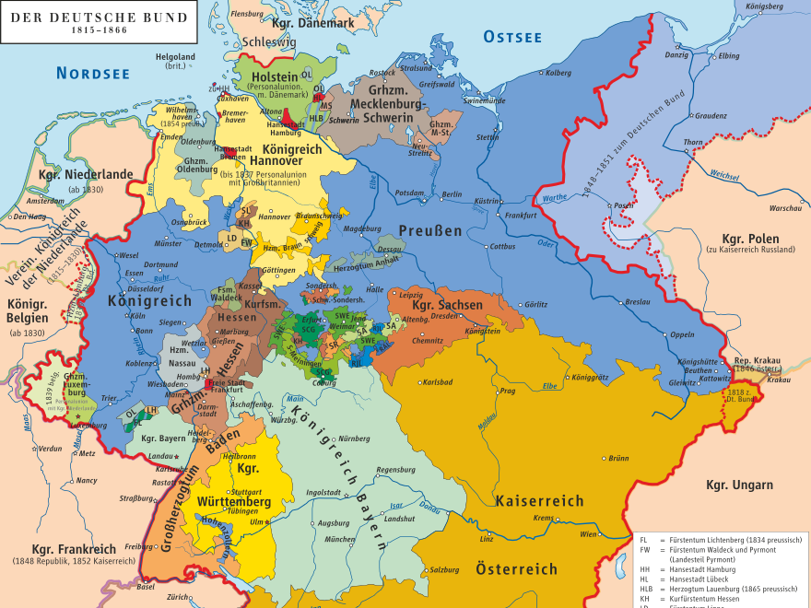
AND THEN THERE WERE TWO
Map by
kgberger

Slide 59

PRUSSIA
austria
Map by
kgberger

Slide 60
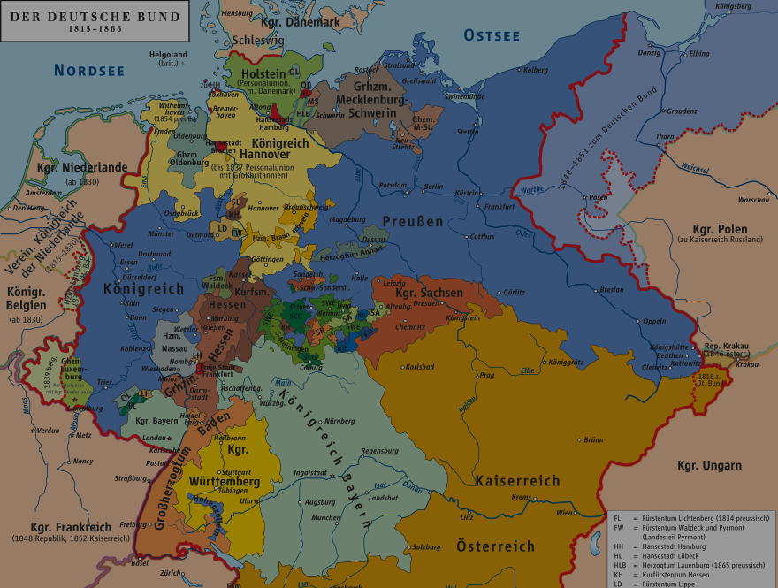
PRUSSIA
WHO WILL DOMINATE?
austria
Map by
kgberger

Slide 61
PRUSSIA
austria
Map by
kgberger

Slide 62
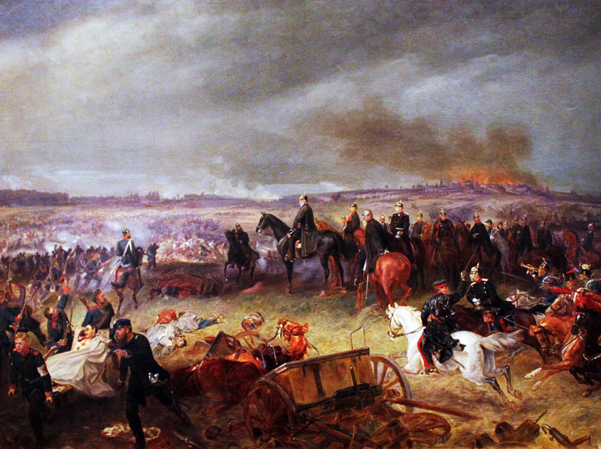
Austro-Prussian War
1866
Georg Bleibtreu, Battle of Königgrätz (1869)

Slide 63
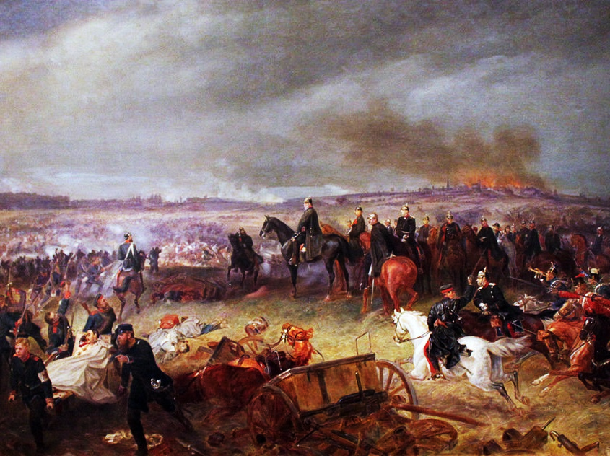
7 weeks
Georg Bleibtreu, Battle of Königgrätz (1869)

Slide 64
#winning

Slide 65
Kleindeutschland

Slide 66
Map by
kgberger

Slide 67
losers
Map Credit: 52 Pickup (Wikipedia)

Slide 68
Predominantly Catholic Southern German states had sided with Austria.
Map Credit: 52 Pickup (Wikipedia)

Slide 69
HOW Will Germany be Unified?

Slide 70
BLOOD & IRON
Photo © Andrea Pun Used with Permission

Slide 71
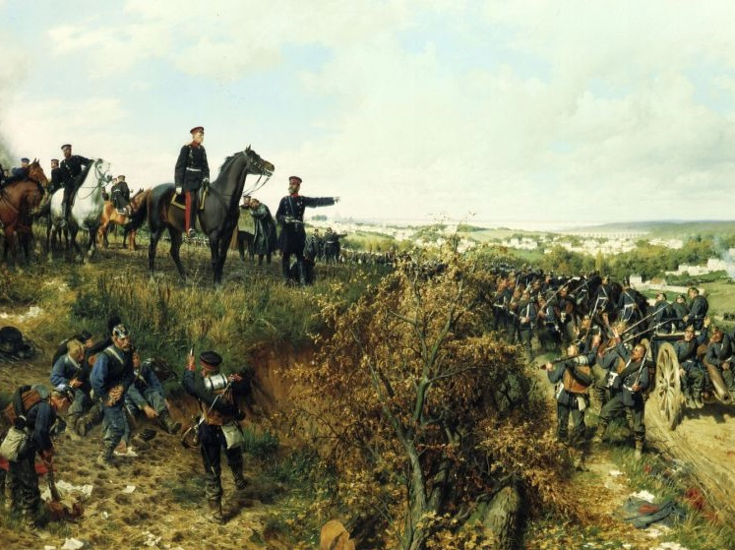
Franco-Prussian War
1870-1871
Anton von Werner - Moltke and his staff near Paris

Slide 72
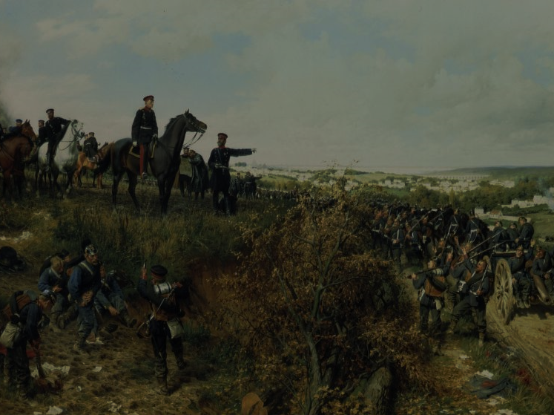
A war to unite
Germany

Slide 73
BLOOD & IRON
"I always considered that a war with France would naturally follow a war against Austria... I was convinced that the gulf which was created over time between the north and the south of Germany could not be better overcome than by a national war... I did not doubt that it was necessary to make a French-German war before the general reorganization of Germany could be realized.”
-- Otto von Bismarck (Memoirs)

Slide 74
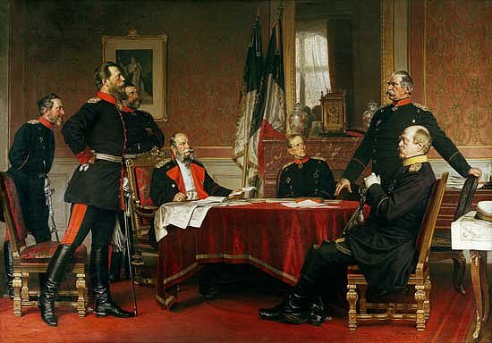
SUPERIOR Technology and ORGANIZATION
The Prussian army, with its efficient General Staff, employed railroads and artillery more effectively than the French.
Bismarck and the Prussian General Staff

Slide 75
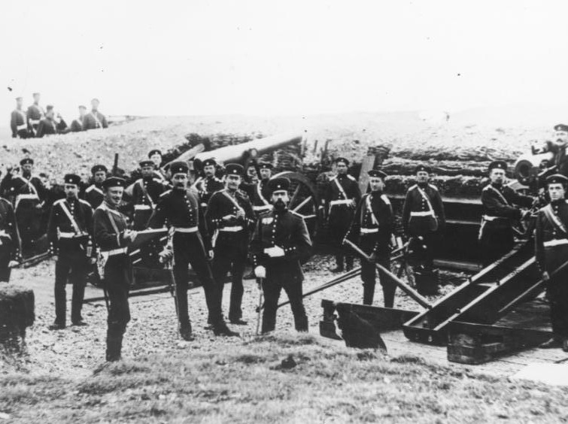
Prussian Artillerymen
German Federal Archive

Slide 76
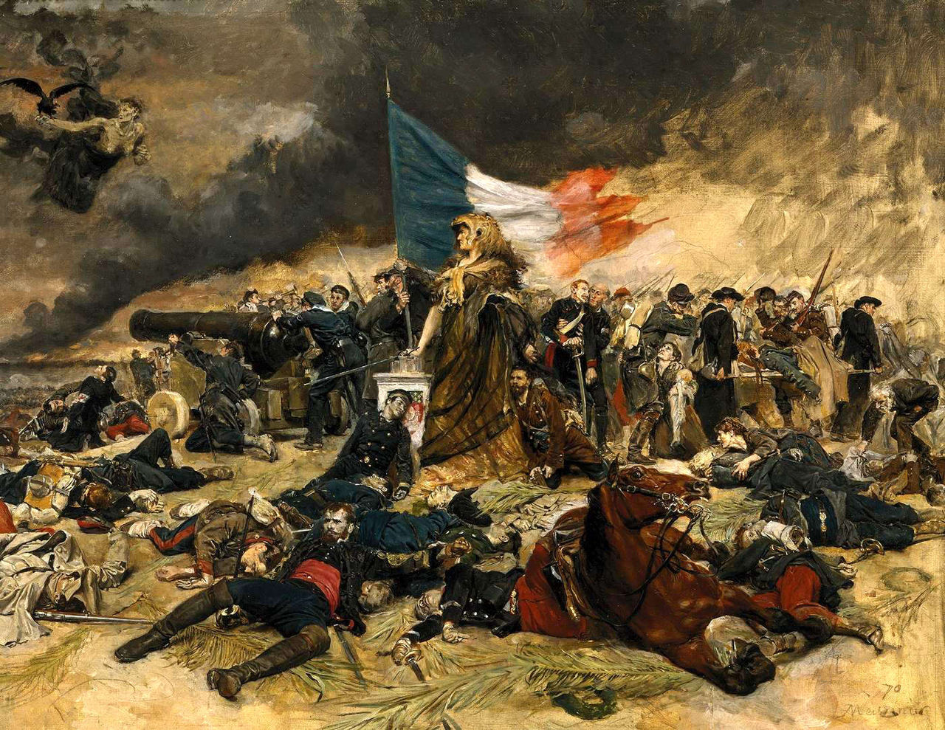
Siege of Paris
Sep. 1870 –
Jan. 1871

Slide 77
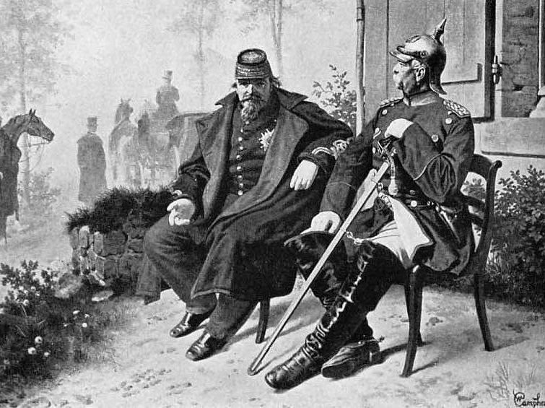
PRUSSIA WINS
Bismarck chillin’ with POW Napoleon III

Slide 78
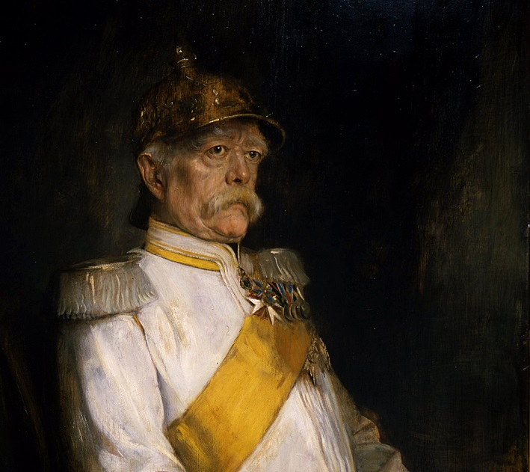

CHANCELLOR
OF Germany

Slide 79
Proclamation of the German Empire
Hall of Mirrors (Versailles)

Slide 80
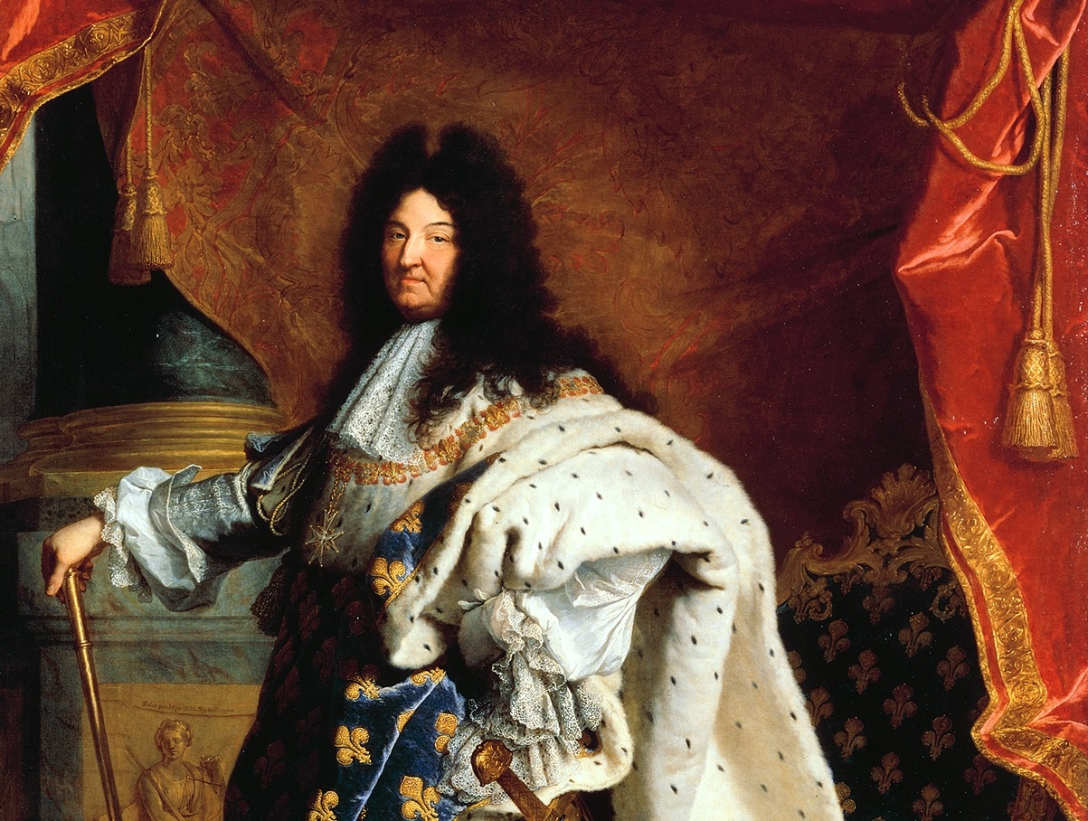
#SMH

Slide 81
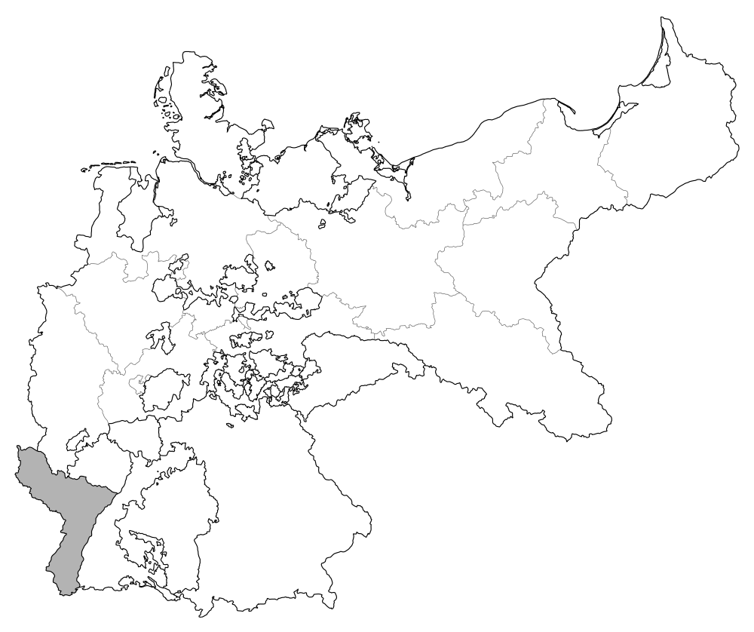
Annexation of Alsace-Lorraine
Map Credit: David Liuzzo

Slide 82
Alsace-Lorraine included many French speakers, and many German speakers there resented annexation into the Empire.
Map Credit: David Liuzzo

Slide 83

reparations
5,000,000,000 ₣
Photo by Marcel Grieder (cc 2.0)

Slide 84
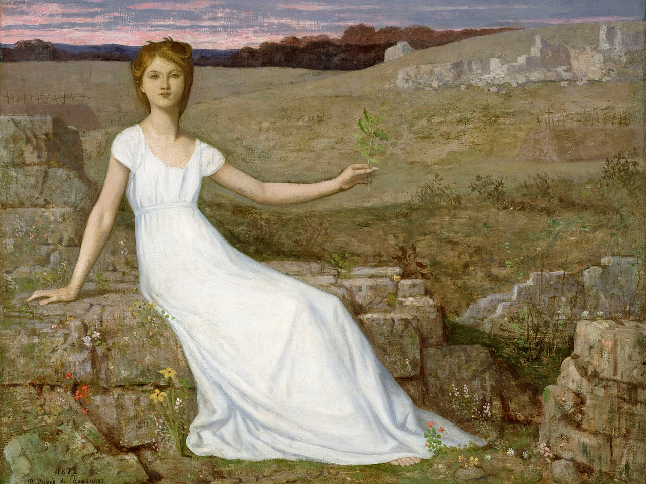
Pierre Puvis de Chavannes, Hope (1872)

Slide 85
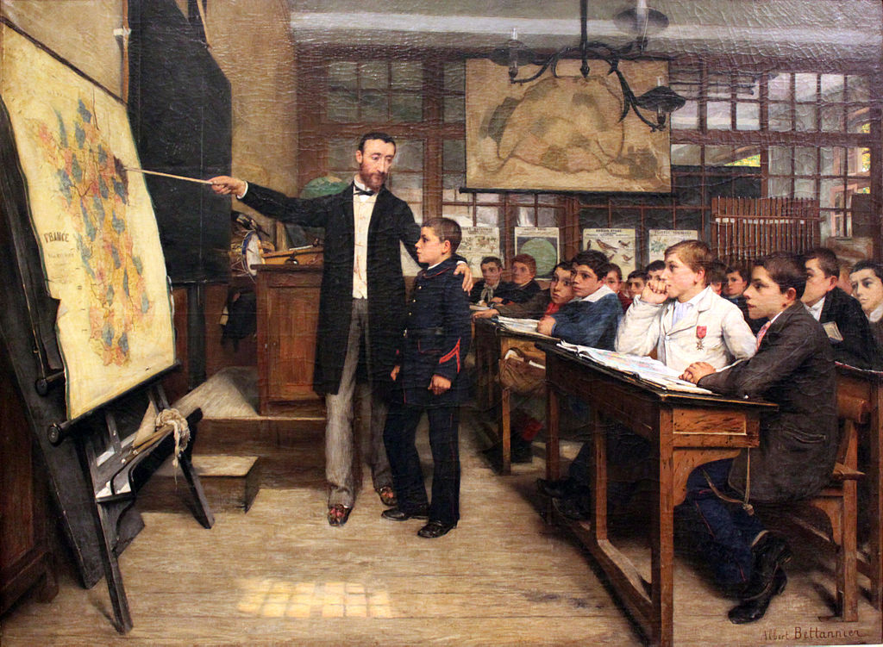
Albert Bettannier, The Black Spot (1887)

Slide 86
We’ll stick it to the Germans next time.
Pierre Puvis de Chavannes, Hope (1872)

Slide 87
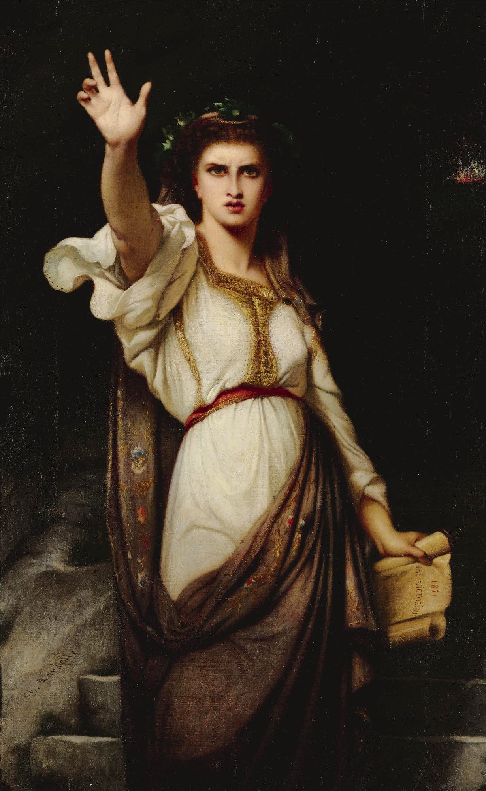
WOE TO THE VICTORS
Charles Zacharie Landelle, 1871

Slide 88
Timeline
of German Unification
1815 | German Confederation Created
1848 | Frankfurt Parliament
1864 | Second Schleswig War
1866 | Austro-Prussian War
1870 | Franco-Prussian War
1871 | German Empire Proclaimed

Slide 89
Auf Wiedersehen!
Some rights reserved by Serge Melki

Slide 90
(Goodbye)
Some rights reserved by Serge Melki

Slide 91







