Slide 1

ROMEBOOK
ANCIENT HISTORY
MEETS MODERN
SOCIAL NETWORKING
This project has been produced and is freely distributed for educational use based on the Facebook® social networking platform.

Slide 2
SAMPLE
PROJECT
This sample is designed to give students an idea of what their finished projects should look like.

Slide 3

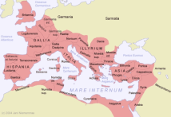
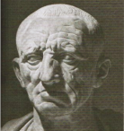

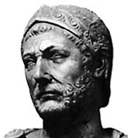
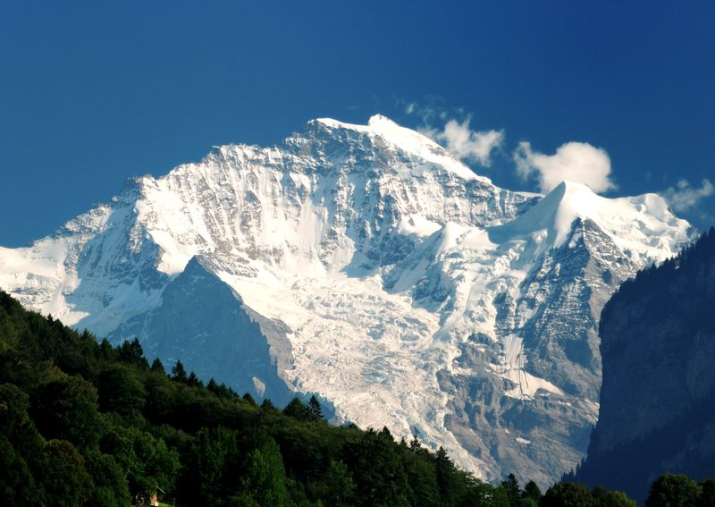

ROMEBOOK
CATO THE ELDER
domvs
News Feed
LOGOVT
CATO THE ELDER
Senate observer Some old guy keeps going on about how we need to destroy Carthage…
UNLike Comment 150 B.C.
You and 24 others Like This
FAVORITES
News Feed
Messages
Groups
Hannibal added one new photo to the album Alps
Like Comment 218 B.C.
NO ONE IN ROME like(s) this
Greece Sucks!!!
Old FashionED…
REAL ROMANS

Slide 4
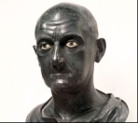
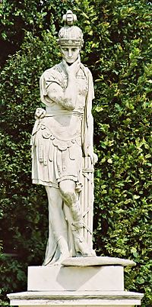
ROMEBOOK
Cato the elder
domvs
MESSAGES
LOGOVT
Cato the elder
Polybius Thanks for getting me out of jail! | 152 B.C.
Scipio Africanus Y U ALWAYS B HATIN??? | 185 B.C.
Lucius Valerius Flaccus Congrats on your election as consul! I look forward to serving with you this year. | 195 B.C.
QUINTUS FABIUS MAXIMUS It was an honor to meet such a fine young Roman as yourself. I will be watching your career closely. | 209 B.C.
FAVORITES
News Feed
Messages
Groups
Greece Sucks!!!
Old FashionED…
REAL ROMANS

Slide 5
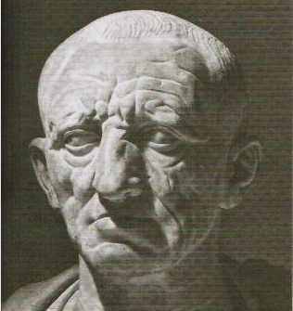


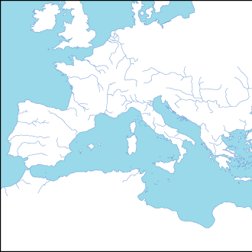
ROMEBOOK
CATO THE ELDER
domvs
LOGOVT
Cato the Elder
Created By:
Tom Richey
Consul & Censor at the Roman Republic
Studied Agriculture at the Family Farm
Lives in Rome
Married
IMAGINES
VIII
BONI
CHARTA
v
ABOVT
AMICI
Cato the Elder Incessantly
Carthago delenda est.
Like Comment
Scipio Aemilianus like(s) this
Scipio Aemilianus I’m working on it!
PIC
Quintus Fabius Maximus
Roman Republic
PIC
Lucius Valerius Flaccus
Roman Republic
QUINTUS ENNIUS
Roman Republic

Slide 6
ROMEBOOK
CATO THE ELDER
domvs
LOGOVT
Cato the Elder
abovt
abovt
I am the Censor of Rome and have previously served as consul. I am a Novus Homo, being the first person in my family to serve as a consul.
History by year
234 B.C. | Born
217 B.C. | Began Military Service in Second Punic War
198 B.C. | Elected Praetor
195 B.C. | Elected Consul
194 B.C. | Awarded a Triumph
184 B.C. | Elected Censor
149 B.C. | Death
BASIC INFORMATION
BORN | 234 B.C.
SEX | Male
RELATIONSHIP STATUS | Married
RELIGIOUS VIEWS | Roman
POLITICAL VIEWS | Roman
CLASS | plebeian
qvotation
“The Worst Ruler is one who cannot rule himself.”

Slide 7


ROMEBOOK
CATO THE ELDER
domvs
LOGOVT
Cato the Elder
charta
Map Credit: http://ja.wikipedia.org...Blank_Roman_Empire.png

Slide 8
ROMEBOOK
CATO THE ELDER
domvs
LOGOVT
Cato the Elder
BONI
interests
Destroying Carthage
The Old Roman Virtues
Hating on Hellensim
Inspirational people
Fabius Maximus, Lucius Junius Brutus
books
Anything Roman, Nothing Greek

Slide 9
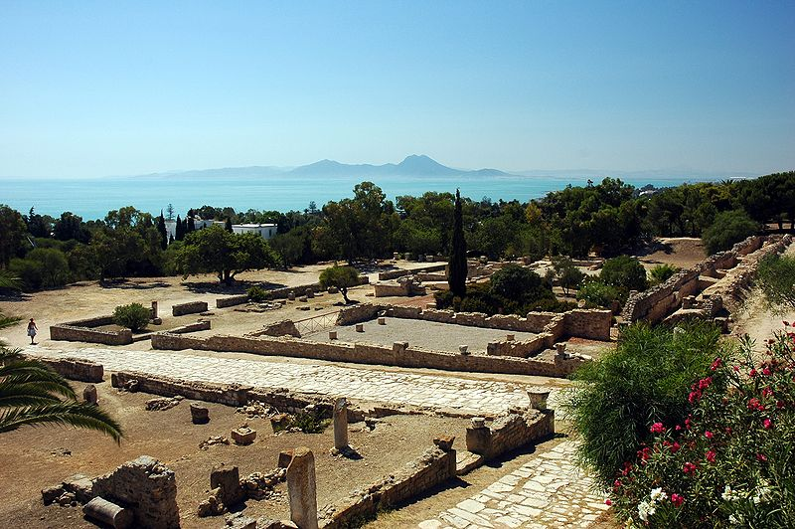
PHOTO I
ROMEBOOK
Cato the Elder
domvs
Cato the Elder 146 B.C. (Posthumously)
The ruins of Carthage… Probably my favorite picture ever.
Like Comment SHARE
______________ like(s) this
Comment
Comment

Slide 10
PHOTO II
ROMEBOOK
Cato the Elder
domvs
Cato the Elder 217 B.C.
A statue of my mentor, Fabius Maximus. LOVE THIS GUY!
Like Comment SHARE
______________ like(s) this
Comment
Comment

Slide 11
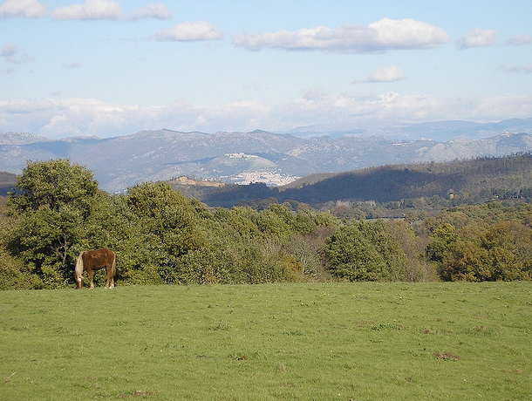
PHOTO III
ROMEBOOK
Cato the Elder
domvs
Cato the Elder date
This is a farm. I love farms.
Like Comment SHARE
______________ like(s) this
Comment
Comment

Slide 12
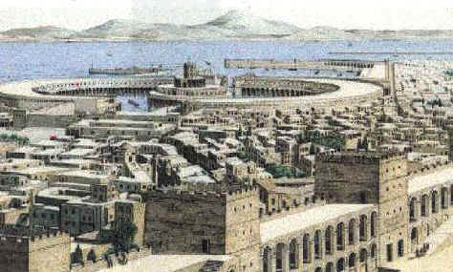
PHOTO IV
ROMEBOOK
Cato the Elder
domvs
Cato the Elder 157 B.C.
Carthage. Someone really should get around to destroying this… I’ll remind you again in an hour.
Like Comment SHARE
______________ like(s) this
Comment
Comment
Iv
PASTE
Photo Iv
here

Slide 13
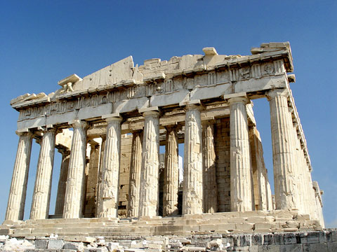
PHOTO V
ROMEBOOK
Cato the Elder
domvs
Cato the Elder 191 B.C.
I visited Athens, once. I was not impressed with anything I saw there.
Like Comment SHARE
______________ like(s) this
Comment
Comment
v
PASTE
Photo v
here

Slide 14

PHOTO VI
ROMEBOOK
Cato the Elder
domvs
Cato the Elder date
Plutarch’s Lives. I’m in here! That makes me kind of a big deal, even though Plutarch compares me to a Greek!
Like Comment SHARE
Plutarch like(s) this
Comment
Comment
vI
PASTE
Photo vI
here

Slide 15
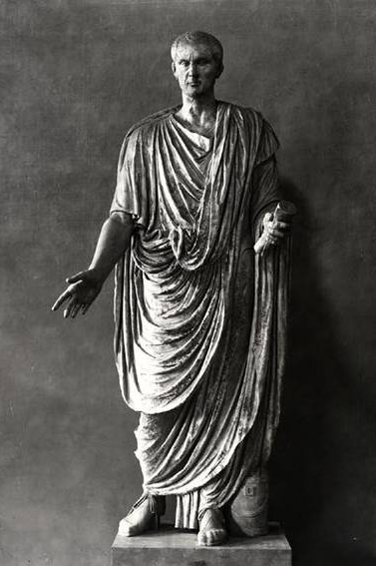
PHOTO VII
ROMEBOOK
Cato the Elder
domvs
Cato the Elder date
“After I'm dead I'd rather have people ask why I have no monument than why I have one.” -- Me
Like Comment SHARE
______________ like(s) this
Comment
Comment
vii
PASTE
Photo vii
here

Slide 16
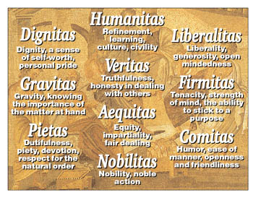
PHOTO VIII
ROMEBOOK
Cato the Elder
domvs
Cato the Elder date
The Old Roman virtues – Hellenism’s got nothin’ on these!
Like Comment SHARE
Fabius Maximus like(s) this
Comment
Comment
viiI
Post
Photo viiI
here

Slide 17

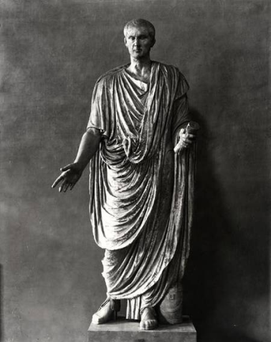
ROMEBOOK
CATO THE ELDER
domvs
LOGOVT
Cato the Elder
IMAGINES
Ruins of Carthage
Fabius Maximus
A Farm
Carthage
Visit to Athens
Books
I’m in
A Statue
of Me
Virtues!

Slide 18







