Slide 1
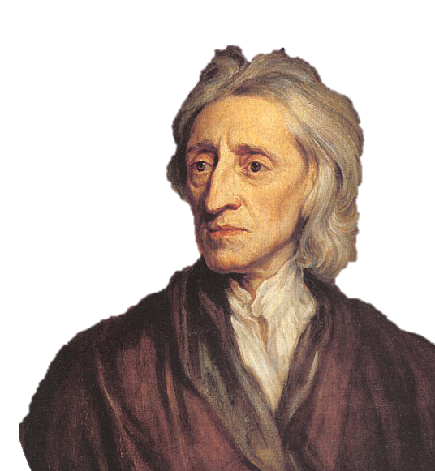
English Traditions of Government
US History
EOC Review

Slide 2
USHC 1.2
Analyze the early development of representative government and political rights in the American colonies, including the influence of the British political system and the rule of law as written in the Magna Carta and the English Bill of Rights, and the conflict between the colonial legislatures and the British Parliament over the right to tax that resulted in the American Revolutionary War.

Slide 3
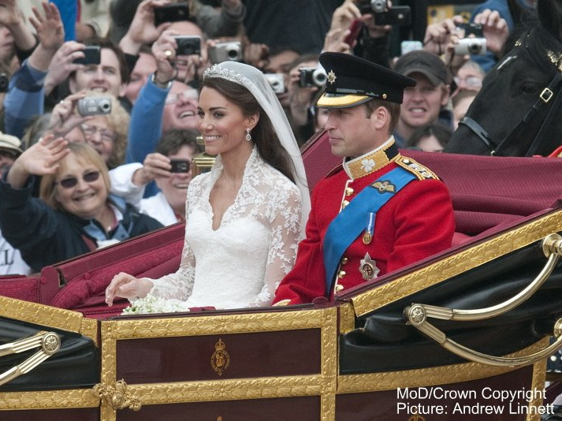

Slide 4
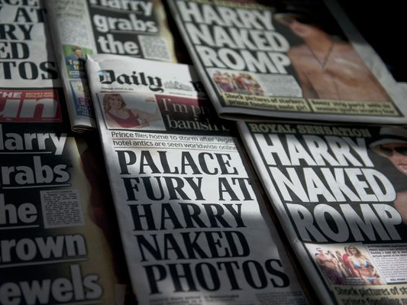
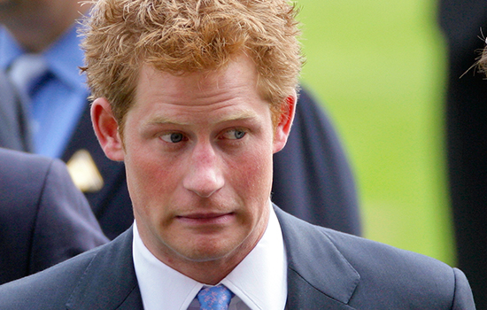
Credit: Daniel Sorabji / AFP/Getty Images

Slide 5

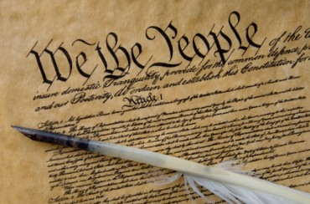
Constitutional Government
LIMITED

Slide 6

In questions of power, then, let no more be heard of confidence in man, but bind him down... with the chains of the Constitution.
-- Jefferson

Slide 7


Slide 8
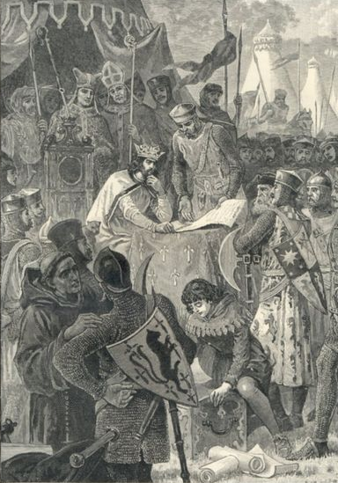
Magna Carta
Latin: Great Charter
1215
Limited Government
Individual Rights
TAXATION BY CONSENT
The Rule of Law
Jury Trials

Slide 9

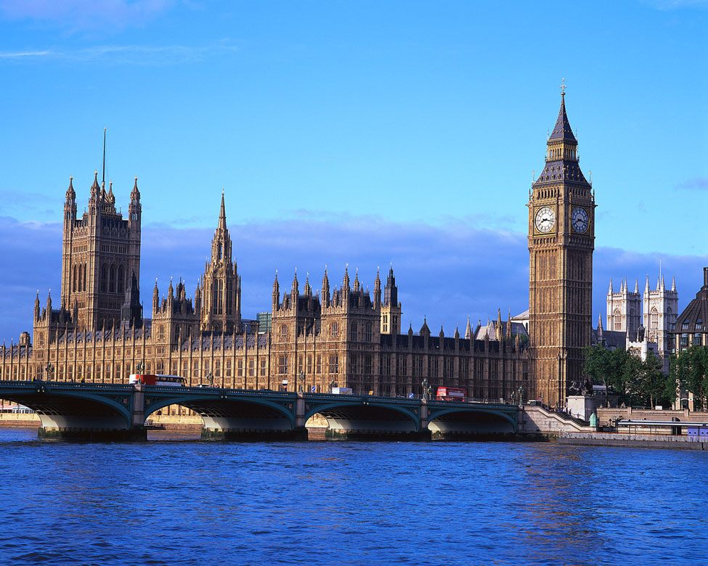

Parliament
Checking monarchs since the 13th century!

Slide 10
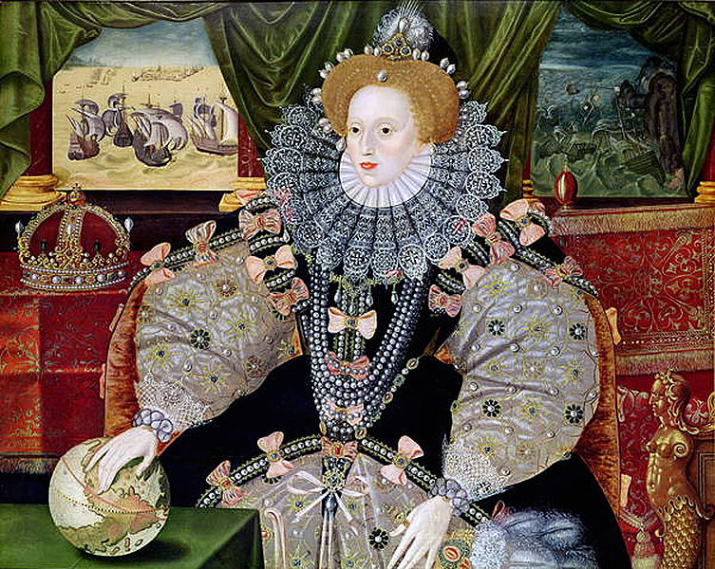
Queen Elizabeth I

Slide 11
R.I.P. 1603

Slide 12
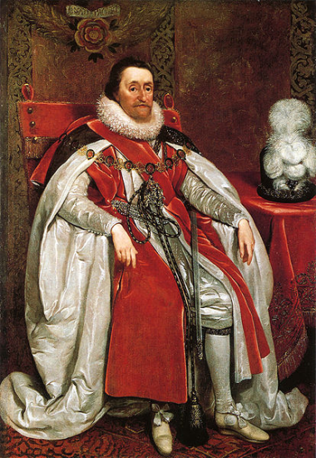
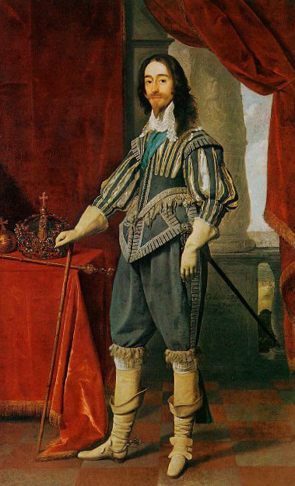
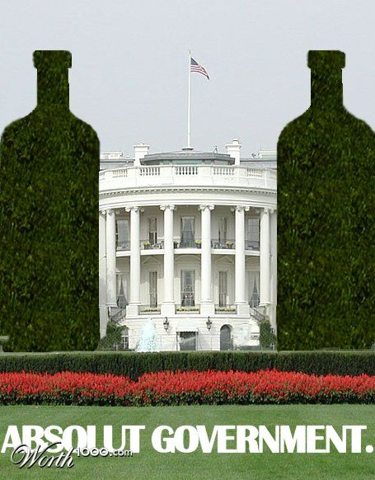
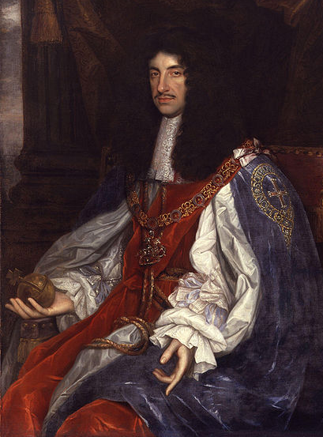
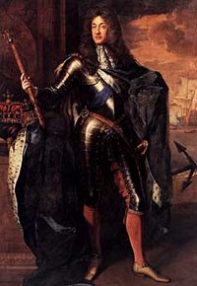
The Stuarts
Absolutism Comes to England
J I
C I
C II
J II

Slide 13
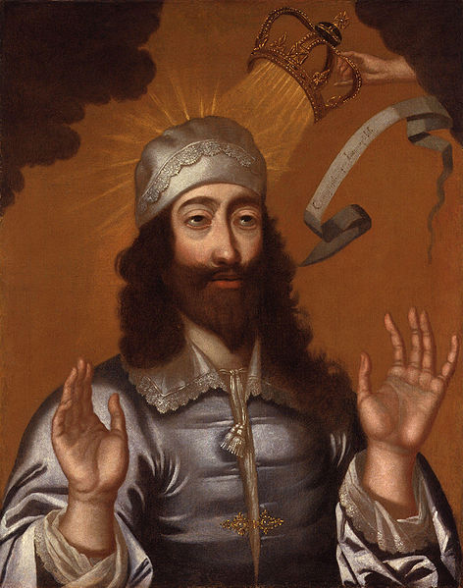


Divine Right
of Kings
The “Top Down” Approach
REJECTED
By the English
BEHEADED
1649

Slide 14
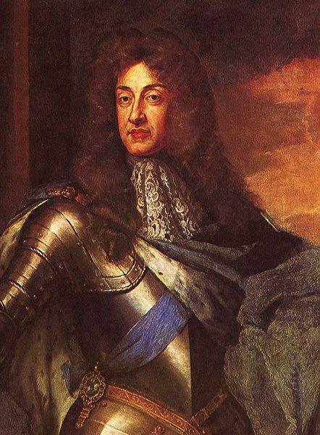
The Glorious Revolution
(1688)
James II
Unpopular “Papist”
Run off by Parliament
Throne VACANT
No Bloodshed

Slide 15

WANTED
A monarch who will sit down, shut up, and let Parliament take care of governing.

Slide 16
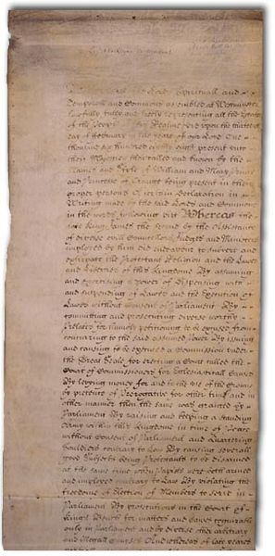
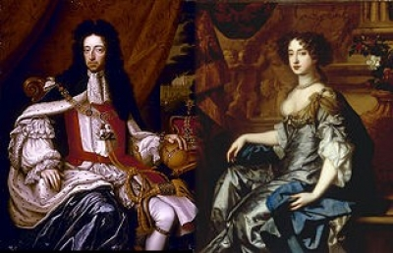
The English Bill of Rights
William III
(of Orange)
Mary II
(Stuart)

Slide 17
The English Bill of Rights
Parliamentary Supremacy
Executive Power Limited
Free and Frequent Elections
Taxation by Consent
Catholic Monarch

Slide 18
The English Bill of Rights
Declaration of Rights
Freedom of Speech (1)
Right to Petition (1)
Arms for Defense (2)
(for Protestants, at least!)
Cruel & Unusual Punishments (8)
Standing Armies in Peacetime (3)

Slide 19
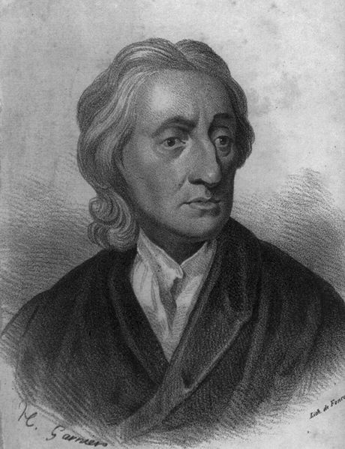
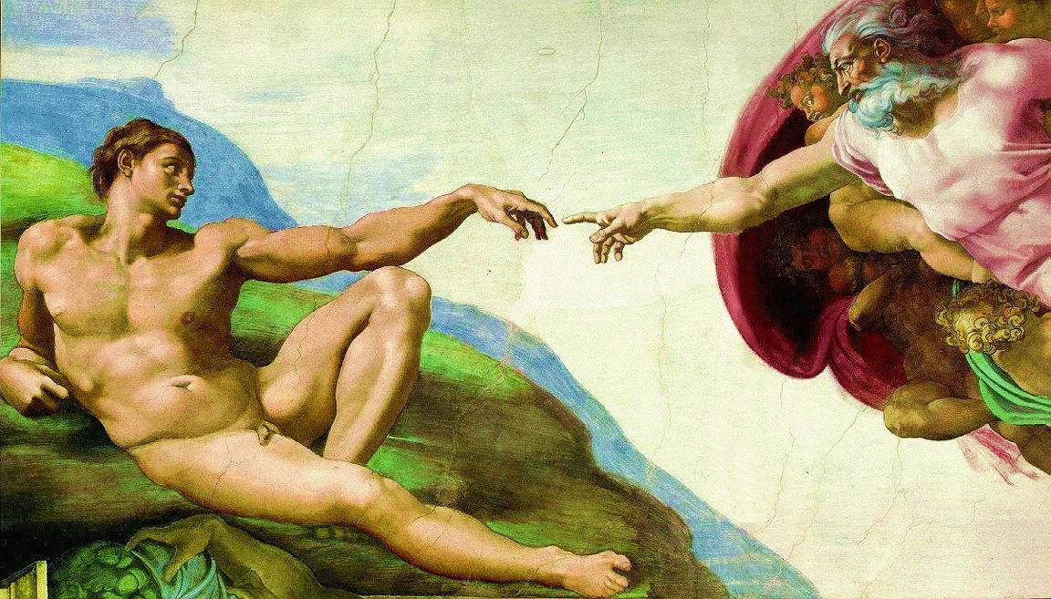
John Locke
Natural Rights
    Life
    Liberty
    Property
GOD-GIVEN

Slide 21
John Locke
Locke’s Values:
Religious Toleration
Consent
of the governed
  Right of Revolution
GOD-GIVEN

Slide 22

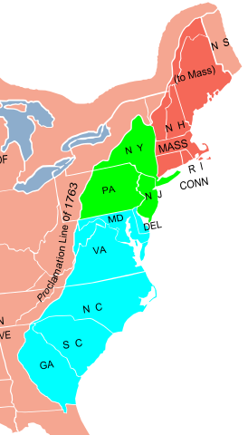
English
Political Traditions
Constitutional Government
Representative Government

Slide 23
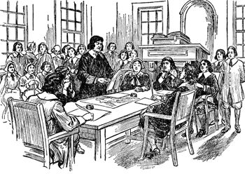
Town Meetings
(New England)
Egalitarian
Democratic

Slide 24
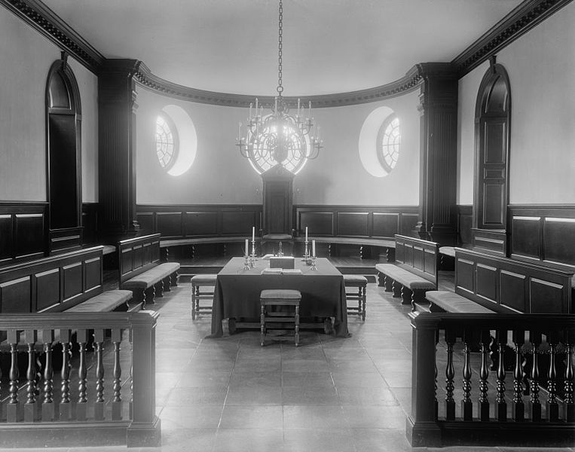
House of Burgesses
(Virginia)
Representative
Aristocratic

Slide 25
Salutary Neglect

Slide 26
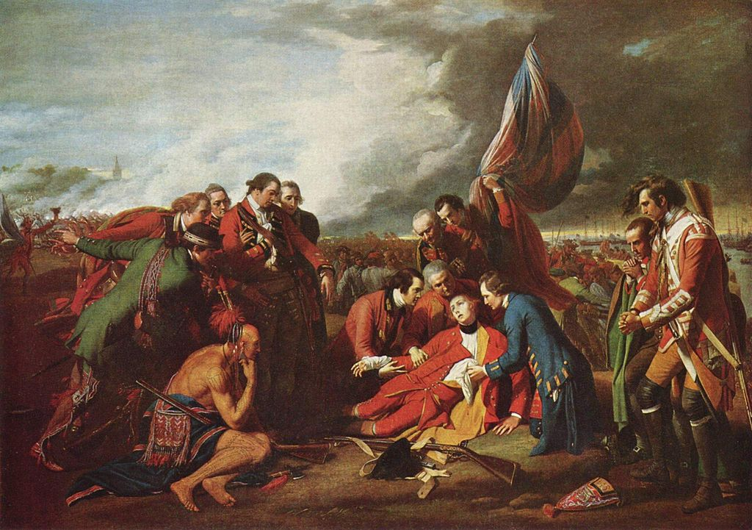
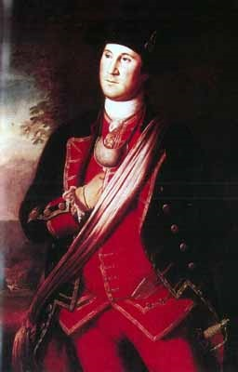
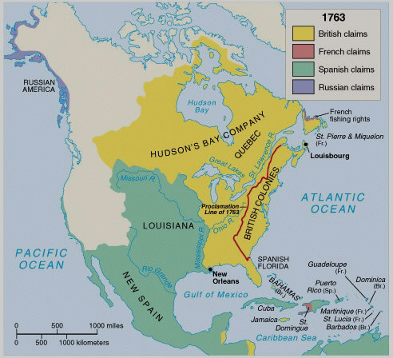
The French and Indian War
1754-1763

Slide 27








