Slide 1
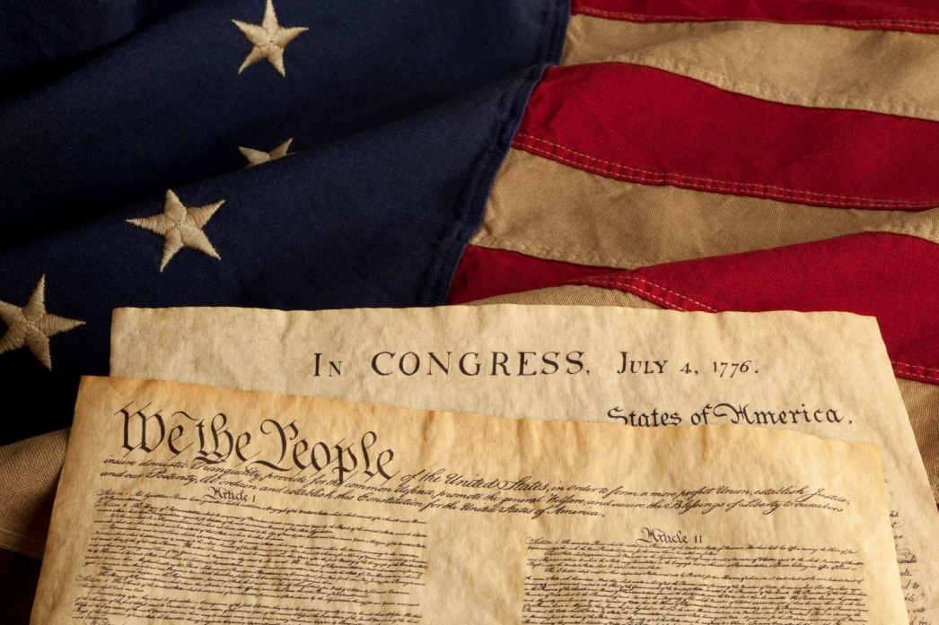


Principles of the Constitution
USHC 1.5
Explain how the fundamental principle of limited government is protected by the Constitution and the Bill of Rights…

Slide 3
A Constitution LIMITS government

Slide 4
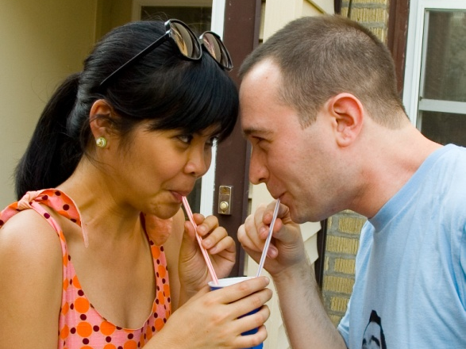
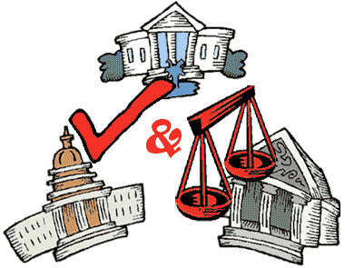
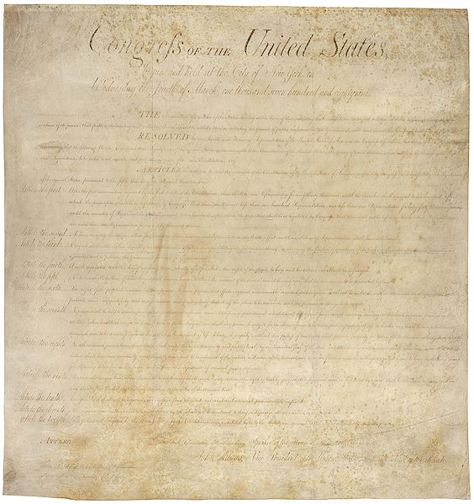
Limiting the Government
Federalism
Checks and Balances
The Bill of Rights

Slide 5

Federalism
The federal government and state governments share power.
Photo by joshbousel

Slide 6
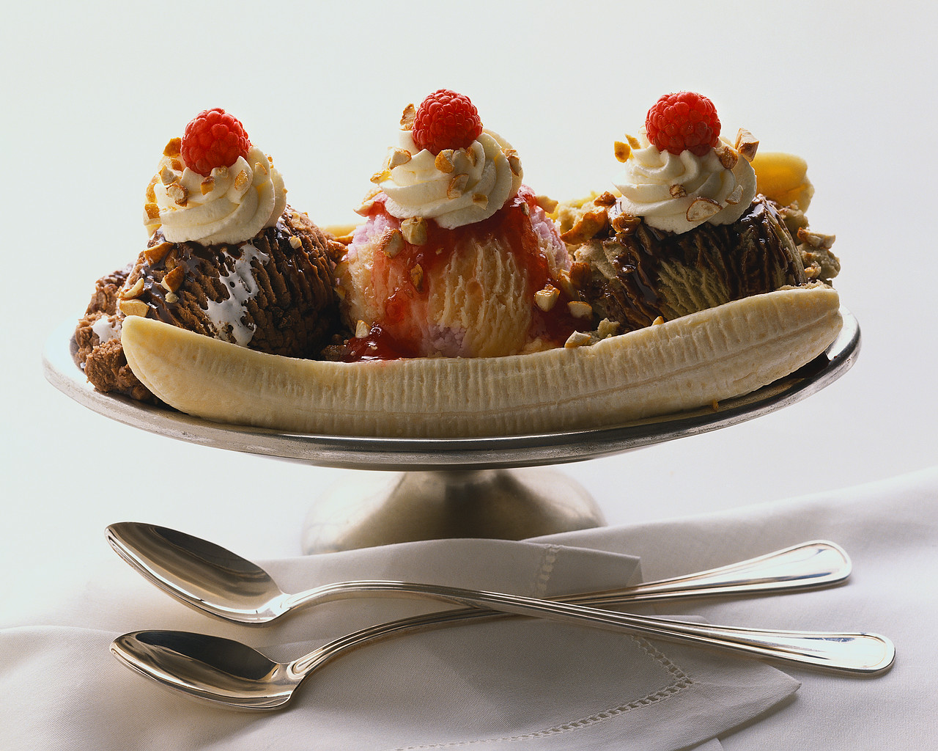
FEDERALISM
Sovereignty is constitutionally divided between a central authority and states.
Delegated Powers
  Powers given to the Federal Government
Reserved Powers
  Powers kept by the states and people
Concurrent (Shared) Powers
  Powers shared by both levels of gov.

Slide 7
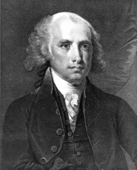
From The Federalist, No. 45
The powers delegated by the proposed Constitution to the federal government, are few and defined. Those which are to remain in the State governments are numerous and indefinite.
The former will be exercised principally on external objects, as war, peace, negotiation, and foreign commerce… The powers reserved to the several States will extend to all the objects which… concern the lives, liberties, and properties of the people…
MADISON
Source: http://www.constitution.org/fed/federa45.htm

Slide 8
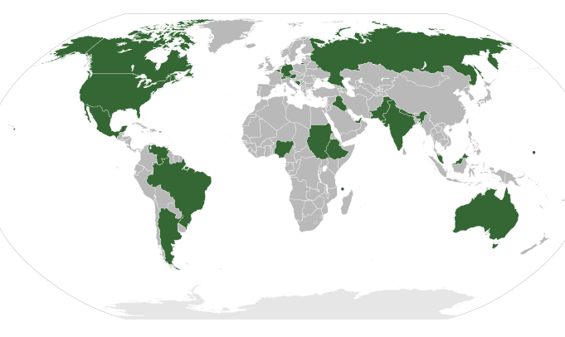
Federal States

Slide 9
Federalism
Federal
[Delegated]
State
[Reserved]
Admit New States
Education
Coin Money
Collect Tariffs
Establish Local Governments
Declare War
Establish Courts
Foreign Policy
Marriage Laws
Weights and Measures
Army and Navy
Organize and Maintain Militia
& Everything Else
National Defense
Punish Treason
Concurrent
Taxation
Immigration and Naturalization
Ratify Constitutional Amendments
Propose Constitutional Amendments
Regulate Foreign Trade
Regulate
Interstate Commerce
Regulate
Intrastate Commerce
AMENDMENT X
The powers not delegated to the United States by the Constitution, nor prohibited by it to the states, are reserved to the states respectively, or to the people.

Slide 10
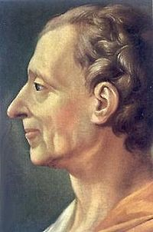
Separation of Powers
Montesquieu
  French Philosopher
  The Spirit of the Laws (1748)
THREE BRANCHES OF GOVERNMENT
LEGISLATIVE (Congress) | EXECUTIVE (President) | JUDICIAL (Courts)
MAKES
Laws
ENFORCES
Laws
JUDGES
Laws
Montesquieu

Slide 11
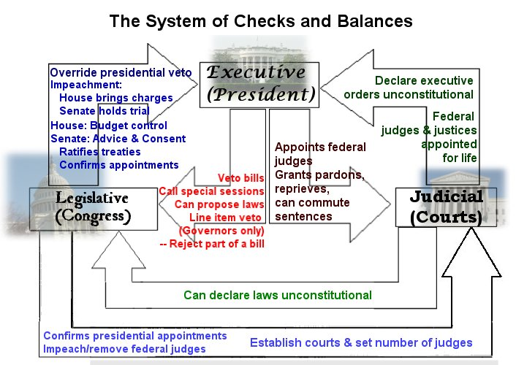
Graphic Organizer 3.4

Slide 12
The Veto
From Latin: “I Forbid”
President checks Congress’ legislative power
2/3 Vote of Both Houses to Override
  1845 – First Veto Overridden

Slide 13
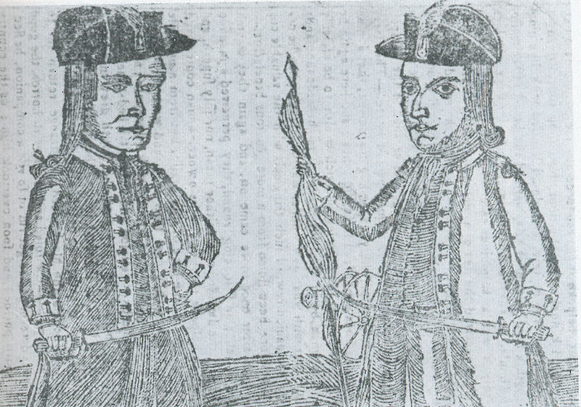
Ordered Government

Slide 14



