Slide 1
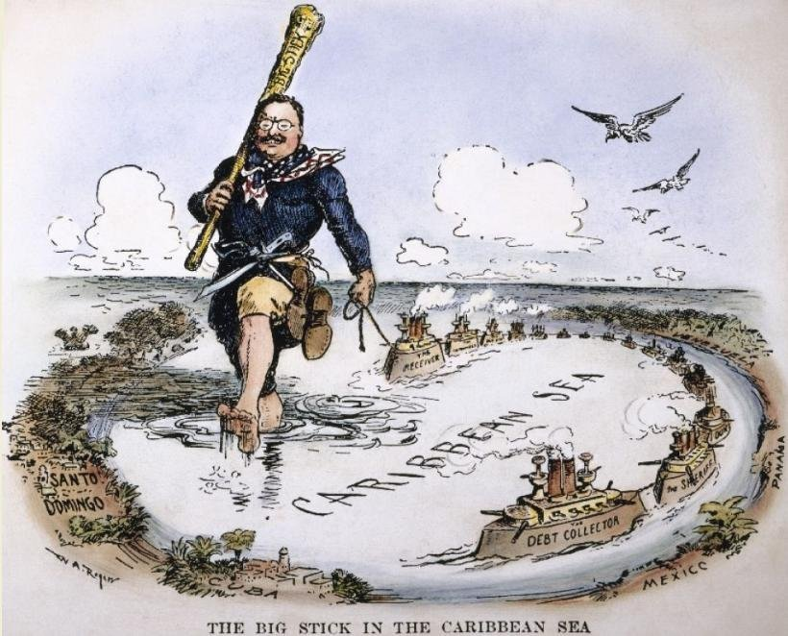
American Foreign Policy
1898-1914
US HISTORY EOC REVIEW
Color Palette By: Piahr
USHC-5.3
Notes:
Image Source: http://marshallmatlock.com/2012/01/the-mans-man-xxxix-teddy-roosevelt/

Slide 2
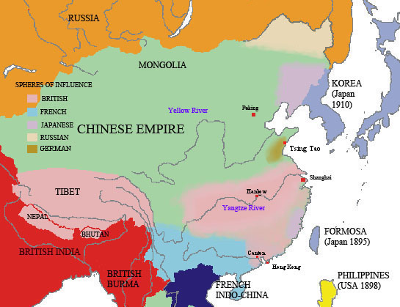
Imperialism in China
INFLUENCE
Map Credit: Mosr

Slide 3
“Open Door” Policy
1899
U.S. disregards existing European Spheres of Influence in China
Photo Credit: YayAdrian

Slide 5
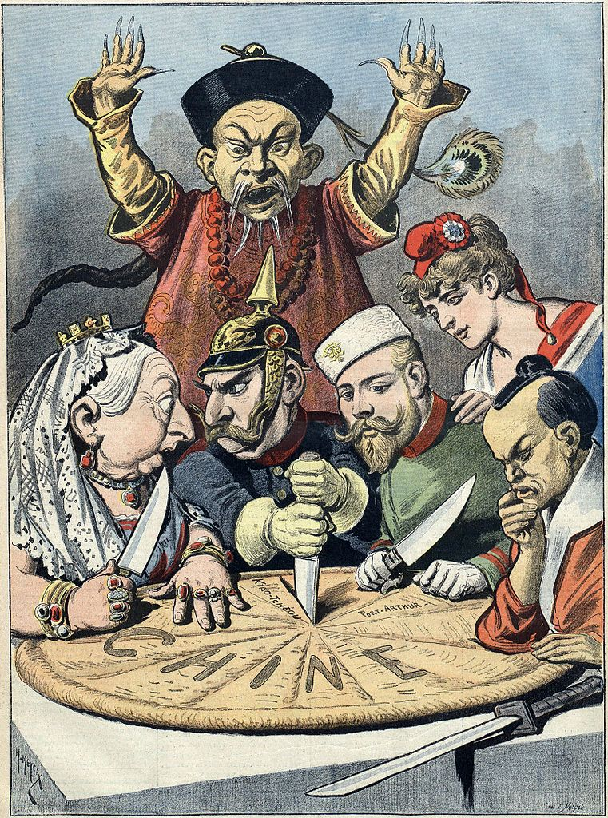
Boxer Rebellion
(1899-1901)

Slide 6
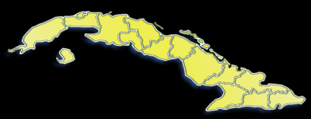
Platt Amendment
1901
“Independent” Cuba
U.S. can intervene in cases of civil unrest
Perpetual Naval Lease @ Guantanamo Bay

Slide 7
A Legacy of Resentment
Cuban resentment against the United States would culminate in the establishment of Fidel Castro’s anti-American government in the 1959 Cuban Revolution.

Slide 8
Notes:
Image Source: http://marshallmatlock.com/2012/01/the-mans-man-xxxix-teddy-roosevelt/

Slide 9
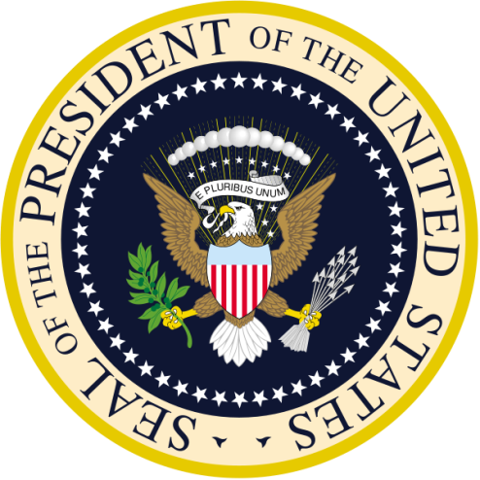
FOREIGN POLICY BY PRESIDENT
President | Tenure | Diplomacy
Teddy Roosevelt (R) | 1901-1909 | Big Stick
William H.Taft (R) | 1909-1913 | Dollar
Woodrow Wilson (D) | 1913-1921 | Moral

Slide 10
“Speak softly… and carry a big stick.”
-- West African Proverb
Photo Credit: Katie Tegtmeyer

Slide 11
“Big Stick” Diplomacy
Teddy Roosevelt
OBJECTIVE:
KEEP EUROPE OUT of Latin America (Roosevelt Corollary to the Monroe Doctrine)
USE FORCE to defend American interests in Latin America

Slide 13
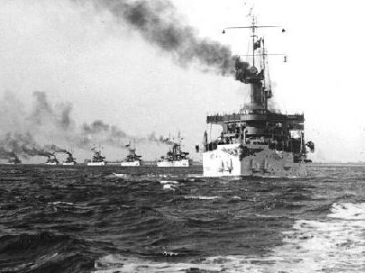
The Great White Fleet
Projection of American NAVAL POWER
The U.S.S. Connecticut leads the fleet

Slide 14
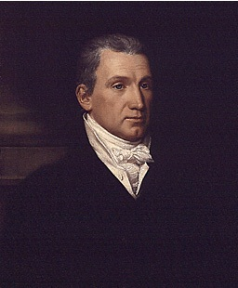
Monroe Doctrine
1823
Read my lips, Europe … NO NEW COLONIES!
Monroe

Slide 15
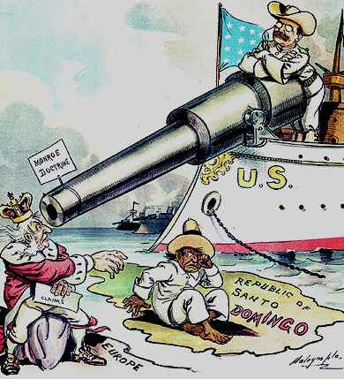
The “Roosevelt Corollary” to the Monroe Doctrine
European nations should stay out of the Americas, altogether…
If Europe has a problem with Latin America, we’ll settle it on their behalf.

Slide 16
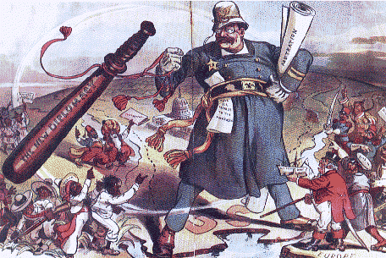
The “Policeman” of Latin America

Slide 17
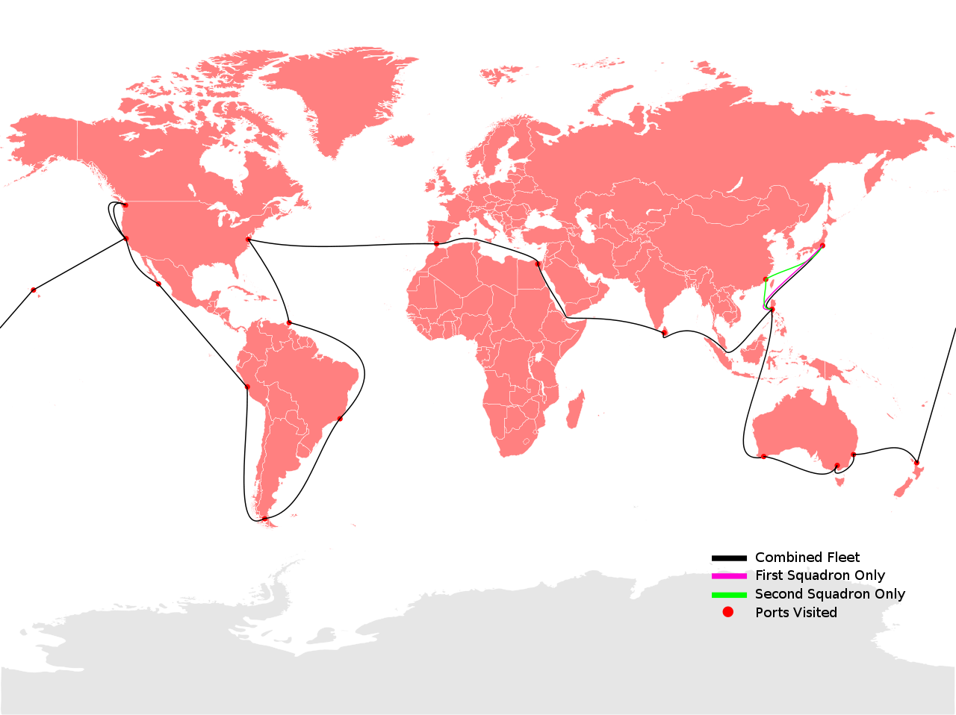
CANAL
Map Credit: TastyCakes

Slide 18
This is getting old...
Map Credit: TastyCakes

Slide 19
Panama Canal
REBELLION
Notes:
http://mapsof.net/map/central-america-political-map#.US1saVeECOA

Slide 20
Yay, Rebels!!!
Photo Credit: James Barber

Slide 21
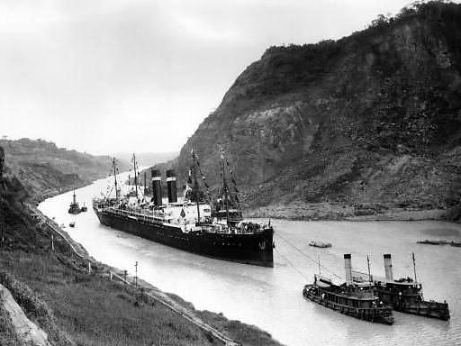
Panama Canal
Completed 1914

Slide 22
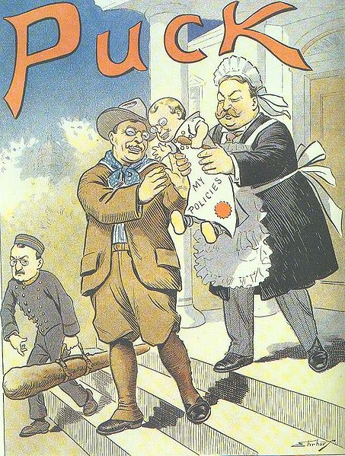

Slide 23
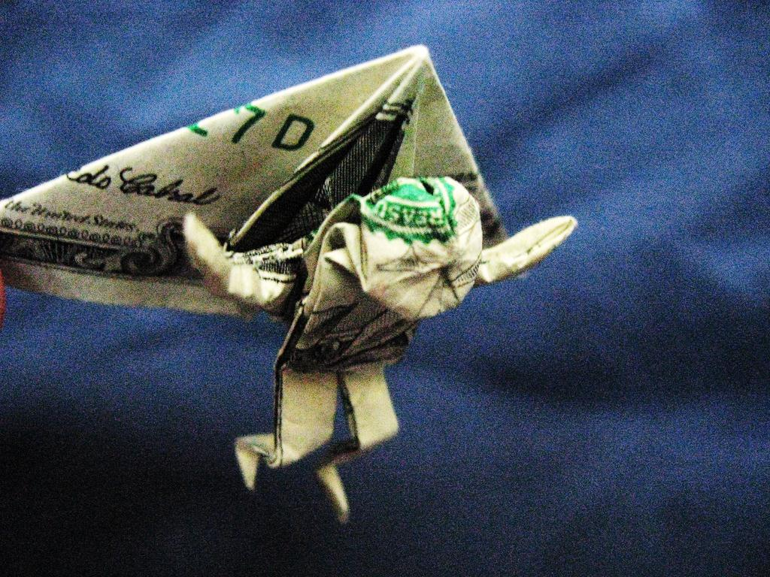
Big Bill’s
Dollar Diplomacy
Photo Credit: Jon_Tucker

Slide 24
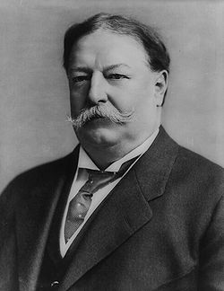
Dollar Diplomacy
William Howard Taft
OBJECTIVE:
PROTECT American business interests in Latin America

Slide 25
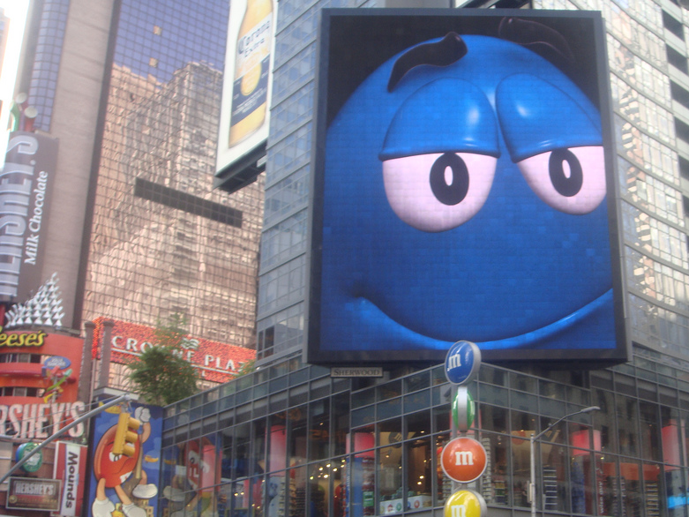
M&M Diplomacy
Photo Credit: Sarah Shelmidine

Slide 26
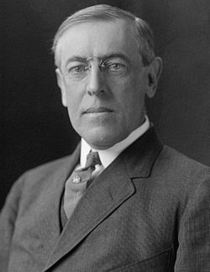
Moral (Missionary) Diplomacy
Woodrow Wilson
OBJECTIVE:
SUPPORT democratic governments in Latin America
OPPOSE oppressive or undemocratic governments

Slide 27
Democracy!

Slide 28
LEARNING.
DELIVERED.

